Slide 1
1.0 (Xuanzang's Heart Sutra, Part One)
The first and second sessions will always start with reciting the Heart Sutra.
The third session will always end with reciting the Heart Sutra followed by reciting the Four Great Vows in Sino-Korean.
Wait – what's Sino-Korean? We'll get to that in a minute, but first … the Big Picture:
摩 訶 般 若 波 羅 蜜 多 心 經 Title
觀 自 在 菩 薩 行 深 般 若 1 乃 至 無 老 死 亦 無 老 死 盡 15
波 羅 蜜 多 時 照 見 五 蘊 皆 空 2 無 苦 集 滅 道 無 智 亦 無 得 以 16
度 一 切 苦 厄 3 無 所 得 故 菩 提 薩 埵 依 17
舍 利 子 色 不 異 空 4 般 若 波 羅 蜜 多 故 心 無 罣 礙 18
空 不 異 色 色 即 是 空 5 無 罣 礙 故 無 有 恐 怖 19
空 即 是 色 6 遠 離 顚 倒 夢 想 究 竟 涅 槃 20
受 想 行 識 亦 復 如 是 7 三 世 諸 佛 依 般 若 21
舍 利 子 是 諸 法 空 相 8 波 羅 蜜 多 故 得 阿 耨 多 羅 22
不 生 不 滅 不 垢 不 淨 9 三 藐 三 菩 提 故 知 般 若 23
不 增 不 減 是 故 空 中 無 色 10 波 羅 蜜 多 是 大 神 呪 24
無 受 想 行 識 無 眼 耳 鼻 舌 身 意 11 是 大 明 呪 是 無 上 呪 25
無 色 聲 香 味 觸 法 12 是 無 等 等 呪 能 除 一 切 苦 26
無 眼 界 乃 至 無 意 識 界 13 眞 實 不 虛 故 說 般 若 波 羅 蜜 多 27
無 無 明 亦 無 無 明 盡 14 呪 即 說 呪 曰 28
揭 諦 揭 諦 波 羅 揭 諦 波 羅 僧 揭 諦 菩 提 娑 婆 訶 Mantra
Class schedule:
3:00 – 3:35 pm
first session
--- 5 minute break ---
3:40 – 4:15 pm
second session
--- 10 minute break ---
4:25 – 5:00 pm
third session

Slide 2
1.1 (Xuanzang's Heart Sutra, Part One)
摩 訶 般 若 波 羅 蜜 多 心 經 Title
觀 自 在 菩 薩 行 深 般 若 1 乃 至 無 老 死 亦 無 老 死 盡 15
波 羅 蜜 多 時 照 見 五 蘊 皆 空 2 無 苦 集 滅 道 無 智 亦 無 得 以 16
度 一 切 苦 厄 3 無 所 得 故 菩 提 薩 埵 依 17
舍 利 子 色 不 異 空 4 般 若 波 羅 蜜 多 故 心 無 罣 礙 18
空 不 異 色 色 即 是 空 5 無 罣 礙 故 無 有 恐 怖 19
空 即 是 色 6 遠 離 顚 倒 夢 想 究 竟 涅 槃 20
受 想 行 識 亦 復 如 是 7 三 世 諸 佛 依 般 若 21
舍 利 子 是 諸 法 空 相 8 波 羅 蜜 多 故 得 阿 耨 多 羅 22
不 生 不 滅 不 垢 不 淨 9 三 藐 三 菩 提 故 知 般 若 23
不 增 不 減 是 故 空 中 無 色 10 波 羅 蜜 多 是 大 神 呪 24
無 受 想 行 識 無 眼 耳 鼻 舌 身 意 11 是 大 明 呪 是 無 上 呪 25
無 色 聲 香 味 觸 法 12 是 無 等 等 呪 能 除 一 切 苦 26
無 眼 界 乃 至 無 意 識 界 13 眞 實 不 虛 故 說 般 若 波 羅 蜜 多 27
無 無 明 亦 無 無 明 盡 14 呪 即 說 呪 曰 28
揭 諦 揭 諦 波 羅 揭 諦 波 羅 僧 揭 諦 菩 提 娑 婆 訶 Mantra
the big
picture
even
bigger
Notes:
Bul saeng bul myeol bul gu bu jeong
Bu jeung bu gam

Slide 3
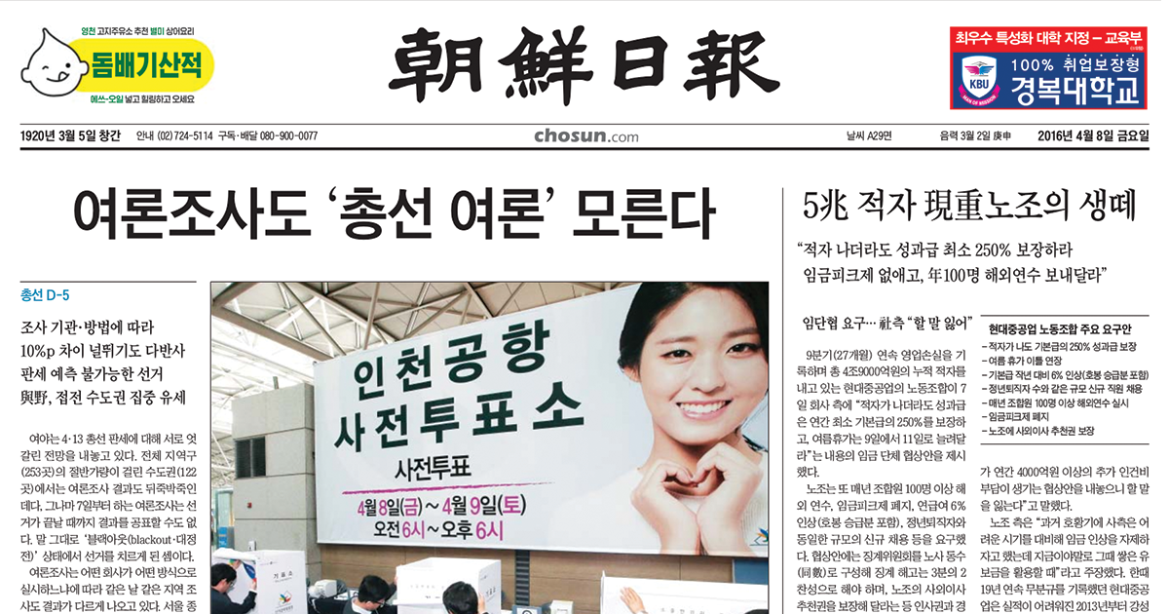
1.2 (Xuanzang's Heart Sutra, Part One)
Hanja, Hangeul, Romaja, and All That
An informal Initiation Into the Mysteries of Sino-Korean
Hanja
Hangeul
Romaja

Slide 4
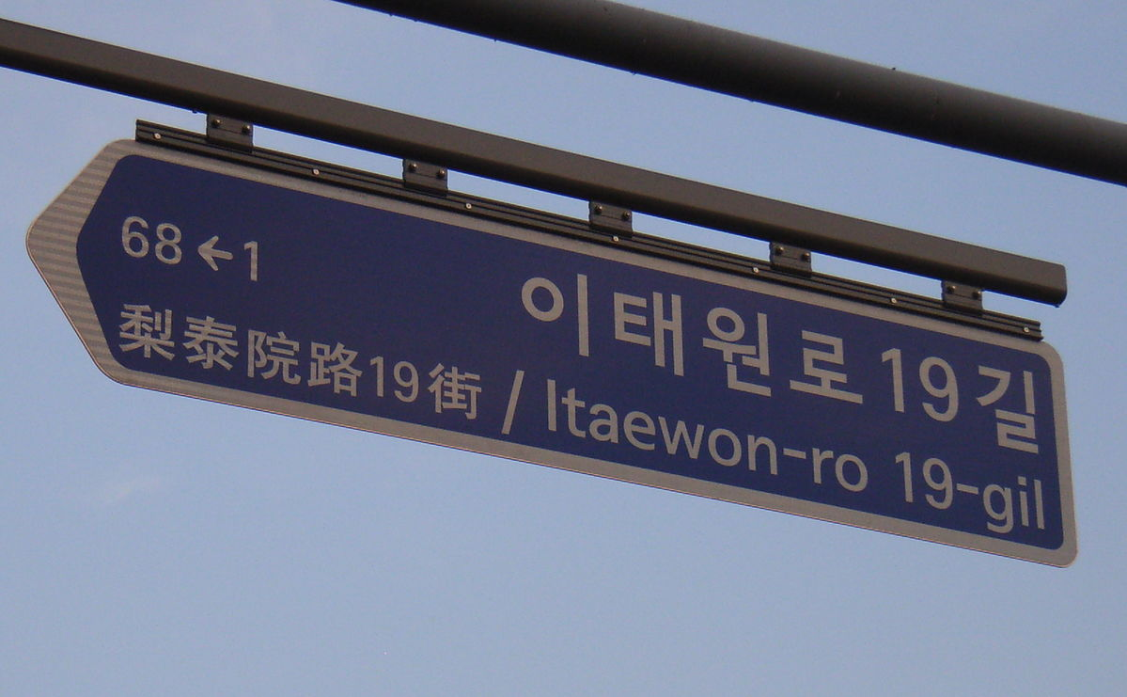
1.3 (Xuanzang's Heart Sutra, Part One)
For 16 centuries the only writing system in Korea was Hanja. Hanja is the Korean word for Chinese characters. "Han" means "Chinese", and "ja" means "character".
Very often Koreans not only wrote using Hanja, they actually wrote in Hanmun, classical literary Chinese. Here "Han" again means "Chinese", and "mun" means "literature". But even when Korean people wrote in their own language, they still had to use Hanja.
But that started to changed in 1443 when the Hangeul system of writing was invented during the reign of King Sejong the Great. In fact, Sejong is often credited with inventing Hangeul himself. In this case "Han" means "great", and "gul" means "script".
Despite the invention of Hangeul, Koreans still made extensive use of Hanja (and Hanmun) for the next 500 years (until the mid 20th century).
Even today Hanja is inescapable. News organizations in South Korea still refer to the United States, China, Japan, and even Korea itself, using Hanja (美 for the United States, 中 for China, 日 for Japan, and 韓 for Korea). Hanja are also encountered on restaurant signs, advertising logos, academic texts, legal documents, street signs, etc.
Hanja
Hangeul
Romaja
Hangeul can be transliterated using the letters of the Latin alphabet. This is called "Romaja". In fact, when we write "Hangeul" this is an example of Romaja! Hangeul, written in Hangeul is 한글.

Slide 5
1.4 (Xuanzang's Heart Sutra, Part One)
摩摩摩 訶訶訶
Shape
Pronunciation (sound):
"ma" in Sino-Korean
"mó" in Mandarin
"ma" in Sino-Japanese
"ma" in Sino-Vietnamese
Meaning:
1. rub, scrape
2. brush lightly against
3. deliberate, discuss
4. phonetic value for transliteration
Pronunciation (sound):
"ha" in Sino-Korean
"hē" in Mandarin
"ka" in Sino-Japanese
"ha" in Sino-Vietnamese
Meaning:
1. shout in rage, scold, bellow
2. phonetic value for transliteration
The "same" Chinese character
1. can appear differently,
2. can be pronounced differently, and
3. can have different meanings/uses

Slide 6
1.5 (Xuanzang's Heart Sutra, Part One)
眾生 眾生 眾生 眾生
衆生 衆生 衆生 衆生
众生 众生 众生 众生
衆生 = "sentient beings". Or does it?
衆 = jung (중) = all
生 = saeng (생) =
alive, birth
So 衆生 = everything born, all living things
Traditional
Older Traditional –
preferred in Korea
Simplified
DengXian MingLiU MS Pmincho SimHei

Slide 7
1.6 (Xuanzang's Heart Sutra, Part One)
Now let's start looking at the very first line of the Heart Sutra: the ten characters that make up the title. For now we'll focus on the first two and the last two characters in the title. This will help to illustrate two very different ways that Hanja (Chinese characters) are used in the Heart Sutra. Sometimes Hanja are only used for their sound, but more often Hanja are used for their meaning.
摩 訶 般若波羅蜜多 心 經
摩 and 訶 are the first two characters in the Heart Sutra. Pronunciation: "ma ha".
Every "hanja" (Chinese character) must have three things:
1. A recognizable physical shape. The shape produced by the hands (writing on a piece of paper, for example) and is recognized by the eyes.
2. A recognizable sound. The sound produced by the mouth and recognized by the ears.
3. A meaning. What the character tells us. The information conveyed to and understood by the mind. But sometimes the "meaning" and "the sound" are the same! The same thing is true in English when we write "ma ha".
Non-Chinese languages that have developed their own transliteration systems for pronouncing Chinese characters:
Korean
Japanese
Vietnamese
Okinawan
Zhuang
Khitan
Manchu
Mongolian

Slide 8
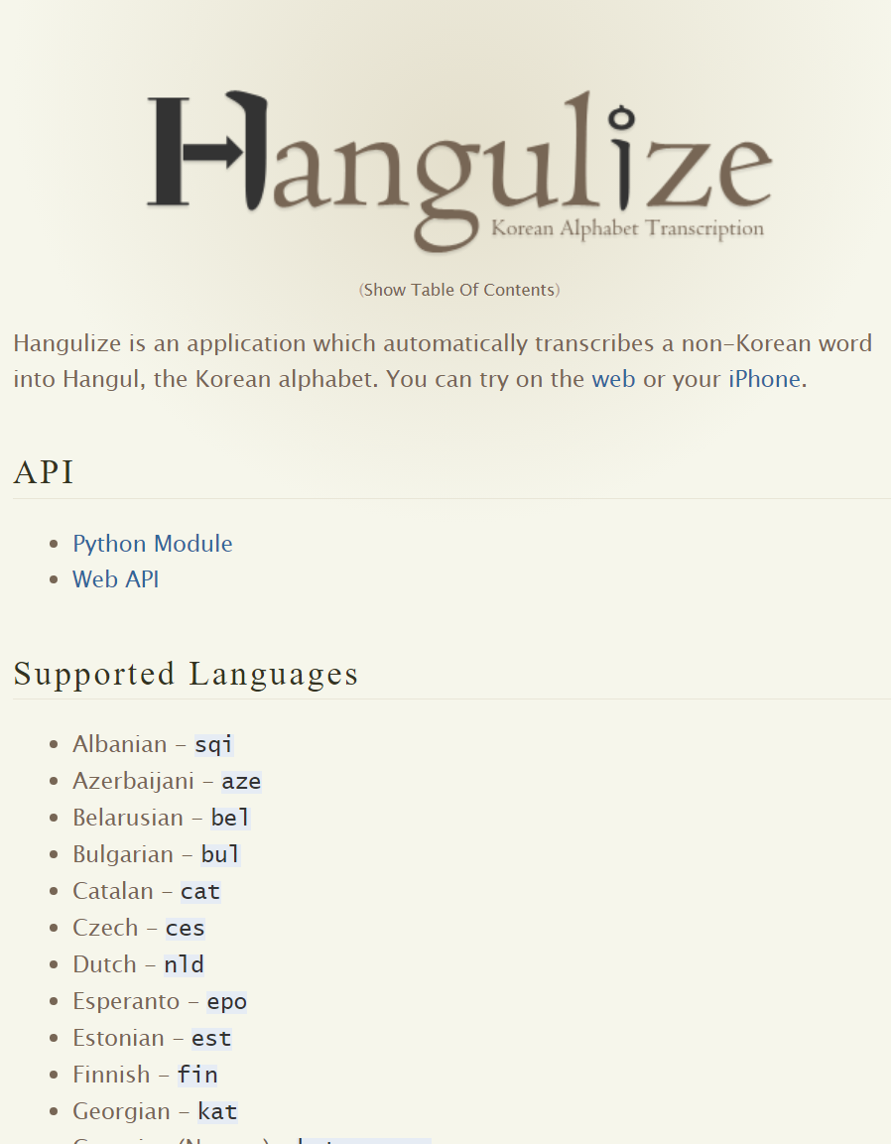
1.7 (Xuanzang's Heart Sutra, Part One)
"The Maha Prajna Paramita Hridaya Sutra"
When we recite the above, this is an example of transliterating Sanskrit using the letters of the English alphabet. More or less the same letters are used by many other Western European languages, including French, German, Spanish, Dutch, Italian, Norwegian, etc. (Transliteration is also sometimes called transcription.)
These letters originally come from Latin, the language of the Romans. When these Latin characters are used for transliteration, the process is referred to as "Romanization".
महा → 摩 訶 → 마 하 → ma ha
1. 2. 3.
1. transliteration from Sanskrit to Chinese characters (音譯 yīnyì – sometimes referred to as hanzification)
2. transliteration from Chinese to Hangeul (hangeulization)
3. transliteration from Hangeul to Latin alphabet (romanization)
From the website for an application that "automatically transcribes a non-Korean word into Hangeul".
https://pythonhosted.org/hangeulize/

Slide 9
1.8 (Xuanzang's Heart Sutra, Part One)
The Maha Prajna Paramita Hridaya Sutra
ma ha ban ya ba ra mil ta shim gyeong
摩 訶 般 若 波 羅 蜜 多 心 經
Things are very different for the last two characters in the title. Here we have an example of translation, not transliteration!!
Below is an example of first translating Sanskrit into Chinese, and then transliterating that into Korean script (hangeulization), and then transliterating that into the Latin alphabet (romanization).
हृदय सूत्रं → 心 經 → 심 경 → shim gyeong
1. 2. 3.
1. translation from Sanskrit to Chinese
2. transliteration from Chinese to Hangeul (hangeulization)
3. transliteration from hangeul to Latin alphabet (romanization)
五種不翻 = Five things not to translate
Xuanzang wrote that there are five things that should not be translated (that is, should be transliterated instead):
1. Mantras (that would lose their power if translated).
2. Polysemous words (that would lose their polysemy if translated).
3. Foreign words with no Chinese equivalent.
4. Words that have traditionally been transliterated in the past.
5. Words that are too lofty and/or mysterious to translate (that is, translating them would make them more ordinary sounding and would therefore be disrespectful).

Slide 10


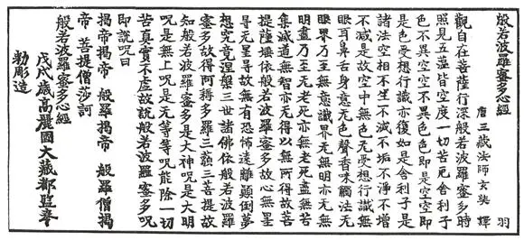
1.9 (Xuanzang's Heart Sutra, Part One)
摩 訶 般若波羅蜜多 心 經
Let's continue to focus on the last two characters in the Title: 心 and 經, pronounced "shim gyeong". In Korean both 심 (shim) and 경 (gyeong) are words that have a wide variety of meanings by themselves. But the combination 심경 (shim gyeong) is more easily recognized as the name of the "Heart Sutra" in Korean.
The relationship between Hangeul and Hanja is very interesting, but also kind of complicated. There are many different Hanja that are pronounced 심 (shim) in Korean, and over 50 different Hanja that have the pronunciation 경 (gyeong). This is made even more complicated by the fact that among their different meanings both 심 and 경 can be used both as family names and as given ("first") names.
Above are typical results if you do a google image search on 심 or 경. To the left is Korean model and pilates instructor Shim Eutteum, and to the right is the Korean TV and film star Gyeong Sujin.
One the other hand, below is a typical result if you search for 심경
The image of Shim Euttem is from the Korean Wikipedia: https://ko.wikipedia.org/wiki/심으뜸. The image of Gyeong Sujin is from her Instagram feed: https://www.instagram.com/love_gyeongsujin/?hl=ko
https://yeeryu.com/168/inside/library/

Slide 11

1.10 (Xuanzang's Heart Sutra, Part One)
When movies are translated into Chinese this often requires the "hanzification" of foreign names.
In the Chinese version of the "Halloween" movie series, the primary protagonist is
麥 克 爾 麥 爾 斯
mài kè ěr mài ěr sī
漢 字 literally: Chinese Character
hàn zì Pinyin
han ja Romaja (로마자)
한 자 hangeul
kan ji Rōmaji (ローマ字)
かん じ Hiragana
hán tự Chữ Quốc ngữ (Vietnamese script)

Slide 12
1.11 (Xuanzang's Heart Sutra, Part One)
摩 訶 般 若 波 羅 蜜 多 心 經 Title
觀 自 在 菩 薩 行 深 般 若 1 乃 至 無 老 死 亦 無 老 死 盡 15
波 羅 蜜 多 時 照 見 五 蘊 皆 空 2 無 苦 集 滅 道 無 智 亦 無 得 以 16
度 一 切 苦 厄 3 無 所 得 故 菩 提 薩 埵 依 17
舍 利 子 色 不 異 空 4 般 若 波 羅 蜜 多 故 心 無 罣 礙 18
空 不 異 色 色 即 是 空 5 無 罣 礙 故 無 有 恐 怖 19
空 即 是 色 6 遠 離 顚 倒 夢 想 究 竟 涅 槃 20
受 想 行 識 亦 復 如 是 7 三 世 諸 佛 依 般 若 21
舍 利 子 是 諸 法 空 相 8 波 羅 蜜 多 故 得 阿 耨 多 羅 22
不 生 不 滅 不 垢 不 淨 9 三 藐 三 菩 提 故 知 般 若 23
不 增 不 減 是 故 空 中 無 色 10 波 羅 蜜 多 是 大 神 呪 24
無 受 想 行 識 無 眼 耳 鼻 舌 身 意 11 是 大 明 呪 是 無 上 呪 25
無 色 聲 香 味 觸 法 12 是 無 等 等 呪 能 除 一 切 苦 26
無 眼 界 乃 至 無 意 識 界 13 眞 實 不 虛 故 說 般 若 波 羅 蜜 多 27
無 無 明 亦 無 無 明 盡 14 呪 即 說 呪 曰 28
揭 諦 揭 諦 波 羅 揭 諦 波 羅 僧 揭 諦 菩 提 娑 婆 訶 Mantra
But it's not just 摩 and 訶.
A total of 77 of the 270 characters in the Heart Sutra are used for their phonetic value.
Note that
般 若 波 羅 蜜 多 is repeated 6 times.

Slide 13
1.12 (Xuanzang's Heart Sutra, Part One)
Mantra for accomplishing one's aspiration
願成就眞言 Hanja
원성취진언
won song chwi jin on Romaja
----------------------------------------------------------------------------------------
唵 阿暮伽
옴 아모카
om amoga
----------------------------------------------------------------------------------------
薩婆怛囉
살바다라
salbadara
----------------------------------------------------------------------------------------
傞陀耶 始廢 吽
사다야 시베 훔
sadaya shibe hum
Transliteration: Using the characters of one language to represent the sounds of another language.
Romanization: transliteration with the Latin alphabet
Hangeulization: transliteration using Hangeul
Hanzification: transliteration using Chinese characters
音譯 yīnyì: Chinese word for hanzification
Hangeul: Korean writing system
Romaja: Korean word for Latin alphabet
Hanja: The Korean word for Chinese Characters
Kanji: Japanese word for Chinese Characters
Hanzi: Chinese word for Chinese Characters
Pinyin: Standardized way of romanizing Mandarin Chinese
Sino-Korean: Korean pronunciation of Hanja (Chinese characters)
Sino-Japanese: Japanese pronunciation of Kanji (Chinese characters)
Sino-Vietnamese: Vietnamese pronunciation of Chinese characters
Hangeul

Slide 14
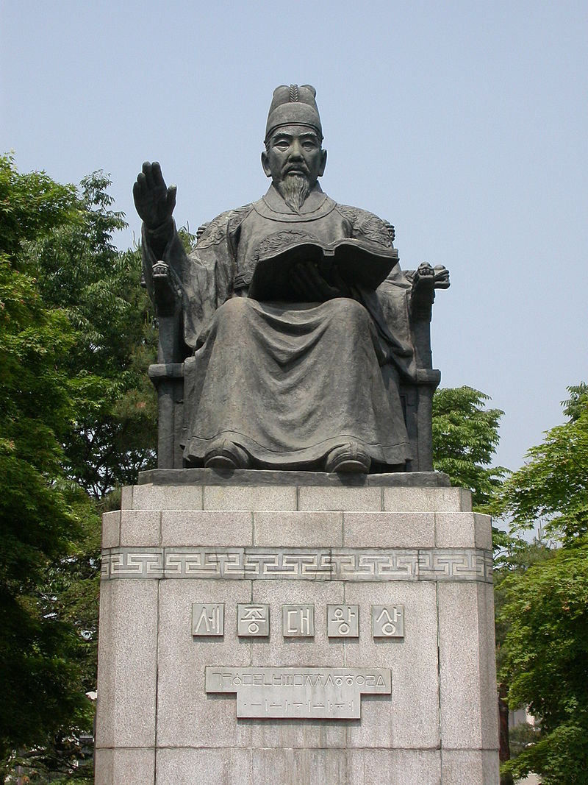
1.13 (Xuanzang's Heart Sutra, Part One)
Shape: (graphemics)
Need to Know: (1) what it looks like, (2) how to write it, (3) components
Important to know: (1) is it a component of other characters? (2) radical
Helpful to know: Where else is this character encountered: (a) in Buddhism, and (b) in the Chinese language and Chinese literature generally
Sound: (phonetics)
Need to know: Romaja (Korean pronunciation)
Important to know: Pinyin (writing, but not pronunciation)
VERY Helpful to know: Hangeul
Helpful to know: Japanese, Vietnamese, Mandarin pronunciations
Meaning: (semantics)
Need to know: Only for main characters (not components): what the character means and how it is used in the Heart Sutra
VERY Important to know: Meaning/usage for components that do not appear as main characters
Helpful to know: other uses and meanings
한글
"Hangeul"
written in Hangeul
Original by Lawin82 From Wikimedia
Bronze statue of
Sejong the Great
at Deoksu Palace
https://en.wikipedia.org/wiki/Sejong_the_Great

Slide 15
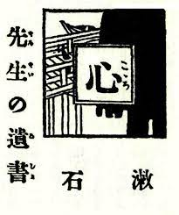
1.14 (Xuanzang's Heart Sutra, Part One)
心心心 經經經
Kokoro: Sensei no Isho
Kokoro: Sensei's Testament
1914 Novel by Natsume Sōseki
Pronunciation:
"shim" in Sino-Korean
"xīn" in Mandarin
"shin" in Sino-Japanese
"tâm" in Sino-Vietnamese
Meaning:
1. heart, center of emotions and thought
2. focal point, essence
3. the mind
Pronunciation:
"gyeong" in Sino-Korean
"jīng" in Mandarin
"gyо̄" in Sino-Japanese
"kinh" in Sino-Vietnamese
Meaning:
1. the warp threads in weaving
2. guideline, norm, standard
3. align, regularize
4. in Buddhism: Sutra
In Japanese, 心 can be pronounced either "shin" or "kokoro".

Slide 16
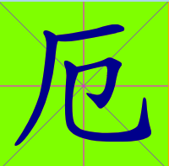
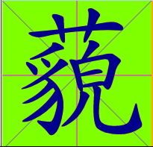
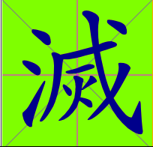
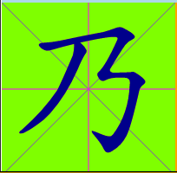
1.15 (Xuanzang's Heart Sutra, Part One)
THEMAHAPRAJNAPARAMITAHRIDAYASUTRA
AVALOKITESVARABODHISATTVAWHENPRACTICINGDEEPLYTHEPRAJNA
PARAMITAPERCEIVESTHATALLFIVESKHANDASAREEMPTY
ANDISSAVEDFROMALLSUFFERINGANDDISTRESS
摩訶般若波羅蜜多心經
觀自在菩薩行深般若
波羅蜜多時照見五蘊皆空
度一切苦厄
Every Hanja must fit into the same sized square as every other Hanja. Therefore, Hanja always form nice neat rows and columns.
厄 = aek = distress 藐 = myak = phonetic
滅 = myol = destroy 乃 = ji = therefore

Slide 17
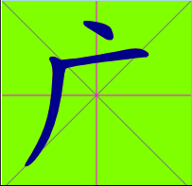
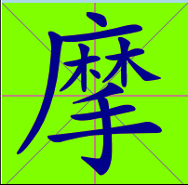
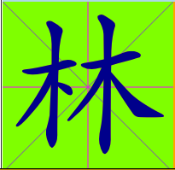
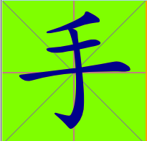
1.16 (Xuanzang's Heart Sutra, Part One)
2.
Also notice that each component must be moved into its own separate region of the square.
3.
Obviously the components contribute to the shape of the new, combined, character.
But the components can also contribute to the pronunciation and meaning of the combination.
Fortunately, we can ignore the intricacies of the Dark Art of Chinese lexicography! But feel free to delve into it if you like to be confused.
1.
When components are combined to form a new character, the components must be compressed so that the combination still fits in the same size square as each of the components separately.

Slide 18

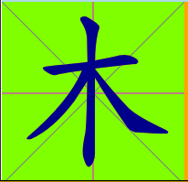
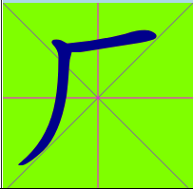

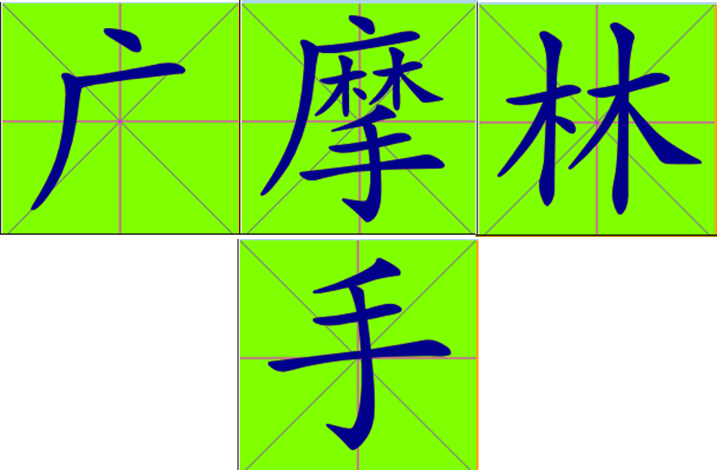

1.17 (Xuanzang's Heart Sutra, Part One)
1. 广, 林, and 手 are the components of 摩.
2. But 广 and 林 can broken down even further into two more components each:
广 =丶+厂
林 = 木 + 木
3. No matter how many components a character has, it takes up the same amount of space as each component by itself.

Slide 19

1.18 (Xuanzang's Heart Sutra, Part One)
1
2
摩 = 广 + 林 + 手
3
Pronunciation (sound):
"ma" in Sino-Korean
"mó" in Mandarin
Meaning:
1. rub, scrape
2. brush lightly against
3. deliberate, discuss
4. phonetic value for transliteration
丶+厂 木+木
4
5
6
1. 广 gwang (광), guǎng; R:53; vast, wide
2. 林 rim (림), lín; R:75+4; forest (seon rim)
3. 手 su (수), shǒu; R:64; hand (chon su gyong)
4. 丶 ju (주), zhǔ; R:3; lord; (alt. form of 主)
5. 厂 han (한), hǎn; R:27; cliff
6. 木 mok (목), mù; R:75; tree, wood (moktak)

Slide 20
1.19 (Xuanzang's Heart Sutra, Part One)
From the lesson plan:
摩 = 广 + 林 + 手 摩 訶 般 若 波 羅 蜜 多 心 經 Title
1. 广 (广 = 丶 + 厂) 4. 丶 ; 5. 厂
2. 林 (林 = 木 + 木) 6. 木
3. 手
1. 广 gwang (광), guǎng; R:53; vast, wide
2. 林 rim (림), lín; R:75+4; forest (seon rim)
3. 手 su (수), shǒu; R:64; hand (cheon su gyeong)
4. 丶 ju (주), zhǔ; R:3; lord; (alt. form of 主)
5. 厂 han (한), hǎn; R:27; cliff
6. 木 mok (목), mù; R:75; tree, wood (moktak)

Slide 21
1.20 (Xuanzang's Heart Sutra, Part One)
訶 = 言 + 可 摩 訶 般 若 波 羅 蜜 多 心 經 Title
-------------------------------------------------------------------------------------------------------------------------------------------------------------------
7. 言 (言 = 亠 + 二 + 口) 9. 亠 ; 10. 二 ; 11. 口
(亠 = 丶 + 一)
12. 一
-------------------------------------------------------------------------------------------------------------------------------------------------------------------
8. 可 (可 = 丁 + 口) 13. 丁 (丁 = 一 + 亅)
14. 亅

Slide 22
1.21 (Xuanzang's Heart Sutra, Part One)
For each character below there are: (1) a number, (2) the character itself, (3) romaja, (4) Hangeul, (5) pinyin, (6) radical, (7) meaning, (8) and then (maybe) some notes in parentheses. The number is somewhat arbitrary – it just represents the order in which the character is covered in this class.
7. 言 eon (언); yán; R:149; words, speech (HSK1 JLPTN4)
8. 可 ga (가); kě; R:30+2; possible, can, be able to (kwanseum, jijang)
9. 亠 du (두); tóu; R:8; lid, cover; cap (component of 11 hanja in the HS)
10. 二 i (이); èr; R:7; 2, two
11. 口 gu (구); kǒu; R:30; mouth (component of 24 hanja in the HS)
12. 一 il (일); yī; R:1; 1, one
13. 丁 jeong (정); dīng; R:1+1; fourth of the ten heavenly stems, fourth, IV
14. 亅 gweol (궐); jué; R:6; hook

Slide 23
1.22 (Xuanzang's Heart Sutra, Part One)
般 = 舟 + 殳 摩 訶 般 若 波 羅 蜜 多 心 經 Title
15. 舟 (舟=丿+冂+⺀) 17. 丿 ; 18. 冂 ; 19. ⺀
16. 殳 (殳=几+又) 20. 几 ; 21. 又
------------------------------------------------------------------------------------------------------------------------------------------------------------------
若 = 艹 + 右 摩 訶 般 若 波 羅 蜜 多 心 經 Title
22. 艹
23. 右 (右=口+𠂇)
------------------------------------------------------------------------------------------------------------------------------------------------------------------
波 = 氵 + 皮 摩 訶 般 若 波 羅 蜜 多 心 經 Title
24. 氵
25. 皮 (皮=厂+丨+又)

Slide 24
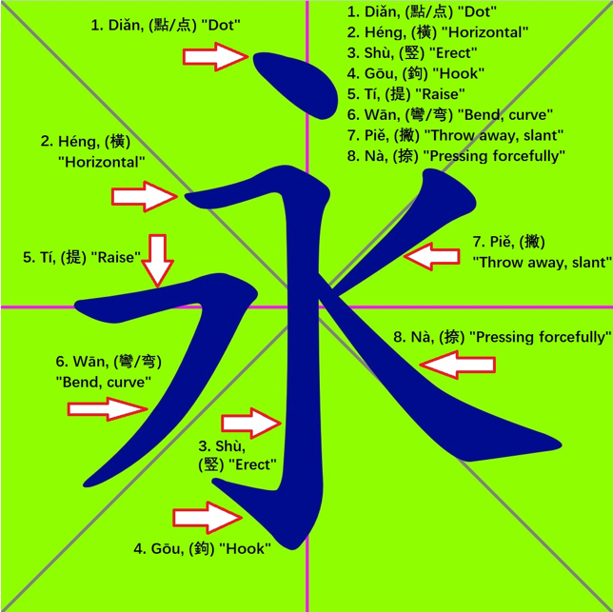
1.23 (Xuanzang's Heart Sutra, Part One)
26. 冰 (冰=冫+水) 27. 冫 ; 28. 水
29. 永 (夂=丿+又)
------------------------------------------------------------------------------------------------------------------------------------------------------------------
30. 摩 (摩=广+林+手) 摩 訶 般 若 波 羅 蜜 多 心 經 Title
The character 永 (yeong/forever) contains all eight strokes.
Strokes are the smallest units of a Chinese character. But when learning to recognize and write the characters, components are more useful. Although opinions vary on this.
In addition to strokes and components there are also radicals. The definition of component is much looser than that of radical.
When you learn to recognize radicals (as components of characters) this is useful for looking up a character in a Chinese dictionary, because the characters are often categorized by their radicals. Unfortunately, while a character may have three, four or more components, it can only have one, or at most two radicals. And it isn't always obvious which component of a given character is considered to be it's radical. Confusing? Yes.

Slide 25
1.24 (Xuanzang's Heart Sutra, Part One)
15. 舟 ju (주) zhōu R:137 boat, ship (HSK6 JLPTN2)
16. 殳 su (수 ) shū R:79 tool; weapon
17. 丿 byeol (별) piě R:4 slash, line
18. 冂 gyeon (경) jiōng R:13 wide; upside-down box
19. ⺀ bing (빙) bīng R:15 ice
20. 几 gwe (궤) jī R:16 stool, chair
21. 又 u (우) yòu R:29 again, once more (component of 8 Hanja in the Heart Sutra)
22. 艹 chu (초) cǎo R:140 grass (component of 8 Hanja in the Heart Sutra)
23. 右 u (우) yòu R30+2 right; west (HSK2 JLPTN5)
24. 氵 su (수) shuǐ R:85 water (left radical) (component of 9 Hanja in the Heart Sutra)
25. 皮 피 pí R:107 skin, hide; surface (HSK3 JLPTN2)
26. 冰 bing (빙) bīng R:15 ice (HSK3 JLPTN2)
27. 冫 bing (빙) bīng R:15 ice
28. 水 su (수) shuǐ R:85 water (HSK1 JLPTN5)
29. 永 yeong (영) yǒng R:85+1 eternal, forever (HSK4 JLPTN2)

Slide 26
1.25 (Xuanzang's Heart Sutra, Part One)
All 30 Hanja for Lesson One:
广林手丶厂木言可亠二
口一丁亅舟殳丿冂⺀几
又艹右氵皮冰冫水永摩

Slide 27
1.26 (Hanja, hangeul, Romaja, and All That)
bal sa hong so won 發 四 弘 誓 願
Reciting the Four Great Vows: 발 사 홍 서 원
-----------------------------------------------------------------------------------------------------------------------------------------------------------------------------------------------------------------
jung saeng mu byon so won do 衆 生 無 邊 誓 願 度
Sentient beings without limit we vow to save. 중 생 무 변 서 원 도
-----------------------------------------------------------------------------------------------------------------------------------------------------------------------------------------------------------------
bon ne mu jin so won dan 煩 惱 無 盡 誓 願 斷
Kleshas without end we vow to cut. 번 뇌 무 진 서 원 단
-----------------------------------------------------------------------------------------------------------------------------------------------------------------------------------------------------------------
bom mun mu ryang so won hak 法 門 無 量 誓 願 學
Dharma gates without number we vow to learn. 법 문 무 량 서 원 학
-----------------------------------------------------------------------------------------------------------------------------------------------------------------------------------------------------------------
bul to mu sang so won song 佛 道 無 上 誓 願 成
Buddha Way without superior we vow to attain. 불 도 무 상 서 원 성

