Slide 1
0.0 (Jijang Bosal Book Club, Preview)
Jijang Bosal has many names:
• Dizang (地藏, Dìzàng) Chinese
• Jizо̄ (じぞう) Japanese
• Kṣitigarbha (क्षितिगर्भ) Sanskrit
• Jijang (지장) Korean
• Địa Tạng Vietnamese
Also: "The Southern Lord of Transformation", "Guiding Teacher of the Dark Realms", "Venerated One of Great Vows", etc
Schedule:
7:00 – 7:35 pm first session
5 minute break
7:40 – 8:15 pm second session
The Book Club meets on the
2nd and 4th Tuesday each month
The first meeting is Tuesday Mar 14

Slide 2
0.1 (Jijang Bosal Book Club, Preview)
So – what is the deal with rebirth in Buddhism?
• Jijang Bosal and the Mantra for Repairing Mistakes
The story goes that there were once two friends named Daoru (道如) and Linju (邻居). Daoru was famous because he had recited the Lotus Sutra 10,000 times. The only problem was that every time Daoru recited the Lotus Sutra he made 100 mistakes. So in the process of chanting the Sutra 10,000 times he made one million mistakes.
Then Daoru's friend, Linju, died. Daoru did "Jijang Bosal" chanting for his friend. Jijang Bosal met Linju in the Bardo and said "Hey – you're a friends with Daoru, right?".
Jijang Bosal then proceeded to teach Linju a mantra, and Jijang Bosal also told Linju that instead of going on to his next life, he would be returned (alive) back to his previous body. Linju's job now was to teach everyone (especially his friend Daoru) this new mantra, which would repair all of the mistakes!
The Mantra for Correcting Mistakes
補 闕 眞言 (bo gwol jinon)
唵 好魯好魯 舍野 謨契 娑婆訶 (om horo horo saya moke sabaha)

Slide 3
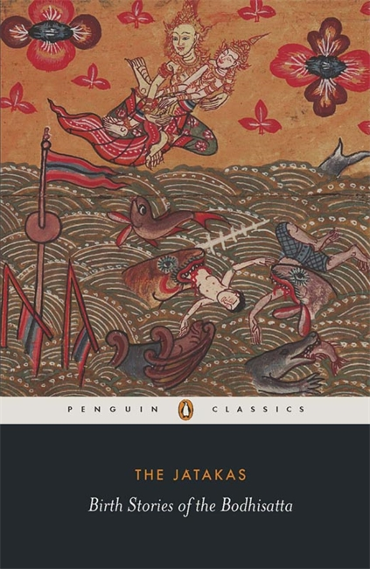
0.2 (Jijang Bosal Book Club, Preview)
All Buddhist traditions agree that one of the key moments during Shakyamuni Buddha's enlightenment was when he clearly recalled all of his previous lives.
After his enlightenment, the Buddha frequently referred to his past lives. Whenever he told one of these stories, though, it was never just about himself. Each of the other "characters" in the past life story was always someone present at the time when the Buddha was telling the story. And the story was always in some way relevant to a present day situation involving everyone in the story.
Whenever he finished telling one of these past life stories, the Buddha would then go around the room and tell people who they were in the story.
The point is that these past life stories were, in fact, always stories about relationships that extend over many lifetimes.
In addition to the so-called "Jataka Tales", many Mahayana Sutras contain stories about the Buddha's past lives, and these, too, are also always stories about relationships.
"The Jatakas: Birth Stories of the Bodhisatta" by Sarah Shaw
https://penguin.co.in/book/the-jatakas/

Slide 4
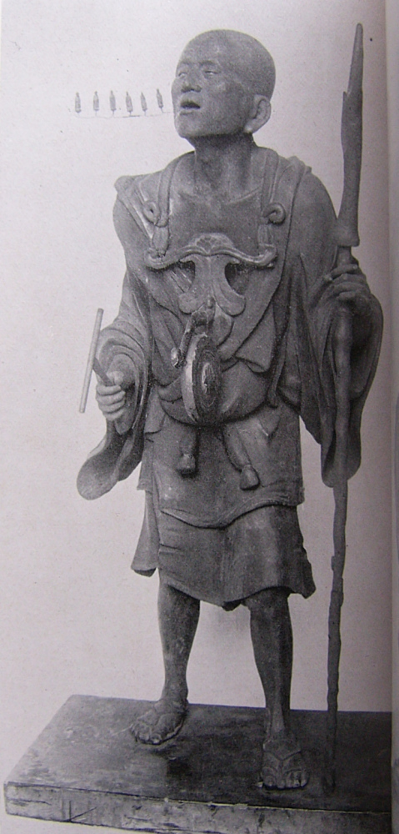
0.3 (Jijang Bosal Book Club, Preview)
Zen Master Seung Sahn frequently referred to rebirth in a matter of fact way in his teachings.
For example, he taught that if you brush against a stranger in a crowded street in a big city, that means you and that stranger have shared karma for 300 lifetimes. He liked to tell that story during retreats, and then say that everyone at the retreat had already practiced together for many lifetimes, and would continue to do so into the future for many lifetimes to come.
One time Master Seung Sahn was walking down the street in a city and he gave a large sum of money to a homeless person. One of his students was with him and voiced some concern. Seung Sahn said that it was none of the student's business: "In a past life he gave me money when I needed it, now I must repay him!"
Another time Master Seung Sahn was being driven to the airport by one of his students. Suddenly a squirrel darted out into the road and was run over by the car. The student who was driving the car was very upset, but Master Seung Sahn said, "Only chant 'Namu Amita Bul' seven times, and the squirrel will come back as your student."
Kūya (空也) chanting nembutsu (念佛)
https://en.wikipedia.org/wiki/Kūya

Slide 5
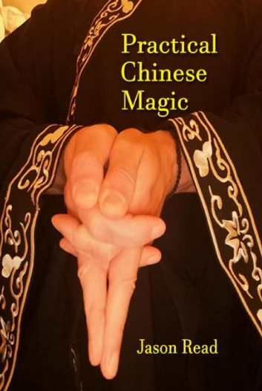
0.4 (Jijang Bosal Book Club, Preview)
The Denkoroku tells the story of Mishaka and Daitaka.
In the far distant past they were friends, but they parted ways when Daitaka met a Buddhist teacher and decided to study meditation, and Mishaka met a great sorcerer and decided to study magic.
Six aeons later they met again. By this time Daitaka was a great Zen Master. In fact, he was the Fifth Ancestor (that is, the fifth holder of the Zen lineage after Shakyamuni Buddha).
It had taken Daitaka countless lifetimes practicing meditation in order to attain enlightenment and become a Zen Master. Meanwhile his old friend Mishaka had been having a good time learning and perfecting various magical feats. By this lifetime Mishaka had become a powerful sorcerer who led an army of seven thousand sorcerers.
But upon reuniting with his old friend, Mishaka was able to attain enlightenment in that very lifetime. He became the Sixth Ancestor in the Zen tradition. And all of his sorcerer followers also became students of the Buddha Way.
A book on Chinese Sorcery that you can buy at Walmart for $37.59
"Practical Chinese Magic" by Jason Read

Slide 6
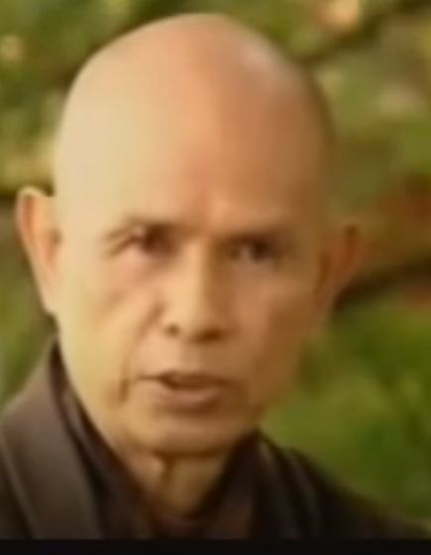
0.5 (Jijang Bosal Book Club, Preview)
"There’s the view of eternalism. Eternalism. That means you have a soul that is eternal. And after you die, that soul remain intact and go to another body and continues like that. That is eternalism.
"And then the other extreme is that after you die, well, there’s nothing left. Nihilism.
"And nirvana is the extinction of these two views: Nihilism and Eternalism.
"And even in the life of a person, in the lifetime of person, when you grow 10 year old you are no longer the same when you were 5. So you at 5 and you at 10 – you are neither same nor a different person. So the notion of same and different should be transcended also.
"So if you don’t see that kind of light you don’t really understand rebirth in Buddhism. You may get caught in the view of eternalism, and you are not different from traditions who hold a view that there is a immortal soul.
"In the light of the teaching, everything is impermanent. Nothing in the five skandhas can remain the same, exactly the same, in two consecutive moments.
"But nothing is lost."
This quote is from a really wonderful video by Thich Nhat Hanh which does a great job of discussing the Buddhist view of rebirth in just under four minutes.
Rebirth in Zen Buddhism

Slide 7
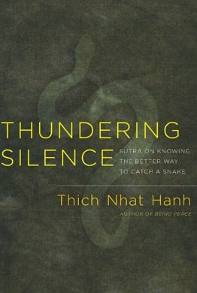
0.6 (Jijang Bosal Book Club, Preview)
Thich Nhat Hanh on the Sutra on Knowing the Better Way to Catch a Snake:
"The Buddha urges us to study and practice the Dharma in an intelligent way so we will not be caught by notions and words, like a person who knows how to catch a snake without being bitten. I had never before heard anyone compare his or her teaching to a snake or say that it can be dangerous to learn and practice, and I was impressed.
"Although his teachings are deep, the Buddha likes to present them in a simple way. While describing the interdependent-origination nature of reality, for instance, he simply says, "This is, because that is." This may not sound difficult, but it is very profound, and many have misunderstood it, including people of his own time, even some monks and nuns who had the opportunity to hear the Buddha directly. It is no wonder that scholars and practitioners of later generations have misunderstood and misrepresented his teachings. Many people think, for example, that the Buddha teaches of nonbeing, annihilation, the destruction of all feelings and intentions, the dissolution of individualities into nirvana, and so forth. The teachings of emptiness, nonself, self, nirvana, non-obtaining, tathagata, etc., continue to be misunderstood, from generation to generation."
Thundering Silence: Sutra on Knowing the Better Way to Catch a Snake
by Thich Nhat Hanh

Slide 8
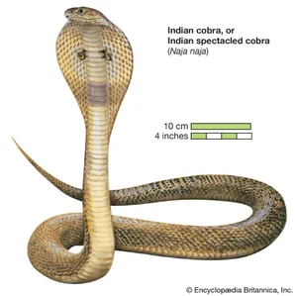
0.7 (Jijang Bosal Book Club, Preview)
In Summary:
The idea of rebirth is universally taught in all Buddhist traditions, including Zen.
If one looks at stories about rebirth in Buddhism these tend to be stories about relationships that continue lifetime after lifetime – not stories just about separate individuals.
The idea that nothing survives the death of the body is rejected by Buddhist teaching as nihilism. The idea that there is an immortal permanent soul is rejected as eternalism.
Everything changes, but "nothing is lost".
Buddhist teachings on death, rebirth, nihilism, eternalism, no-self, emptiness, etc, can be dangerous! You have to learn how to handle them properly. But what does that mean? At the very least it means to handle them with care. Don’t just grab hold of them carelessly and wave them around. That's how you get bitten.
"Whether belonging to the past, the future, or the present, whether it is our own body or the body of someone else, whether subtle or gross, ugly or beautiful, near or far, the body is not mine, is not me, is not the self."
[Sutra on Knowing the Better Way to Catch a Snake]
Image of cobra from
brittanica.com

Slide 9
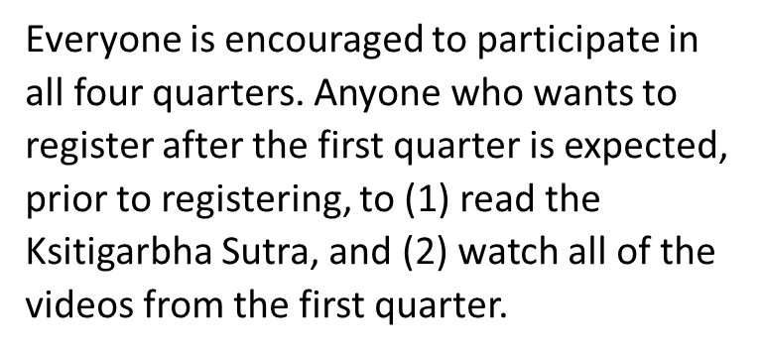
0.8 (Jijang Bosal Book Club, Preview)
Syllabus at a glance:
1. March, April, May:
The Kṣitigarbha Sutra, aka:
Kṣitigarbha Bodhisattva Pūrvapraṇidhāna Sūtra, aka:
地藏菩薩本願經 (Dìzàng Púsà Běnyuàn Jīng), aka:
Dizang Bodhisattva Fundamental Vows Sutra
Multiple versions/translations of this Sutra are freely available online.
2. June, July, August:
"The Making of a Savior Bodhisattva: Dizang in Medieval China"
Zhiru Ng, Chair of Religious Studies, Pomona College
If you register for this portion of the class you are expected to obtain a copy of the book!
3. September, October, November:
"Living Karma: The Religious Practices of Ouyi Zhixu"
Beverley Foulks McGuire, Professor of Philosophy and Religion, University of North Carolina Wilmington
If you register for this portion of the class you are expected to obtain a copy of the book!
4. December (2023), January (2024), February:
"The Scripture on the Ten Kings and the Making Purgatory in Medieval China"
Stephen F. Teiser, D.T. Suzuki Professor in Buddhist Studies, Princeton University
If you register for this portion of the class you are expected to obtain a copy of the book!

Slide 10
0.9 (Jijang Bosal Book Club, Preview)
All meetings of the Book Club will be recorded and posted publicly on youtube. It is only necessary to register for the Book Club if you want to participate in the live classes via Zoom.
Registrants are expected to do the reading before each meeting and to be actively involved in the class by asking questions and participating in discussion.
The group will meet twice a month on the 2nd and 4th Tuesday night from 7pm to 8:15pm (Eastern Time). Each month approximately 30 minutes of class time will be devoted to discussion.
The book club will last for one year, split into four three month quarters. In each quarter we'll be reading a different book, starting with the Ksitigarbha Sutra.

Slide 11
0.10 (Jijang Bosal Book Club, Preview)
The Buddha traveled to Triastrimsas Heaven in order to teach the Ksitigarbha Sutra to his mother (who had died 7 days after giving birth to her son Siddhartha).
Wait. What?
That's right. If you are a secular/agnostic/atheist Stephen Batchelor type Buddhist (not that there's anything wrong with that), then Jijang Bosal (aka Ksitigarbha) might not be your guy.
Jijang Bosal is, after all, the Bodhisattva you pray to during the 49 day period after a loved one dies.
This 49 day period is the time between one lifetime and the next is called 中有 (jung-hu 중유), or "in-between existence". One of Jijang Bosal's jobs is to help people during that time to ensure a favorable rebirth in their next life, up to and including rebirth in Amitabha's Pure Land. In East Asia this 49 day period is often extended to up to three years (particularly with respect to the "Ten Kings").
And not only does the Ksitigarbha Sutra assume as given such things as rebirth, heavenly realms, and otherworldly Pure Lands, it also dwells at some length on the subject of Hell.
Having said that, it isn't really necessary to believe in the literal truth of everything that's said in the Ksitigarbha Sutra (or any other Sutra). But one must be willing to at least, as the poets say, suspend one's disbelief.

Slide 12
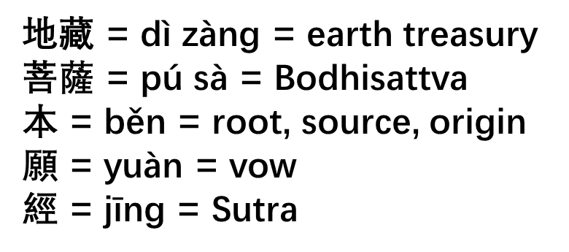
0.11 (Jijang Bosal Book Club, Preview)
The full title of the Sutra is
地藏菩薩本願經
Jijang Bosal Root Vow Sutra
All Bodhisattvas are beings who have dedicated themselves to Compassion, and yet there is one Bodhisattva in particular who is the "Bodhisattva of Compassion": Kwanseum Bosal.
Just so, all Bodhisattvas make "Great Vows", but there is one Bodhisattva who is known as Dae Won Bon Jon (大願 本尊 Great Vows Root Teacher): Jijang Bosal.
Like all Bodhisattva's, Jijang Bosal is committed to saving all sentient beings, but Jijang Bosal is especially dedicated to saving the worst of us, especially those sentient beings whose karma is bad enough to warrant an extended trip to Hell in forthcoming lives.

Slide 13
0.12 (Jijang Bosal Book Club, Preview)
There is a lot of emphasis on Hell realms in the Ksitigarbha Sutra. In fact, another name for Jijang Bosal is "Hell Bodhisattva" (地獄菩薩), which only requires changing one character: 獄 instead of 藏.
我不入地狱, 誰入地狱
wǒ bù rù dìyù, shéi rù dìyù
I not enter hell, who enter hell? That is, "If I do not go to hell (to save the beings there), then who will?"
The point is that no matter what kind of bad karma we have accumulated, and no matter where we are, Jijang Bosal is committed to helping us. The Sutra makes a special point of focusing on those who manage to escape from rebirth in the lower realms, only to quickly accumulate yet more bad karma and thus be forced back down again.
"They are like fish that get caught in a net and then get free, only to get caught in another net." (Ch. 4)
"Because beings of Jambudvipa have strong habits of doing evil actions, no sooner have they left the lower realms, they go back again. This requires Jijang Bosal to work hard through many kalpas in guiding them across to liberation." (Ch. 8)

Slide 14
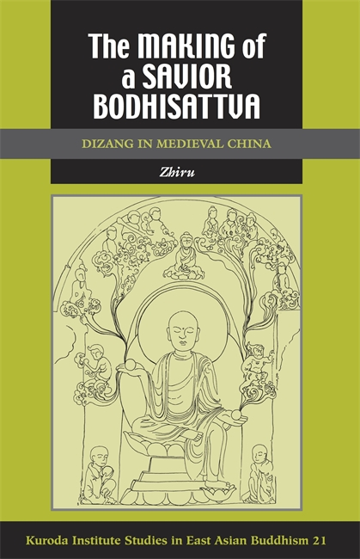
0.13 (Jijang Bosal Book Club, Preview)
"In modern Chinese Buddhism, Dizang is especially popular as the sovereign of the underworld. Often represented as a monk wearing a royal crown, Dizang helps the deceased faithful navigate the complex underworld bureaucracy, avert the punitive terrors of hell, and arrive at the happy realm of rebirth. The author is concerned with the formative period of this important Buddhist deity, before his underworldly aspect eclipses his connections to other religious expressions and at a time when the art, mythology, practices, and texts of his cult were still replete with possibilities…..
"The Making of a Savior Bodhisattva presents a fascinating wealth of material on the personality, iconography, and lore associated with the medieval Dizang. It elucidates the complex cultural, religious, and social forces shaping the florescence of this savior cult in Tang China while simultaneously addressing several broader theoretical issues that have preoccupied the field. Zhiru not only questions the use of sinicization as a lens through which to view Chinese Buddhist history, she also brings both canonical and noncanonical literature into dialogue with a body of archaeological remains that has been ignored in the study of East Asian Buddhism."
[From: https://uhpress.hawaii.edu/title/the-making-of-a-savior-bodhisattva-dizang-in-medieval-china/]

Slide 15
0.14 (Jijang Bosal Book Club, Preview)
"Her classes—such as Worlds of Buddhism, Life Story of the Buddha, Religious Traditions of China, and the Lotus Sutra in East Asia—attract a wide range of students, from religious studies majors connecting the dots between world religions to Asian Americans hoping to get a better grasp of their cultural heritage to religious seekers searching for spiritual clues in Eastern thought.
"'My colleagues say that they probably have fewer seekers than I do,' she says, 'and I think that has to do with the way Buddhism is portrayed and understood in American culture, in the sense that Buddhism is often seen as a religion that’s less institutionalized, a personal religion, something that you could actually pick and choose from.'
"But despite her evident dedication to her religious order, Ng isn’t trying to convert anyone. Buddhism, she says, is not that kind of religion. 'Buddhism is really about epistemology,' she explains, 'in the sense that you’re trying to unlearn how you know the world and coming up with a different way of experiencing knowing the world that involves internal transformation. I always tell my students that we wear contact lenses, but we don’t see the contact lenses, so we already have preconceived constructions of things. So it’s always very good to expose yourself to something new.'"
[from: https://magazine.pomona.edu/2016/summer/the-meaning-of-emptiness/]
Zhiru Ng, Professor of Religious Studies,
Pomona College, and author of:
The Making of a Savior Bodhisattva:
Dizang in Medieval China

Slide 16
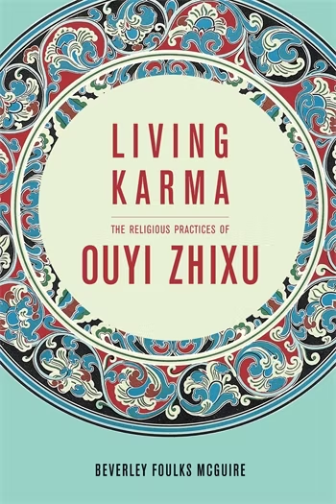
0.15 (Jijang Bosal Book Club, Preview)
"Living Karma is the first Western-language monograph (and a welcome one) on Ouyi Zhixu (1599-1655), one of the most influential Buddhist figures of Ming dynasty China. Beverly Foulks McGuire draws on Ouyi’s ritual texts and personal writings to show how this master’s understanding of karma shaped his religious practices and aspirations. By taking into consideration both the ritual and textual aspects of Ouyi’s corpus, the author is able to demonstrate that thought and action were indissoluble in Ouyi’s karmic worldview. Besides providing an important study on a largely disregarded figure in Chinese Buddhism, McGuire calls attention to the danger of separating these two complementary aspects of Buddhist doctrine and practice when studying the history of this religious tradition, an insight that could be extended to the study of other traditions as well. This is the third book in the Sheng Yen Series in Chinese Buddhist Studies at Columbia University Press.
"Building on karma as a 'bridge concept' (p. 3), McGuire’s Living Karma is an original study that dissociates itself from a uniquely conceptual/theoretical approach to Buddhist notions, and considers instead how these notions were lived by practitioners on a day-to-day basis. Besides adding a valuable contribution to the relatively meager body of scholarship on Ming-dynasty Buddhism, McGuire also provides an original characterization of Ouyi Zhixu through his understanding of karma and connected religious practices. Known in the West as a learned scholastic and prolific writer, as we discover through this study he was also a fervent Buddhist practitioner, a practitioner with uncertainties and fears. McGuire invites us to consider a fundamental problem: just as ordinary living beings fear parting from life, Buddhist practitioners can apprehend karmic retribution and the prospect of an evil rebirth--and this concern can shed an entirely new light on their action and practice."
[from: Daniela Campo's review in H-Net Reviews: https://china.usc.edu/mcguire-living-karma-religious-practices-ouyi-zhixu-january-1-2014]

Slide 17
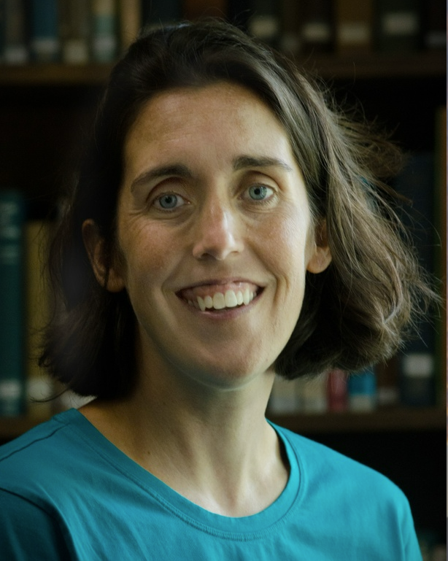
0.16 (Jijang Bosal Book Club, Preview)
"Finally, and this is perhaps the most powerful normative implication of Ouyi's karmic worldview, karma is best understood within the context of one's own life, not that of others. In other words, Ouyi applies karma to himself and his own circumstances; he does not presume to judge the karma of others. As he admits in the conclusion of his autobiography, only Buddhas and bodhisattvas (namely Sakyamuni and Dizang) have the power to judge him…. For Ouyi, karma is primarily about the moral status of his actions. Neither a theodicy nor a license to judge other people's actions, karma provides a means of confronting and responding to the reality of his own life and morality…. Because one cannot decipher karma, Ouyi implies that the most honest stance toward other people's suffering is that of extreme humility."
[From the conclusion to "Living Karma: The Religious Practices of Ouyi Zhixu".]
Beverley McGuire, Professor of East Asian Religions at the University of North Carolina Wilmington. Author of "Living Karma: The Religious Practices of Ouyi Zhixu".

Slide 18
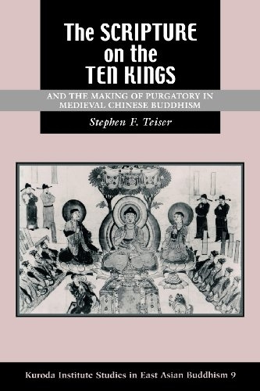
0.17 (Jijang Bosal Book Club, Preview)
"In theory, purgatory is easily delineated in both time and space. It lasts from the moment of death until the spirit of the deceased is reborn in another bodily form, usually in third year after death. Just as important as the beginning and ending points are the gradations marking the passage of time. During the first forty-nine days after death the dead person passes a critical juncture ever seven days. The timing of the "seven seven" rites derives from Buddhism; in Tibet the same stretch is described in the Bardo Thodol (popularly known in the West as the Tibetan Book of the Dead). In the Chinese case the journey of the spirit is viewed less in psychological terms and more as a bureaucratic experience."
[From the Introduction to "The Scripture on the Ten Kings and the Making of Purgatory in Medieval Chinese Buddhism" by Stephen Teiser: https://uhpress.hawaii.edu/title/the-scripture-on-the-ten-kings-and-the-making-of-purgatory-in-medieval-chinese-buddhism/]

Slide 19
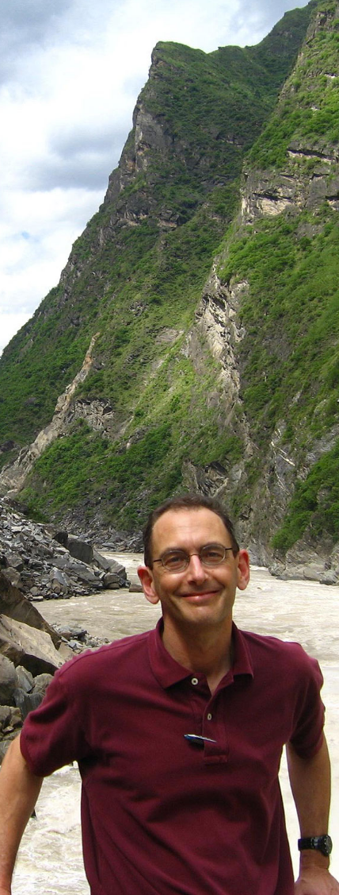
0.18 (Jijang Bosal Book Club, Preview)
Stephen F. Teiser is D. T. Suzuki Professor in Buddhist Studies and Professor of Religion in the Department of Religion at Princeton University. His work traces the interaction between cultures using textual, artistic, and material remains from the Silk Road, specializing in Buddhism and Chinese religions. His forthcoming monograph from Sanlian Publishers, based on the 2014 Guanghua Lectures in the Humanities at Fudan University, is entitled 儀禮與佛教研究 (Ritual and the Study of Buddhism). He also serves as Director of Princeton’s interdepartmental Program in East Asian Studies, and in 2014 he received the Graduate Mentoring Award in the Humanities from Princeton University’s McGraw Center for Teaching and Learning,
Teiser's previous work appeared in three monographs: Reinventing the Wheel: Paintings of Rebirth in Medieval Buddhist Temples (2006), awarded the Prix Stanislas Julien by the Académie des Inscriptions et Belles Lettres, Institut de France; "The Scripture on the Ten Kings" and the Making of Purgatory in Medieval Chinese Buddhism" (1994), awarded the Joseph Levenson Book Prize (pre-twentieth century) in Chinese Studies by the AAS; and The Ghost Festival in Medieval China (1988), awarded the prize in History of Religions by the ACLS. He has also edited several books, including Readings of the Platform Sūtra (2012) and Readings of the Lotus Sūtra (2009).
[from: https://www.princeton.edu/~sfteiser/

Slide 20
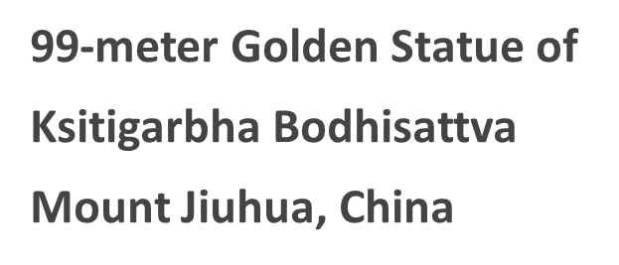

0.19 (Jijang Bosal Book Club, Preview)
"And the tenth, and final king, of the Ten Kings is 'Odojeonryun – 오도전륜' in Korean (Wudao Zhuanlun wang – 五道轉輪), or 'The King Who Turns the Wheel of Rebirth in the Five Paths' in English, who presides over the dead after three years. After this court, the dead are assigned to their next mode of life. The clouded pathway shows the five (sometimes six) paths of rebirth in Buddhism. Other versions of this courtroom portray the paths more clearly using symbols to indicate gods, asuras, humans, beasts, hungry ghosts (agwi), and sufferers in hell. Some of these courtrooms also include animal skins to the left of the king. It’s assumed that the king’s assistants would clothe a sinner with the hide appropriate for a soul’s rebirth. As for The King Who Turns the Wheel of Rebirth in the Five Paths, he wears a military suit and a general’s hat. He breathes fire, and he accompanied by assistants and club-wielding demons. This king sends the dead back into the world of the living, which is an attempt to bring the narrative of “The Scripture on the Ten Kings” full circle."
[From: Siwang – The Ten Kings of the Underworld: 시왕, by Dale Quarrington]
http://koreantempleguide.com/siwang-the-ten-kings-of-the-underworld-시왕/

