Slide 1
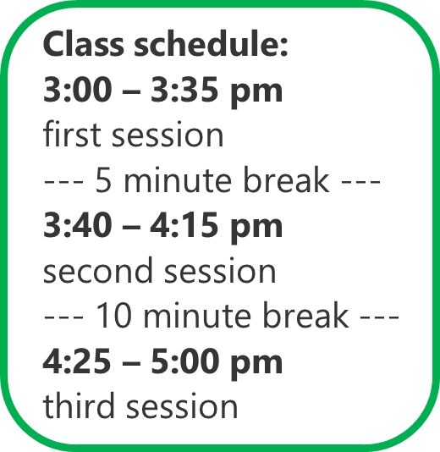
2.0 (Xuanzang's Heart Sutra, Lesson Two)
In this class (lesson two) we will complete the title of the Heart Sutra, and start looking at the Mantra.
In the process of learning the 360 characters that we'll be covering in this course, there are some topics, tips, strategies, and tools that need to be picked up along the way.
No two people will use exactly the same learning strategy, but we can (and should) learn from each other.
Topics: What are (1) components, (2) radicals, (3) strokes? How are Chinese characters pronounced in Sino-Korean? What do they mean? How are components put together to make more complex characters? How do components contribute to the (1) shape, (2) sound, and (3) meaning of more complex characters?
Tips, tools, and strategies: How to actually learn all this stuff?? Where to start? What to focus on? How do I test myself to see how I'm doing?
2023 Mar 4 Apr 1
May 6 Jun 3
Jul 1 Aug 5
Sep 2 Oct 7
Nov 4 Dec 2
2024 Jan 6 Feb 3

Slide 2
2.1 (Xuanzang's Heart Sutra, Lesson Two)
摩 訶 般 若 波 羅 蜜 多 心 經 Title
觀 自 在 菩 薩 行 深 般 若 1 乃 至 無 老 死 亦 無 老 死 盡 15
波 羅 蜜 多 時 照 見 五 蘊 皆 空 2 無 苦 集 滅 道 無 智 亦 無 得 以 16
度 一 切 苦 厄 3 無 所 得 故 菩 提 薩 埵 依 17
舍 利 子 色 不 異 空 4 般 若 波 羅 蜜 多 故 心 無 罣 礙 18
空 不 異 色 色 即 是 空 5 無 罣 礙 故 無 有 恐 怖 19
空 即 是 色 6 遠 離 顚 倒 夢 想 究 竟 涅 槃 20
受 想 行 識 亦 復 如 是 7 三 世 諸 佛 依 般 若 21
舍 利 子 是 諸 法 空 相 8 波 羅 蜜 多 故 得 阿 耨 多 羅 22
不 生 不 滅 不 垢 不 淨 9 三 藐 三 菩 提 故 知 般 若 23
不 增 不 減 是 故 空 中 無 色 10 波 羅 蜜 多 是 大 神 呪 24
無 受 想 行 識 無 眼 耳 鼻 舌 身 意 11 是 大 明 呪 是 無 上 呪 25
無 色 聲 香 味 觸 法 12 是 無 等 等 呪 能 除 一 切 苦 26
無 眼 界 乃 至 無 意 識 界 13 眞 實 不 虛 故 說 般 若 波 羅 蜜 多 27
無 無 明 亦 無 無 明 盡 14 呪 即 說 呪 曰 28
揭 諦 揭 諦 波 羅 揭 諦 波 羅 僧 揭 諦 菩 提 娑 婆 訶 Mantra
Months 1-3
Months 7-9
Months 4-6
Months 10-12
Months 7-9
Months 1-3

Slide 3
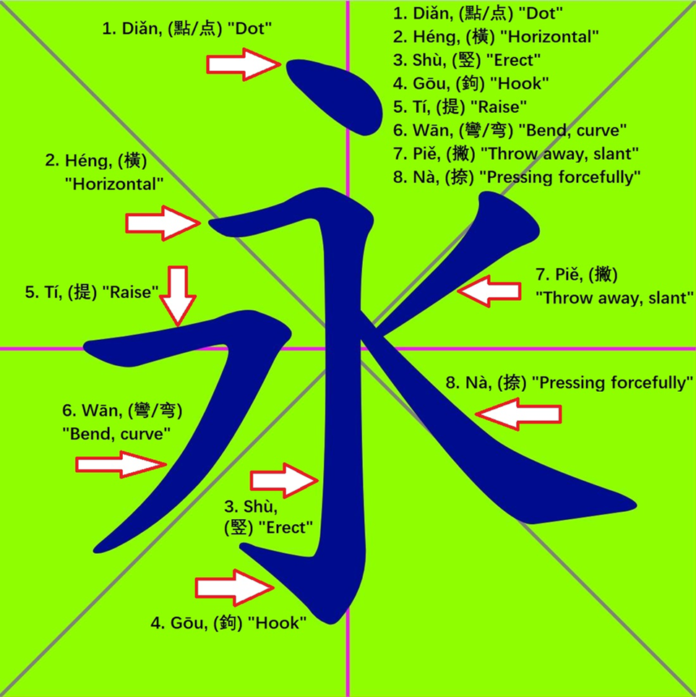
2.2 (Xuanzang's Heart Sutra, Lesson Two)
The Eight Strokes:
1. ㇔ 點 diǎn / jeom (점) spot, speck, dot
2. ㇐ 橫 héng / heong (횡) horizontal, across
3. ㇑ 豎 shù / su (수) erect, vertical, upright
4. ㇚ 鉤 gōu / gu (구) hook, sickle, check
5. ㇀ 提 tí / ji (지) carry, lift, raise
6. ??? 彎 wān / man (만) bend, turn
7. ㇒ 啄 zhuó / tak (탁) slant, abandon
8. ㇏ 捺 nà / nal (날) press down firmly
The character 永 [ yeong (영) forever ] contains all eight strokes (sorta kinda).

Slide 4
2.3 (Xuanzang's Heart Sutra, Lesson Two)
But really the way you learn about strokes is by writing characters, one stroke at a time, over and over again.
To the right are three examples of fairly simple characters showing how they are drawn one stroke at a time. They are from the 30 characters in the second lesson.
These kinds of diagrams, especially when combined with stroke order animations, are invaluable for learning how to draw characters correctly.
You really want to get to the point where you are writing at least 500 strokes a day. That might seem like a lot, but if you write these three characters 10 times each, that already adds up to 150 strokes!
After a while you will be able to work your way up to 1000 strokes a day with a little effort and determination.
To write the entire Heart Sutra takes a grand total of 2,689 strokes.
To write just the title is only 110 strokes. The mantra has 227 strokes.

Slide 5
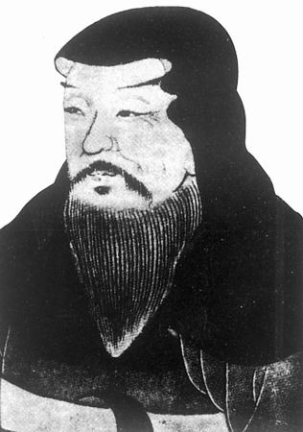
2.4 (Xuanzang's Heart Sutra, Lesson Two)
Components and strokes are pretty easy to understand. Actually, it's better to just have a "feel" for what a stroke is and what a component is than to have some sophisticated theoretical definition of what they are.
But what is a radical?
1. All radicals are components.
2. Every character has exactly one radical (but can have many components).
3. Not all components are radicals (examples: 中, 弟, 回, 囬, 冈, 咅) .
4. Traditionally radicals are used to index characters in a Chinese dictionary. This is reflected in the fact that the Chinese word for "radical" is 部首 (section head). This is also why the radicals are numbered.
5. There is no easy way to tell which component of a character is the radical!!!!
In the Heart Sutra there are 305 characters and components. In this course we are also including an additional 55 characters, most of which are made of components already found in the Heart Sutra. Altogether we will learn a little over 100 radicals, which is about half of "all" the radicals in Chinese (~214).
許慎 (Xǔ Shèn / Heo Shin / 허신)
(c. 58 – c. 148 AD)
Author of 說文解字 (Shuōwén Jiězì / Seolmun Haeja / 설문해자
[Wikimedia image taken from:
https://en.wikipedia.org/wiki/Xu_Shen

Slide 6
2.5 (Xuanzang's Heart Sutra, Lesson Two)
摩 Kangxi radical 64, 手 + 11, 15 strokes total
摩 = 广 + 林 + 手 摩 訶 般 若 波 羅 蜜 多 心 經 Title
1. 广 (广 = 丶 + 厂) 4. 丶 ; 5. 厂
2. 林 (林 = 木 + 木) 6. 木
3. 手
1. 广 gwang (광), guǎng; vast, wide
2. 林 rim (림), lín; forest (seon rim)
3. 手 su (수), shǒu; hand (cheon su gyeong)
4. 丶 ju (주), zhǔ; lord; (alt. form of 主)
5. 厂 han (한), hǎn; cliff
6. 木 mok (목), mù; tree, wood (moktak)

Slide 7
2.6 (Xuanzang's Heart Sutra, Lesson Two)
訶 (Kangxi radical 149, 言+ 5, 12 strokes
訶 = 言 + 可 摩 訶 般 若 波 羅 蜜 多 心 經 Title
-------------------------------------------------------------------------------------------------------------------------------------------------------------------
7. 言 (言 = 亠 + 二 + 口) 9. 亠 ; 10. 二 ; 11. 口
(亠 = 丶 + 一)
12. 一
8. 可 (可 = 丁 + 口) 13. 丁 (丁 = 一 + 亅)
14. 亅
7. 言 eon (언); yán; words, speech
8. 可 ga (가); kě; possible, can, be able to
9. 亠 du (두); tóu; lid, cover; cap
10. 二 i (이); èr; 2, two
11. 口 gu (구); kǒu; mouth
12. 一 il (일); yī; 1, one
13. 丁 jeong (정); dīng; fourth stem, fourth, IV
14. 亅 gweol (궐); jué; hook

Slide 8
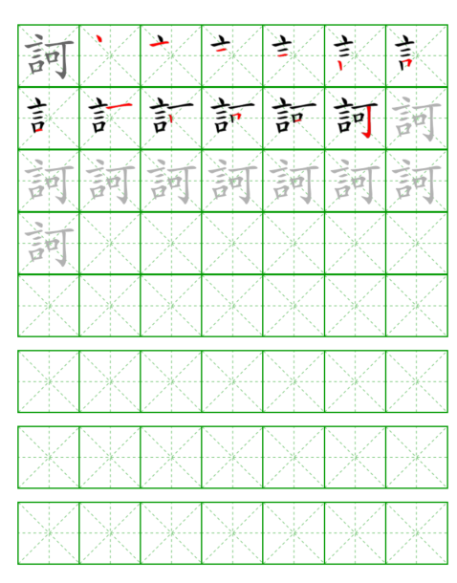
2.7 (Xuanzang's Heart Sutra, Lesson Two)
1. Use the Lesson Plans to keep track of where you are and where you're going.
2. Use Memrise to learn to recognize the characters, what they mean, and how they are pronounced. Flashcards are good for this, too!!
3. Use practice sheets and stroke order diagrams to learn how to write the characters.
4. Try to write 500 strokes a day – or even more. Find a pen that you really like. If 500 is too many, set a lower goal that you can realistically do.
5. Use the "Writing the Ox" web application to relate individual characters and components to the Big Picture.
6. Learn how to use a dictionary to look up characters using (1) pinyin, (2) radical, and (3) English meaning.
7. Use google, wiktionary, youtube, etc, to do your own investigation about characters and components.
8. Learn how to recite the Heart Sutra by Heart. Try to recite it at least once a day, preferably more. It's a good practice to recite it three times in a row, even if you can't do this every day, you should get accustomed to doing it.
Practice sheet for the character 訶 (ha) from PurpleCulture.Net:
https://www.purpleculture.net/chinese_practice_sheet/

Slide 9
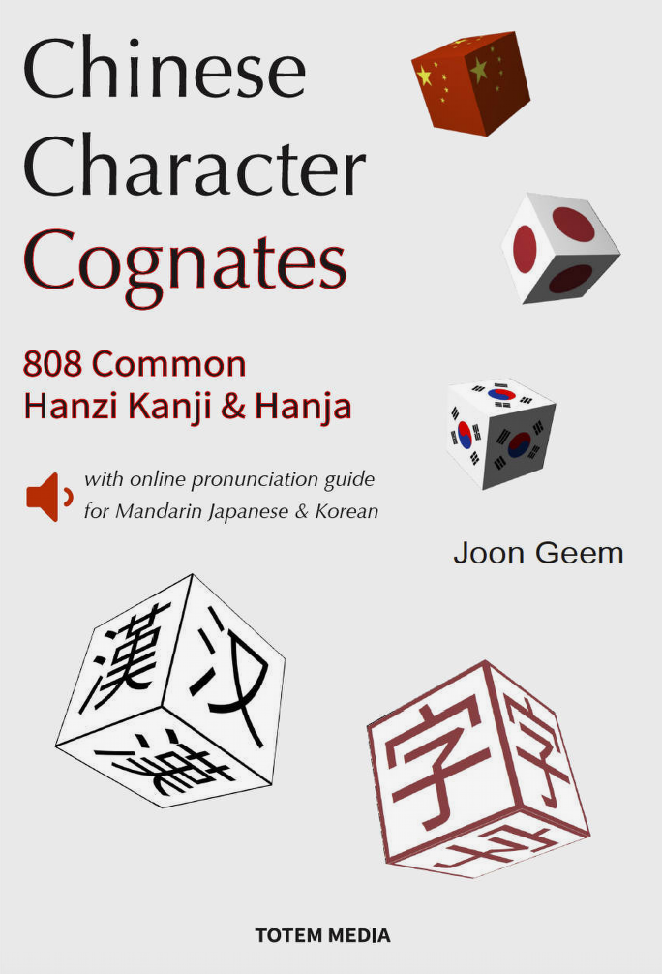
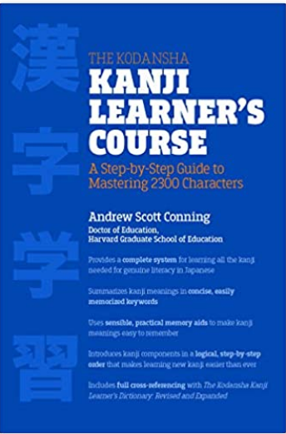
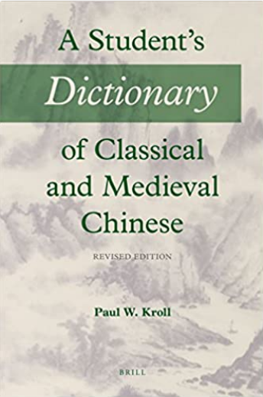
2.8 (Xuanzang's Heart Sutra, Lesson Two)
Chinese Character Cognates: 808 Common Hanzi Kanji & Hanja with online pronunciation guide for Mandarin Japanese & Korean
They often look alike, though that's not always the case.
They certainly don’t sound alike, but they certainly mean the same.
If you know one, you should already know them all.
If one doesn’t know any, one should start with all three.
What are they? Why, they're Chinese character cognates, of course!
Pros: Great for Sino-Korean! Both Hangeul and Romaja provided for all Hanja. Really helpful to see Mandarin, Korean, and Japanese side-by-side. And it's inexpensive: $9.99 for Kindle.
Cons: The Kindle version has the usual terrible Kindle problems. Impossible to cut and paste, and almost impossible to search!
Pros: Very well organized. LOTS of characters!
Cons: Japanese. A little pricey.
The Kodansha Kanji Learner's Course: A Step-by-Step Guide to Mastering 2300 Characters
Master Kanji Through Extensive Reading: To give you the capacity to read a diverse range of authentic Japanese texts, the Kodansha Kanji Learner's Course now has an accompanying series of Graded Reading Sets (GRS) with over 30,000 reading exercises graded kanji-by-kanji, parallel English text, complete pronunciation guides, and extensive grammar support. Download the FREE Volume 1 of the GRS series (bit.ly/2hqs6Fp) to experience the pleasure of reading and understanding authentic Japanese from your very first kanji.
A Student's Dictionary of Classical and Medieval Chinese
As a lexicon meant for practical use, it immensely facilitates reading and translating historical, literary, and religious texts dating from approximately 500 BCE to 1000 CE. Being primarily a dictionary of individual characters (zidian 字典) and the words they represent, it also includes an abundance of alliterative and echoic binomes (lianmianci 連綿詞) as well as accurate identifications of hundreds of plants, animals, and assorted technical terms in various fields. It aims to become the English-language resource of choice for all those seeking assistance in reading texts dating from the Warring States period through the Tang dynasty.
Pros: Read the description. It delivers.
Cons: Pricey. No Sino-Korean

