Slide 1

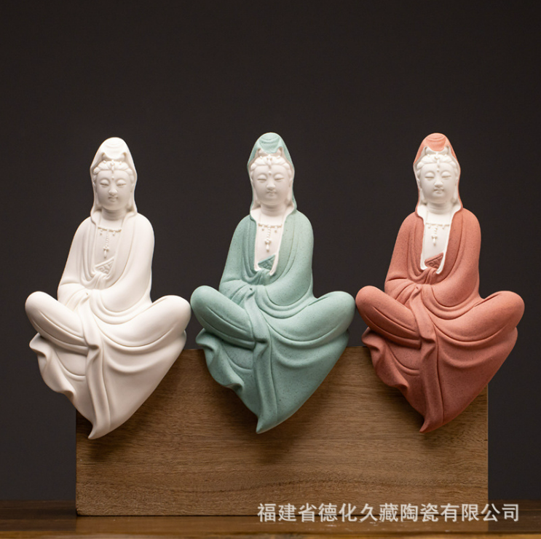
3.0 (Xuanzang's Heart Sutra, Lesson Three)
In this class (lesson three) we will cover the Heart Sutra Mantra, as well as the first three characters of the first line of the Heart Sutra.
揭諦揭諦波羅揭諦波羅僧揭諦菩提娑婆訶
a je a je ba ra a je ba ra seung a je mo ji sa ba ha
觀自在
gwan ja jae
2023 Mar 4 Apr 1
May 6 Jun 3
Jul 1 Aug 5
Sep 2 Oct 7
Nov 4 Dec 2
2024 Jan 6 Feb 3
Image from: tw.1688.com
https://tw.1688.com/pic/-B9DBD7D4D4DAC6D0C8F8CFF1CDBCC6AC.html

Slide 2
3.1 (Xuanzang's Heart Sutra, Lesson Three)
The Big Picture
摩 訶 般 若 波 羅 蜜 多 心 經 Title
觀 自 在 菩 薩 行 深 般 若 1 乃 至 無 老 死 亦 無 老 死 盡 15
波 羅 蜜 多 時 照 見 五 蘊 皆 空 2 無 苦 集 滅 道 無 智 亦 無 得 以 16
度 一 切 苦 厄 3 無 所 得 故 菩 提 薩 埵 依 17
舍 利 子 色 不 異 空 4 般 若 波 羅 蜜 多 故 心 無 罣 礙 18
空 不 異 色 色 即 是 空 5 無 罣 礙 故 無 有 恐 怖 19
空 即 是 色 6 遠 離 顚 倒 夢 想 究 竟 涅 槃 20
受 想 行 識 亦 復 如 是 7 三 世 諸 佛 依 般 若 21
舍 利 子 是 諸 法 空 相 8 波 羅 蜜 多 故 得 阿 耨 多 羅 22
不 生 不 滅 不 垢 不 淨 9 三 藐 三 菩 提 故 知 般 若 23
不 增 不 減 是 故 空 中 無 色 10 波 羅 蜜 多 是 大 神 呪 24
無 受 想 行 識 無 眼 耳 鼻 舌 身 意 11 是 大 明 呪 是 無 上 呪 25
無 色 聲 香 味 觸 法 12 是 無 等 等 呪 能 除 一 切 苦 26
無 眼 界 乃 至 無 意 識 界 13 眞 實 不 虛 故 說 般 若 波 羅 蜜 多 27
無 無 明 亦 無 無 明 盡 14 呪 即 說 呪 曰 28
揭 諦 揭 諦 波 羅 揭 諦 波 羅 僧 揭 諦 菩 提 娑 婆 訶 Mantra
Months 1-3
Months 7-9
And
Here
Months 4-6
Months 10-12
Months 7-9
Months 1-3
You Are Here

Slide 3
3.2 (Xuanzang's Heart Sutra, Lesson Three)
揭 諦 揭 諦 波 羅 揭 諦 波 羅 僧 揭 諦 菩 提 娑 婆 訶 HJ
jiē dì jiē dì bō luó jiē dì bō luó sēng jiē dì pú tí sà pó hē Mn
yết-đế yết-đế ba la yết-đế ba la tăng yết đế bồ đề tát bà ha Vt
gya tei gya tei hara gya tei hara so gya tei bo ji so wa ka Jp
a je a je ba ra a je ba ra seung a je mo ji sa ba ha Kr
ga te ga te pa ra ga te pa sam ga te bo dhi sva ha SR
gate gate pāragate pārasaṃgate bodhi svāhā IAST
गते गते पारगते पारसंगते बोधि स्वाहा SD
Different ways of saying the
Heart
Sutra
Mantra
HJ = Hanja; Mn = Mandarin; Vt = Vietnamese; Jp = Japanese; Kr = Korean; SR = Sanskrit romanization; IAST = International Alphabet of Sanskrit Transliteration; SD = Sanskrit Devanagari

Slide 4
3.3 (Xuanzang's Heart Sutra, Lesson Three)
What new characters and components are being introduced in this lesson, and where do they come from??
1 2 3 4 5 6 7 8
揭諦揭諦波羅揭諦波羅僧揭諦菩提娑婆訶
a je a je ba ra a je ba ra seung a je mo ji sabaha
9 10 11
觀自在
gwan ja jae
揭 = new
揭 = repeat
波 = old
揭 has 3 new components
諦 has 3 new components
僧 has 1 new component
菩 has 1 new component
提 has 3 new components
娑 has 2 new components
婆 has 0 new components
觀 has 4 new components
自 has 0 new components
在 has 1 new component

Slide 5
3.4 (Xuanzang's Heart Sutra, Lesson Three)
If you add up all the characters and components on the previous slide you'll find that there are 11 new characters plus 18 new components, for a grand total of 29. To make it a nice round 30 we'll also include the following very interesting character in this lesson:
㡭=幺+幺+一+幺+幺+𠃊
gye yo yo il yo yo eun
Whenever there is a character or component, like 𠃊, that does not have a stroke order animation available for it, I try to find some other relevant character that contains that component/character that does have a stroke order animation.
斷 dan (단) "extinguish" = 㡭 gye (계) "continue" + 斤 geun (근) "axe"
煩 惱 無 盡 誓 願 斷 "Delusions are endless we vow to extinguish them all."
[From the Four Great Vows]
斷
煩 惱 無 盡 誓 願 斷
煩 惱 = kleshas
無 盡 = uncountable
誓 願 = vow
斷 = extinguish

Slide 6

3.5 (Xuanzang's Heart Sutra, Lesson Three)
Let's look at the first two characters in the mantra – both of which are new.
揭
扌 曷
曰 匃
囗 一 勹 人 𠃊
諦
言 帝
亠 二 口 立 冖 巾
丶 一 亠 丷 一
64
66
The blue arrow indicates the radical
72
73
74
61
75
62
63
揭 a (아); raise
扌 su (수); hand
曷 gal (갈); why
曰 wal (왈); say
匃 gae (개); crouch
囗 wi (위); circle
一 il (일); one
勹 po (포); wrap
人 in (인); person𠃊 eun (은); hide
諦 je (제); truth
言 eon (언); words
帝 je (제); emperor
亠 du (두); lid
二 I (이); 2, two
口 gu (구); mouth
立 rib (립); establish
冖 myeok (멱); cover
巾 geon (건); kerchief
丶 ju (주); lord
丷 pal (팔); 8, eight

Slide 7


3.6 (Xuanzang's Heart Sutra, Lesson Three)
The character 僧 (seung) presents us with some interesting issues.
僧
亻 曾
曰
囗 一 丷
丷
丨
Alternative versions (preferred in Japan according to wiktionary)
67
僧
亻 曽
曰 丷 田
囗 一 囗 十
These are not "real"/"official"
characters or components
76
亻in (인) person
曾 jeung (증) great
曽 jeung (증) great
曰 wal (왈) say
囗 wi (위) circle
一 il (일) one
丷 pal (팔) eight
丨 gon (곤) rod
田 jeon (전)
十 shib (십) ten

Slide 8
3.7 (Xuanzang's Heart Sutra, Lesson Three)
Now the next two (new) characters in the mantra: 菩 mo (모) & 提 ji (지):
菩
艹 咅
立 口
亠 䒑
丶一 一 丷
提
扌 是
日 疋
囗 一 乛 龰
68
69
77
78
79
80
艹 cho (초) grass
咅 pu (부) spit
立 rib (립) stand
口 gu (구) mouth
亠 du (두) lid
䒑 cho (초) grass
丶 ju (주) lord
一 il (일) one
丷 pal (팔) eight
扌 su (수) hand
是 shi (시) to be
日 il (일) sun
疋 so (소) foot
囗 wi (위) circle
乛 eul (을) second
龰 ji (지) foot

Slide 9
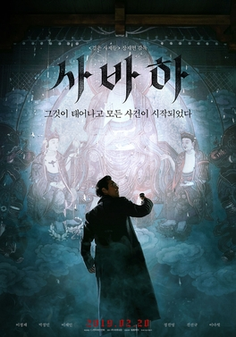
3.8 (Xuanzang's Heart Sutra, Lesson Three)
Now let's finish the mantra with 娑 sa (사) and 婆 ba (바). Recall that
we've already covered 訶 ha (하), which is the 2nd character in the title.
娑
氵 少 女
婆
氵 皮 女
厂丨又
70
71
81
82
娑 sa (사) whirling
氵 su (수) water
少 so (소) few
女 yeo (여) female
婆 ba (바) grandmother
皮 pi (피) skin
厂 han (한) cliff
丨 gon (곤) rod
又 u (우) again
訶 ha (하) blame
Svaha: The Sixth Finger
2019 South Korean thriller movie directed by Jang Jae-hyun
https://www.kmdb.or.kr/eng/db/kor/detail/movie/K/19625

Slide 10
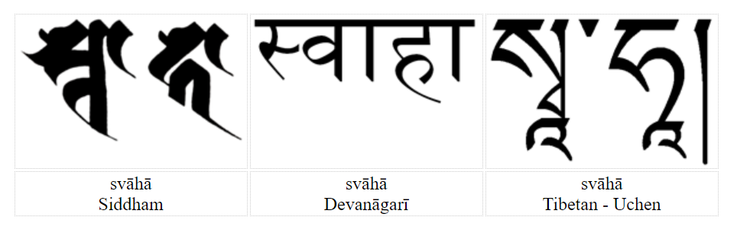
3.9 (Xuanzang's Heart Sutra, Lesson Three)
Different ways of writing
sabaha in Chinese characters:
Svāhā is not really a seed-syllable, since it is two syllables, but in Buddhist mantras it does function in the same way as a seed-syllable. Monier-Williams says the etymology is probably su (good, well, whole, etc) + ah (to call, to say, to speak, etc); so that it would literally mean something like: "well spoken". Conze translates it as "all hail" and most other translators seem to follow him. However he admits that it is not a very satisfactory translation. He refers to svāhā as a term of blessing: "an ecstatic shout of joy, expressive of a feeling of complete release". [Conze, Buddhist Wisdom Books, p.128]
Svāhā is imported from Vedic ritual, where it was used when making oblations to the sacred fire. After each ladle of offering the priest exclaims svāhā! In the Yajur Veda there are long lists of phrases which have the name of a god in the dative form (meaning to or for the deity) followed by svāhā, e.g agnaye svāhā, somāya svāhā (Taittirīra Saṃhitā 7.1.14.1). These may be the precursors of Buddhist mantras.* Svāhā first shows up in Buddhist texts in the Dhāraṇīs which were interpolated into Mahāyana sūtras such as the White Lotus and Golden Light.
娑 婆 訶
薩 婆 訶
娑 縛 訶
薩 縛 訶
薩 嚩 訶
娑 嚩 訶
萨 婆 诃
娑 婆 诃
萨 巴 哈
思 哇 哈
莎 哈
莎 訶
莎 诃
蓑 哈
From visiblemantra.org/svaha.html

Slide 11
3.10 (Xuanzang's Heart Sutra, Lesson Three)
The character 觀 gwan (관) has 25 strokes and a grand total of 14 unique components.
觀
雚 見
艹 口 口 隹 目 儿
亻一 主 囗 二
丶王
83
觀 gwan (관) perceive
雚 gwan (관) heron
見 gyeon (견) see
艹 cho (초) grass
口 gu (구) mouth
隹 chu (추) small bird
目 mog (목) eye
儿 in (인) child
亻 in (인) person
一 il (일) one
主 ju (주) lord
囗 wi (위) circle
二 i (이) two
丶 ju (주) lord
王 wang (왕) king
86
87
88
89

Slide 12

3.11 (Xuanzang's Heart Sutra, Lesson Three)
And finally:自 ja (자) & 在 jae (재), and don’t forget 㡭 gye (계)
自
丿 目
在
𠂇丨 土
84
85
自 ja (자) self, oneself
丿byeol (별) slash
目 mog (목) eye
在 jae (재) be; at; live
𠂇 ?? left, left hand
丨 gon (곤) rod
土 to (토) earth
㡭 gye (계) continue
幺 yo (요) small
一 il (일) one
𠃊 eun (은) hide
90
㡭
幺 幺 一 幺 幺𠃊
65

Slide 13
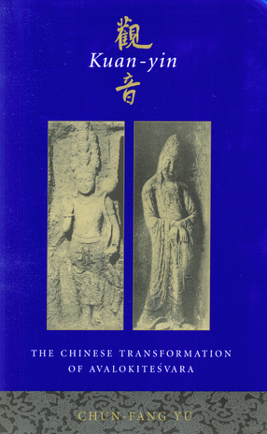
3.12 (Xuanzang's Heart Sutra, Lesson Three)
There are many different names of Avalokitesvara. The name 觀自在 seems to be very specifically associated with Xuanzang's version of the Heart Sutra.
"Although the meaning of avalokita is clear, the bodhisattva’s name is not. As Holt (1991) points out, Buddhologists have not been able to agree on a uniform explanation of the name Avalokitesvara. Why is it so? 'Separately, the Sanskrit terms avalokita and isvara are rather clear, meaning 'glance' or 'look' and 'lord,' respectively. But when compounded to form avalokitesvara, the name of the bodhisattva has been taken to variously mean 'Lord of what we see,''Lord who is seen,'' Lord who is seen (from on high),''Lord who sees,' or 'Lord who sees (from on high)'" (Holt 1991:31). Hsüan-tsang (ca. 596–664) [aka Xuanzang], the famous Chinese pilgrim to India, translated Avalokitesvara as 'Kuan-tzu-tsai' (Master Perceiver) [觀自在]. But the popularity of this name has always been surpassed by Kuan-yin [觀音] or Kuan-shih-yin [觀世音], which results from compounding Avalokita and Isvara meaning 'He who perceives the sounds of the world.'"
Kuan-yin The Chinese Transformation of Avalokitesvara
by Chün-fang Yü (p. 14)
Kuan-yin The Chinese Transformation of Avalokitesvara
by Chün-fang Yü
http://cup.columbia.edu/book/kuan-yin/9780231120296

Slide 14
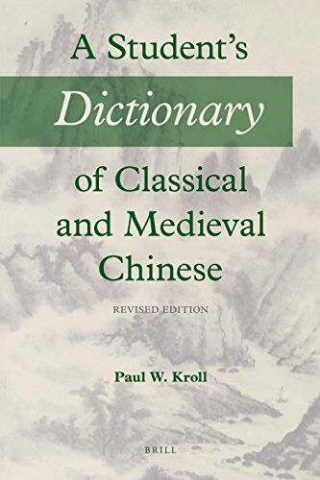
3.13 (Xuanzang's Heart Sutra, Lesson Three)
The waters are further muddied, with respect to the name Gwan Ja Jae (觀自在), by the fact that the second and third characters taken together,自在, form a two character word in Chinese (sometimes called a "binome").
It is very common in Chinese for two characters to be combined with a particular meaning associated with that combination. The meaning of the combination is never completely unrelated to the meanings of the individual characters, but in many, probably most, cases, the meaning of the combination is not immediately obvious just based on the meanings of the individual characters.
As we get further into the Heart Sutra we will encounter many examples of two-character words. If you study for the HSK exams (the official exams for Chinese language proficiency) a large part of the vocabulary that you have to learn is composed of such two character combinations.
In the specific case of 自在, Paul W. Kroll's "A Student's Dictionary of Classical and Medieval Chinese" (under the entry for the first character in the combination,自), the meaning of 自在 is given as "self-abiding, self-possessed, calm, poised."
A Student's Dictionary of Classical and Medieval Chinese
by Paul W. Kroll
https://brill.com/display/title/61179

Slide 15

3.14 (Xuanzang's Heart Sutra, Lesson Three)
The Prajna Paramita teachings are the essence of Mahayana Buddhism.
The Heart Sutra is the essence of the Prajna Paramita teachings.
The Heart Sutra Mantra is the essence of the Heart Sutra.
Therefore, know that Prajna Paramita
is the great transcendent mantra,
is the great bright mantra,
is the utmost mantra,
is the supreme mantra,
which is able to relieve all suffering
and is true, not false.
So proclaim the Prajna Paramita mantra,
proclaim the mantra which says:
The Heart Sutra Mantra from Kukai (774-835)
From the Princeton University Museum of Art:
https://artmuseum.princeton.edu/collections/objects/84975
揭諦揭諦波羅揭諦波羅僧揭諦菩提娑婆訶
a je a je ba ra a je ba ra seung a je mo ji sa ba ha

