Slide 1
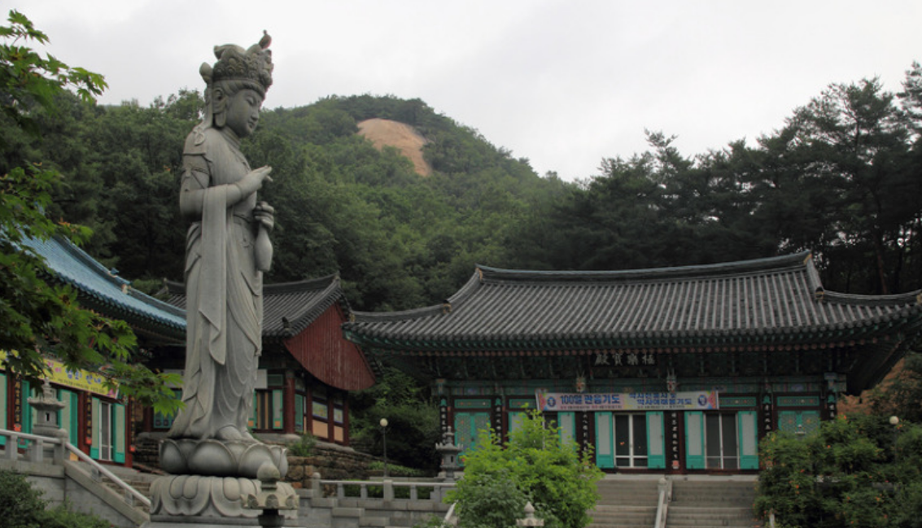
4.0 (Xuanzang's Heart Sutra, Lesson Four)
In this class (lesson four) we will finish the first two lines of the Heart Sutra:
觀自在菩薩行深般若 Line 1
gwan ja jae bo sal haeng shim ban ya
波羅蜜多時照見五蘊皆空 Line2
ba ra mil ta shi jo gyeon o on gae gong
관 자 재 보 살 행 심 반 야
gwan ja jae bo sal haeng shim ban ya
바 라 밀 다 시 조 견 오 온 개 공
ba ra mil ta shi jo gyeon o on gae gong
2023 Mar 4 Apr 1
May 6 Jun 3
Jul 1 Aug 5
Sep 2 Oct 7
Nov 4 Dec 2
2024 Jan 6 Feb 3
Class schedule:
3:00 to 3:35 pm
first session
--- 5 minute break ---
3:40 to 4:15 pm
second session
--- 10 minute break ---
4:25 to 5:00 pm
third session
Kwanseum Bosal statue at Hoeryongsa Temple from: cafe.daum.net
https://m.cafe.daum.net/821j/KvbO/514?listURI=%2F821j%2FKvbO

Slide 2
4.1 (Xuanzang's Heart Sutra, Lesson Three)
The Big Picture
摩 訶 般 若 波 羅 蜜 多 心 經 Title
觀 自 在 菩 薩 行 深 般 若 1 乃 至 無 老 死 亦 無 老 死 盡 15
波 羅 蜜 多 時 照 見 五 蘊 皆 空 2 無 苦 集 滅 道 無 智 亦 無 得 以 16
度 一 切 苦 厄 3 無 所 得 故 菩 提 薩 埵 依 17
舍 利 子 色 不 異 空 4 般 若 波 羅 蜜 多 故 心 無 罣 礙 18
空 不 異 色 色 即 是 空 5 無 罣 礙 故 無 有 恐 怖 19
空 即 是 色 6 遠 離 顚 倒 夢 想 究 竟 涅 槃 20
受 想 行 識 亦 復 如 是 7 三 世 諸 佛 依 般 若 21
舍 利 子 是 諸 法 空 相 8 波 羅 蜜 多 故 得 阿 耨 多 羅 22
不 生 不 滅 不 垢 不 淨 9 三 藐 三 菩 提 故 知 般 若 23
不 增 不 減 是 故 空 中 無 色 10 波 羅 蜜 多 是 大 神 呪 24
無 受 想 行 識 無 眼 耳 鼻 舌 身 意 11 是 大 明 呪 是 無 上 呪 25
無 色 聲 香 味 觸 法 12 是 無 等 等 呪 能 除 一 切 苦 26
無 眼 界 乃 至 無 意 識 界 13 眞 實 不 虛 故 說 般 若 波 羅 蜜 多 27
無 無 明 亦 無 無 明 盡 14 呪 即 說 呪 曰 28
揭 諦 揭 諦 波 羅 揭 諦 波 羅 僧 揭 諦 菩 提 娑 婆 訶 Mantra
Months 1-3
Months 7-9
We
Are
Here
Months 4-6
Months 10-12
Months 7-9
Months 1-3

Slide 3
4.2 (Xuanzang's Heart Sutra, Lesson Three)
What new characters and components are being introduced in Lesson Four?
1 2 3
觀 自 在 菩 薩 行 深 般 若 Line 1
gwan ja jae bo sal haeng shim ban ya
4 5 6 7 8 9
波 羅 蜜 多 時 照 見 五 蘊 皆 空 Line 2
ba ra mil ta shi jo gyeon o on gae gong
觀 = old
薩 = new
薩 3 new components
行 2 new components
深 1 new components
時 2 new components
照 5 new components
五 0 new components
蘊 3 new components
皆 2 new components
空 2 new components

Slide 4
4.3 (Xuanzang's Heart Sutra, Lesson Four)
This lesson introduces 9 new characters, and when those characters are broken down into their components, 20 of those components are new. There will also be one more character introduced.
薩行深時照五蘊皆空 9 new characters
阝产生彳亍罙寺寸昭 20 new components
灬火召刀縕囚皿比白
穴八
蛋蛋蛋蛋蛋

Slide 5
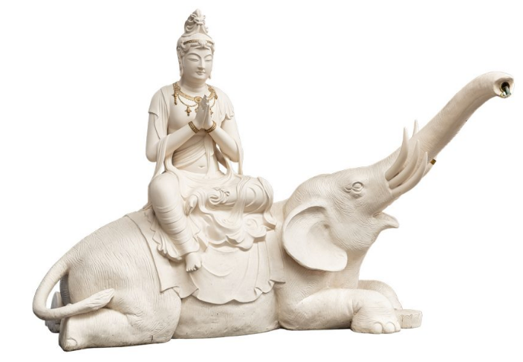
4.4 (Xuanzang's Heart Sutra, Lesson Four)
The new characters and components for Lesson Four are numbered 91 through 120
The new characters and components for Lesson Four are numbered 91 thru 120.
The blue arrow indicates the radical
91
92
薩 行
艹 阝 产 生 彳 亍
亠 丷 厂 𠂉 土
丶 一
觀 自 在 菩 薩 行 深 般 若 1
波 羅 蜜 多 時 照 見 五 蘊 皆 空 2
100
101
102
103
104
艹 + 隡
is an alternative decomposition of 薩
薩 sal (살)
艹 grass; cho (초)
阝 mound; bu (부)
产 birth; san (산)
生 life; saeng (생)
亠 lid; du (두)
丷 eight; pal (팔)
厂 cliff; han (한)
𠂉 person; in (인)
土 earth; to (토)
丶 lord; ju (주)
一 one; il (일)
行 action; haeng (행)
彳 walk; cheok (척)
亍 walk; chok (촉)
Samantabhadra, the Bodhisattva of Great Practice
https://www.banshoji.or.jp/product境内・坐禅堂-手水普賢菩薩像/

Slide 6
4.5 (Xuanzang's Heart Sutra, Lesson Four)
菩薩 (bosal, 보살) means "Bodhisattva". 薩 only occurs in Chinese as part of 菩薩, or as an abbreviation for it.
菩提 means "Bodhi", it can be pronounced either as "moji" (모지), as in the Mantra, or as "bori" (보리), lines 17 & 23.
There are many (at least 21) two-character words in the Heart Sutra, and several of these appear more than once.
摩訶 ma-ha; "great"; Title
菩提 mo-ji/bo-ri; "Bodhi"; lines Mantra, 17, 23
自在 ja-jae; "self-possessed"; line 1
菩薩 bo-sal; "Bodhisattva"; line 1
照見 jo-gyeon; perceive; line 2
一切 il-che; "all"; lines 3, 26
亦復 yeok-bu; "also"; line 7
乃至 nae-ji; "and so forth"; lines 13, 25
意識 ui-shik; "mano-vijñāna"; line 13
無明 mu-myeong; "ignorance"; line 14
所得 so-deuk; "what is acquired"; line 17
薩埵 sal-ta; "sattva"; line 17
罣礙 ga-ae; "hindrance"; lines 18, 19
恐怖 gong-po; "terrifying"; line 19
遠離 won-li; "far apart from"; line 20
顚倒 jeon-do; "distorted"; line 20
夢想 mong-sang; "dream"; line 20
究竟 gu-gyeol; "ultimate"; line 20
涅槃 yeol-ban; "nirvana": line 20
能除 neung-je; "take away"; line 26
眞實 jin-shil; "highest truth"; line 27

Slide 7
4.6 (Xuanzang's Heart Sutra, Lesson Four)
摩 訶 般 若 波 羅 蜜 多 心 經 Title
觀 自 在 菩 薩 行 深 般 若 1 乃 至 無 老 死 亦 無 老 死 盡 15
波 羅 蜜 多 時 照 見 五 蘊 皆 空 2 無 苦 集 滅 道 無 智 亦 無 得 以 16
度 一 切 苦 厄 3 無 所 得 故 菩 提 薩 埵 依 17
舍 利 子 色 不 異 空 4 般 若 波 羅 蜜 多 故 心 無 罣 礙 18
空 不 異 色 色 即 是 空 5 無 罣 礙 故 無 有 恐 怖 19
空 即 是 色 6 遠 離 顚 倒 夢 想 究 竟 涅 槃 20
受 想 行 識 亦 復 如 是 7 三 世 諸 佛 依 般 若 21
舍 利 子 是 諸 法 空 相 8 波 羅 蜜 多 故 得 阿 耨 多 羅 22
不 生 不 滅 不 垢 不 淨 9 三 藐 三 菩 提 故 知 般 若 23
不 增 不 減 是 故 空 中 無 色 10 波 羅 蜜 多 是 大 神 呪 24
無 受 想 行 識 無 眼 耳 鼻 舌 身 意 11 是 大 明 呪 是 無 上 呪 25
無 色 聲 香 味 觸 法 12 是 無 等 等 呪 能 除 一 切 苦 26
無 眼 界 乃 至 無 意 識 界 13 眞 實 不 虛 故 說 般 若 波 羅 蜜 多 27
無 無 明 亦 無 無 明 盡 14 呪 即 說 呪 曰 28
揭 諦 揭 諦 波 羅 揭 諦 波 羅 僧 揭 諦 菩 提 娑 婆 訶 Mantra
Two character words in the Heart Sutra
Two character words in the Heart Sutra

Slide 8
4.7 (Xuanzang's Heart Sutra, Lesson Four)
深
氵 罙
冖 儿 木
觀 自 在 菩 薩 行 深 般 若 1
波 羅 蜜 多 時 照 見 五 蘊 皆 空 2
時
日 寺
囗 一 土 寸
93
94
105
106
107
深 shim (심); deep
氵 su (수); water
罙 shim (심); far
冖 myeok (멱); cover
儿 a (아) "child"
木 mog (목); tree
時 shi (시); time
日 il (일); sun
寺 sa (사); temple
囗 wi (위); circle
一 il (일); one
土 to (토); work
寸 chon (촌); inch

Slide 9
4.8 (Xuanzang's Heart Sutra, Lesson Four)
觀 自 在 菩 薩 行 深 般 若 1
波 羅 蜜 多 時 照 見 五 蘊 皆 空 2
96
五
二
照
昭 灬
日 召 火
囗 一 刀 口
95
109
108
111
110
照 illuminate; jo (조)
昭 luminous; jo (조)
灬 fire; hua (화)
日 sun; il (일)
召 summon; jo (조)
火 fire; hua (화)
囗 circle; wi (위)
一 one; il (일)
刀 knife; do (도)
口 mouth; gu (구)
五 five (5); o (오)
二 two (2); i (이)
112

Slide 10
4.9 (Xuanzang's Heart Sutra, Lesson Four)
97
蘊
艹 縕
糹 囚 皿
幺丶 囗 人
觀 自 在 菩 薩 行 深 般 若 1
波 羅 蜜 多 時 照 見 五 蘊 皆 空 2
蘊 skandha; on (온)
艹 grass; cho (초)
縕 hemp; on (온)
糹 silk; sil (실)
囚 prisoner; su (수)
皿 vessel; myeong (명)
幺 small; yo (요)
丶 lord; ju (주)
囗 circle; wi (위)
人 person; in (인)
113
114
115

Slide 11
4.10 (Xuanzang's Heart Sutra, Lesson Four)
皆
比 白
丿 日
囗 一
空
穴 工
宀 八
丶冖
98
99
觀 自 在 菩 薩 行 深 般 若 1
波 羅 蜜 多 時 照 見 五 蘊 皆 空 2
117
皆 all; gae (개)
比 compare; bi (비)
白 white; baek (백)
丿 slash; byeol (별)
日 sun; il (일)
囗 circle; wi (위)
一 one (1); il (일)
空 sunyata; gong (공)
穴 hole; hyeol (혈)
工 work; gong (공)
宀 roof; myeon (면)
八 eight (8); pal (팔)
丶 lord; ju (주)
冖 lid; myeok (멱)
118
116
119

Slide 12
4.11 (Xuanzang's Heart Sutra, Lesson Four)
觀 自 在 菩 薩 行 深 般 若 1
perceive self-composed bodhisattva practice deep prajna
波 羅 蜜 多 時 照 見 五 蘊 皆 空 2
paramita when perceive five skandhas all sunyata
Avalokitesvara Bodhisattva, when practicing deeply the Prajna Paramita, perceives that all five skandhas are empty [Seung Sahn]
Avalokiteshvara while practicing deeply with the Insight that Brings Us to the Other Shore, suddenly discovered that all of the five Skandhas are equally empty [Thich Nhat Hanh]
Avalokiteshvara, who helps all to awaken, moves in the deep course of realizing wisdom beyond wisdom, sees that all five streams of body, heart, and mind are without boundary [Kaz Tanahashi]
Avalokiteshvara Bodhisattva, when deeply practicing prajna paramita, clearly saw that all five aggregates are empty [sotozen.com]

Slide 13
4.12 (Xuanzang's Heart Sutra, Lesson Four)
That still only adds up to 29 characters for this lesson.
To bring it up to 30 let's add this simple character:
入 ip (입) meaning: "enter"
從⾨⼊者不是家珍 。 "What comes in through the gate
is not the family treasure."
出門 逢 釋 迦, "Go out through the gate,
入門 逢 彌 勒。 you meet Shakyamuni.
Come in through the gate,
you meet Maitreya."
子入大廟、 "When Kongzi entered the Grand
每事問。 Temple, he asked about
everything."
Also found in: Ox Herding Poems (4, 5, 10).
HSK 4 and JLPT N5.
Compare:
入 ip (입) "enter"
八 pal (팔) "eight"
人 in (인) "person"
儿 a (아) "child"
120

Slide 14

4.13 (Xuanzang's Heart Sutra, Lesson Four)
行 haeng, 행; practice, austerity, action, impulse
According to the Digital Dictionary of Buddhism, 行 means "acts, deeds, or exercises aimed at taking one closer to the final goal of enlightenment (Skt. carya; pratipad, prāyoga; Pāli cariyā; Tib. spyod pa, lam, sgrub pa)."
Also: "To engage in (Skt. ava-car*; Tib. 'jug par byed pa)."
According to Paul Kroll's Dictionary of Classical and Medieval Chinese, in a Buddhist context, 行 means "'formations' of habitual action."
In Sino-Korean, walking meditation is called gyeong-haeng, 經行. The Japanese pronunciation of this is the (possibly more familiar) kinhin.
經 gyeong (경) also means the warp threads on a loom.
HSK level: 3; JLPT level: N5
Also in: Homage to the Three Jewels, in the section about the Four Great Bodhisattvas, specifically in reference to Samantabhadra, the Bodhisattva of Great Practice: 大行普賢菩薩, dae haeng bo hyeon bo sal.
Uisang's "Song of Dharma Nature", which states "therefore those who practice enter the realm of original suchness": 是故行者還本際 (the translation of this is far from straightforward!)
Peg Loom, for learning how to weave
Image from, and loom available for purchase from, montessoriservices.com
https://www.montessoriservices.com/peg-loom

Slide 15
4.14 (Xuanzang's Heart Sutra, Lesson Four)
深 shim (심) "deep"
HSK 4 and JLPT N3
Ox Herding Poem #1:
忙 忙 撥 草 去 追 尋 busy, busy, pulling grass; go, chase, search
水 闊 山 遙 路 更 深 water wide, mountain distant, path deep
Ox Herding Poem #4:
有 時 纔 到 高 原 上 sometimes the ox runs off to a high plateau
又 入 烟 雲 深 處 居 sometimes it escapes deep into the mist
Kwanseum Bosal Chanting
南無普門示現願力弘深 homage to universal gateway manifestation Avalokitesvara Bodhisattva, the power of
whose vows is wide and deep
深深痴迷
Truly, Madly, Deeply (Savage Garden)
I'll be your dream, I'll be your wish, I'll be your fantasy
I'll be your hope, I'll be your love, be everything that you need
I love you more with every breath truly, madly, deeply do
I will be strong, I will be faithful 'cause I'm counting on
A new beginnin'
A reason for livin'
A deeper meaning, yeah
I wanna stand with you on a mountain
I wanna bathe with you in the sea
I wanna lay like this forever
Until the sky falls down on me
我将是你的梦，
你的向往，你的幻想
我将是你的希望，你的真爱，
你所需要的一切
每一次呼吸都会加深我对你的爱，
那么深沉，那么疯狂
我将变得坚强，变得可以信赖
因为我正期待
一次重生
一个生存的理由
一个更深的涵义
我想和你屹立于山峰之颠
我想和你畅游在深深大海
我想就这样永远躺着
直到星星都坠落

Slide 16

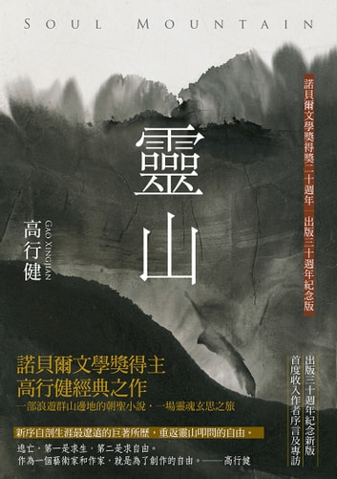
4.15 (Xuanzang's Heart Sutra, Lesson Four)
時 shi (시) time; when
HSK 1; JLPT N5
Yebul:
靈山當時受佛付囑 Spirit Mountain (Vulture Peak) at that time receive
Buddha teaching
Ox Herding Poem #4:
鞭 索 時 時 不 離 身 The whip and the rope must never leave the body
for even an instant (時 時 = constantly)[
Master Uisang's Song of Dharma Nature:
初發心時便正覺， As soon as thought arises, this is true enlightenment,
生死涅槃常共和。 Samsara and nirvana are in complete harmony.
Soul Mountain (靈山)
by Gao Xingjian (高行健)
When he was awarded the Nobel Prize for Literature in 2000, this novel was cited in particular by the committee.
https://www.harpercollins.com/products/soul-mountain-gao-xingjian

Slide 17
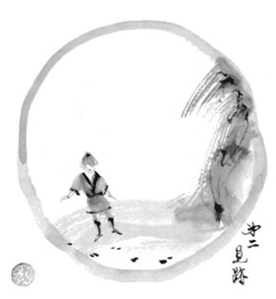
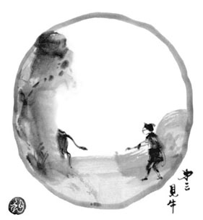
4.16 (Xuanzang's Heart Sutra, Lesson Four)
照見 jo gyeon (조견) perceive (lit: illuminate + see)
From the Digital Dictionary of Buddhism:
• To shed light on; to observe clearly; to come to understand. To take a view (Skt. vyavalokayati). [Charles Muller; source(s): Nakamura, Hirakawa]
• To distinguish; to determine by seeing. [Charles Muller]
There is also a separate entry for the whole phrase 照見五蘊皆空:
• Basic Meaning: perceiving that the five aggregates are empty in their intrinsic nature.
照 HSK 3; JLPT N2
見 HSK 1; JLPT N5
The second and third Ox Herding Pictures are called:
見 跡 Seeing the Footsteps (gyeon joek; 견적)
見 牛 Seeing the Ox (gyeon u; 견우)
見 跡
見 牛
Pictures by Yokō Tatsuhiko
https://terebess.hu/english/oxherding.html

Slide 18
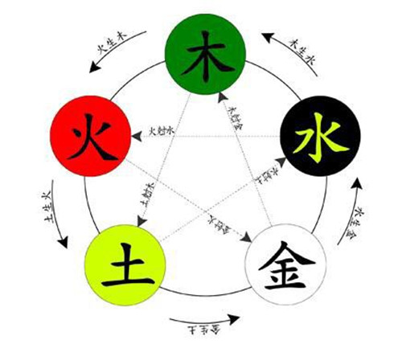
4.17 (Xuanzang's Heart Sutra, Lesson Four)
五行 o haeng 오행 (five elements)
天有五星 heaven has five stars
太白、歲星、辰星、荧惑、鎮星 Venus, Jupiter, Mercury, Mars, Saturn
地 有 五 行 earth has five elements
金、木、水、火、土 metal, wood, water, fire, earth
In their purified form, the five skandhas are the "five fragrances":
五香 = five fragrances (o hyang)
戒 = śīla (gye 계)
定 = samādhi (jeong 정)
慧 = prajñā (hye 혜)
解脫 = mokṣa (hae tal 해탈)
知見 = knowledge of moksha (hae tal ji gyeon 해탈 지견)
The "five fragrances" are found at the beginning of the Homage to the Three Jewels (Ye Bul).
https://zixun.jia.com/article/530832.html
木 and 水 were in Lesson 1, 土 was in Lesson 3, 火 is in Lesson 4, and 金 will be in Lesson 7.

Slide 19
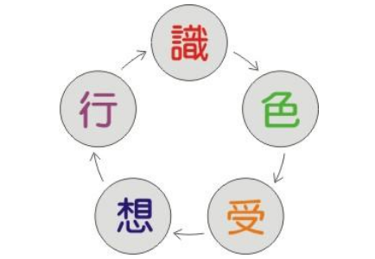
4.18 (Xuanzang's Heart Sutra, Lesson Four)
蘊 on 온 skandhas
According to the hsk.academy website, this is an HSK 6 character with these meanings in modern Mandarin:
to accumulate
to hold in store
to contain
to gather together
to collect
depth
inner strength
Profundity
蕴藏: to hold in store; to contain (untapped reserves etc)
藏 (jang 장) by itself means to hide or to store.
So 蕴藏 is a good example of a two character word where both characters have very similar meaning.
https://www.hrfjw.com/remen/wuyun.html
色 form saek (색)
受 feeling su (수)
想 perception sang (상)
行 impulse haeng (행)
識 consciousness shik (식)
(行 is in Lesson 4, 色 is in Lesson 5, and 受, 想, and 識 are in Lesson 6.)

Slide 20
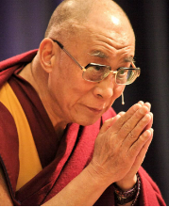
4.19 (Xuanzang's Heart Sutra, Lesson Four)
The last two characters in Line 2 are:
皆 空, "all empty" (gae gong 개공)
In the next lesson we will meet the following two character word:
一 切, "everything" (il che 일체)
These can be combined to make: 一切皆空 "everything all empty"
"How do we develop this understanding of the non-substantiality or emptiness of everything? It is not enough just to imagine that everything is empty and devoid of substantial existence. It is not enough to simply keep repeating this verse in one’s mind, almost like a formula; that is also not adequate. What is required is to develop a genuine insight into emptiness through a rational process of analysis and through a process of reflection.
"One of the most effective ways to understand everything as empty of substantial reality is to understand the interdependent nature of reality. What is unique about dependent origination is that within this understanding there is a possibility to find a middle way between total nothingness on the one hand, and substantial or independent existence on the other. So by finding that true middle way, one can arrive at a genuine understanding and insight into emptiness.
"Once this kind of insight into emptiness is found in one’s meditation through a rational process and deep contemplation, then there is a kind of new-quality when you interact with the world and the objects around you. There is a new quality to your engagement with the world because there is this awareness of the illusion-like nature of reality. The text suggests that practitioners should engage in mind training with this awareness of the illusory nature of reality."
The quote to the left is from "Basically Good", an article by His Holiness the Dalai Lama that appeared in the May 29, 2016 issue of Lion's Roar magazine.
https://www.lionsroar.com/basically-good/

Slide 21

4.20 (Xuanzang's Heart Sutra, Lesson Four)
One of the problems with Sunyata (Śūnyatā, शून्यता), aka "Emptiness", is that it really isn't that hard to get a little glimpse of it. Then the real problem comes when someone mistakes such a brief glimpse with a full understanding, or what the Dalai Lama refers to as "a genuine insight into emptiness". Gaining a little bit of understanding of Sunyata is a good thing, as long as you keep going, instead of saying, "oh! - this is it! – I've got it!"
Another, related problem, is to think that Mahayana Buddhist philosophy teaches that ultimately nothing really matters, since it's all just "nothing" anyway. Zen Master Seung Sahn taught that however deep one's understanding of emptiness is, one should never lose sight of what he called "correct function". The title of his most famous book relates directly to this issue: "Dropping Ashes on the Buddha". Despite its ultimately empty nature, treating a statue of the Buddha as an ashtray is not "correct function".
Thich Nhat Hanh was of the opinion that this is such a grave issue that Xuanzang's Heart Sutra needs to be changed to make it more obvious that it does not advocate a nihilistic point of view. In 2014 he presented a new "translation" of the Heart Sutra which was in fact (and he himself very clearly explains this) not really a "translation" but rather a revision of Xuanzang's Heart Sutra. In fact, Thich Nhat Hanh criticizes both Xuanzang, and the Sixth Ancestor Hui Neng for presenting a "wrong view" of emptiness.
The Other Shore: A New Translation of the Heart Sutra with Commentaries
by Thich Nhat Hanh
https://www.parallax.org/product/the-other-shore-a-new-translation-of-the-heart-sutra-with-commentaries/

Slide 22
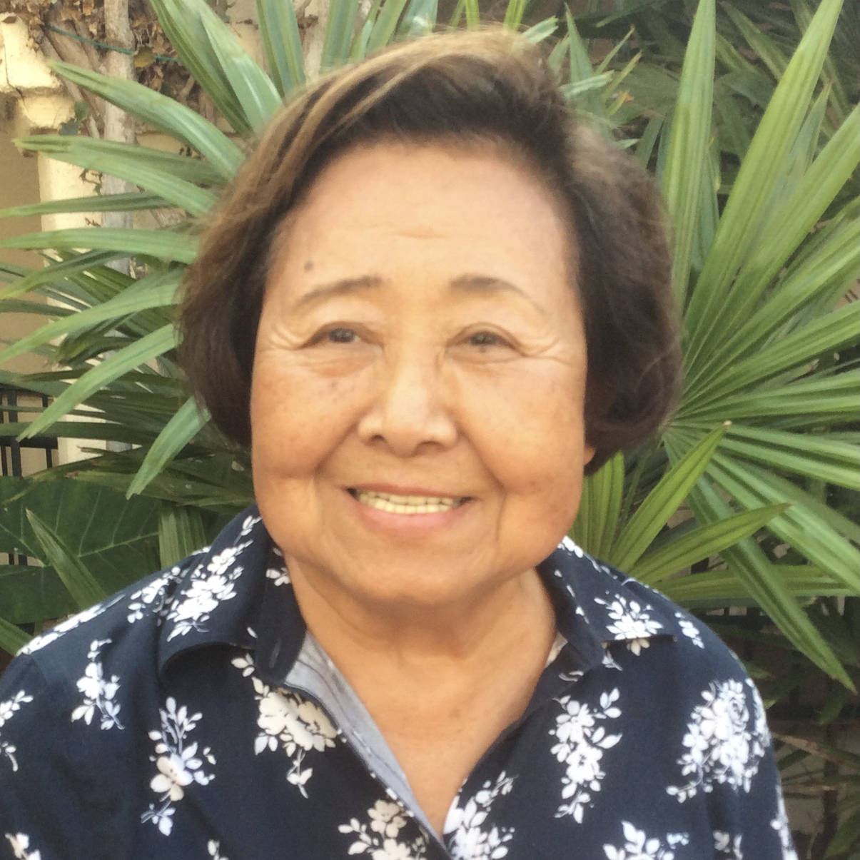
4.21 (Xuanzang's Heart Sutra, Lesson Four)
Sutra's featuring Avalokitesvara (mostly taken from Chün-fang Yü's book, Kuan-yin: The Chinese Transformation of Avalokitesvara pp. 31-104)
1. Prediction of future Buddhahood and being a successor to Amitabha:
Sutra of Kuan-shih-yin Bodhisattva’s Receiving Prediction, Karuha-puhdarika
Sutra, Sutra of the Original Cause for Kuan-shih-yin Bodhisattva’s Rebirth in
the Pure Land
2. Avalokitesvara as a Savior:
Lotus Sutra, Sutra of Visualization on Amitayus Buddha, Surangama Sutra,
The Great Prajña-paramita Sutra, Avatamsaka Sutra, Heart Sutra, Mahavairocana
Sutra, Tattvasaggraha Sutra, Ksitigarbha Sutra
3. Sutras in which Avalokitesvara teaches Dharanis:
Dharahi Sutra of Invoking Avalokitesvara Bodhisattva to Dissipate Poison and Harm (a
favorite of Zhiyi); Sutra of the Divine Dharani on the Eleven-headed Avalokitesvara
[Spoken] by the Buddha; Dharani Sutra of Amoghapasa; Sutra of the Secret Method
[Spoken] by Master Perceiver Bodhisattva Who Has a Thousand Luminous Eyes;
Thousand-Handed and Thousand-Eyed Avalokitesvara Bodhisattva's Vast, Perfect,
Unimpeded, Great-Compassionate Heart Dharani Sutra (this is the Sutra that
contains the Great Dharani)
Chün-Fang Yü
Sheng Yen Professor Emerita of Chinese Buddhism, Departments of Religion and East Asian Languages and Cultures, Columbia University
https://religion.columbia.edu/content/chun-fang-yu

Slide 23
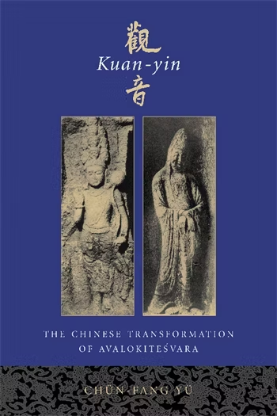
4.22 (Xuanzang's Heart Sutra, Lesson Four)
On Avalokitesvara in the Surangama Sutra:
The bodhisattva is called Kuan-shih-yin or Kuan-yin, but it offers a different explanation for the name. It provides yet a third meaning of kuan. The bodhisattva begins by describing how he obtained samadhi by meditating on the organ of hearing as instructed by a buddha also named Kuan-shih-yin under whom he studied:
At first by directing the organ of hearing into the stream of meditation, this organ was detached from its object, and by wiping out (the concept of) both sound and stream-entry, both disturbance and stillness became clearly non-existent. Thus advancing step by step both hearing and its object ceased completely, but I did not stop where they ended. When the awareness of this state and this state itself were realized as non-existent, both subject and object merged into the void, the awareness of which became all embracing. With further elimination of the void and its object both creation and annihilation vanished giving way to the state of Nirvana which then manifested. (Luk 1966:135)
The sound mentioned here is not that made by the faithful who cry out his name, but any sound that, when examined (kuan) with penetrating insight, leads to the realization of sunyata. Although the bodhisattva saves beings from various dangers and grants fourteen kinds of fearlessness in this sutra, the reason he can do so is different from that given in the Lotus. "Since I myself do not meditate on sound but on the meditator, I cause all suffering beings to look into the sound of their voices in order to obtain liberation"(Luk 1966:139). The bodhisattva concludes by once more linking his name to his meditation on hearing: "That Buddha praised my excellent method of perfection and gave me, in the presence of the assembly, the name of Kuan-shih-yin. Because of my all-embracing (absolute function of) hearing, my name is known everywhere" (Luk 1966:142). In the Surangama Sutra, therefore, kuan is understood neither as perceiving and responding to the cries for help uttered by the faithful, nor visualizing the divine visage of the bodhisattva, but as investigating the real nature of sound and realizing it as being void. [pp. 40-41]
Kuan-yin: The Chinese Transformation of Avalokitesvara
by Chün-fang Yü
http://cup.columbia.edu/book/kuan-yin/9780231120296

Slide 24
4.23 (Xuanzang's Heart Sutra, Lesson Four)
Vocabulary for Lesson Four (NOTE: CCC = Chinese Character Cognates by Joon Geem)
薩 sattva; sal (살); radical: 140+14 (䒑, 艸, 艹); CCC not found
行 action; haeng (행); radical: 144 (行); CCC Entry 644
深 deep; shim (심); radical: 85+8 (水, 氵); CCC Entry 470
時 temple; shi (시); radical: 72+6 (日); CCC Entry 380
照 illuminate; jo (조); radical: 86+9 (灬, 火); CCC footnote for Entry 490 (片)
五 five (5); o (오) ; radical: 7+2 (二); CCC Entry 15
蘊 skandha; on (온); radical: 140+16 (䒑, 艸, 艹); CCC not found
皆 all; gae (개); radical: 106+4 (白); Entry 521
空 sunyata, emptiness, sky, space; gong (공); CCC Entry 558
阝 mound; bu (부); radical: 170 (阝); CCC Entries 756-762
产 property, give birth; san (산); radical: 117+1 (立); CCC Entry 503
生 birth, life, nature; saeng (생); radical: 100 (生); CCC Entry 502
彳 step; cheok (척); radical: 60 (彳); CCC Entries 283-289

Slide 25
4.24 (Xuanzang's Heart Sutra, Lesson Four)
Vocabulary for Lesson Four Continued (NOTE: CCC = Chinese Character Cognates by Joon Geem)
亍 step; chok/ma (촉/마); radical: 7+1 (二); CCC not found
罙 far; shim (심); radical: 14+6 (冖); CCC see etymology of Entry 343
寺 temple; sa (사); radical: 41+3 (寸); Entry 235
寸 inch; chon (촌); radical: 41 (寸); CCC Entries 235-239
昭 luminous; jo (조); radical: 72+5 (日); CCC not found
灬 fire; hua (화); radical: 86 (灬, 火); CCC Entries 481-484
火 fire; hua (화); radical: 86 (灬, 火); CCC Entry 481
召 to summon; jo (조); radical: 30+2 (口); CCC Entry 336 (招)
刀 knife, blade; do (도); radical: 18 (⺈, 刀, 刂); CCC Entry 80
縕 hemp; on (온); radical: 120+10 (糹); CCC not found
囚 prisoner; su (수); radical: 31+2 (囗); CCC Entry 476

Slide 26

4.25 (Xuanzang's Heart Sutra, Lesson Four)
Vocabulary for Lesson Four Continued (NOTE: CCC = Chinese Character Cognates by Joon Geem)
皿 vessel, container; myeong (명); radical: 108 (皿); CCC Entries 476 and 525
比 compare; bi (비); radical: 81 (比); CCC Entry 440
白 white, clear; baek (백); radical: 106 (白); CCC Entry 518
穴 hole; hyeol (혈); radical: 116 (穴); CCC Entry 558 (etymology)
八 eight (8); pal (팔); radical: 12 (八); CCC Entry 69
入 enter; ip (입); radical: 11 (入); CCC Entry 65
外太空

