Slide 1
5.0 (Xuanzang's Heart Sutra, Lesson Five)
度 一 切 苦 厄 (3)
do il che go aek (도일체고액)
-------------------------------------------------------------------------------------------------------------------------------------------
舍 利子色不異空 (4)
sa ri ja saek bur i gong (사리자색불이공)
-------------------------------------------------------------------------------------------------------------------------------------------
空 不 異 色 色 即 是 空 (5)
gong bur i saek saek jeuk shi gong (공불이색색즉시공)
-------------------------------------------------------------------------------------------------------------------------------------------
空 即 是 色 (6)
gong jeuk shi saek (공즉시색)
Heart
Sutra
Lesson
Five
2023 Mar 4 Apr 1
May 6 Jun 3
Jul 1 Aug 5
Sep 2 Oct 7
Nov 4 Dec 2
2024 Jan 6 Feb 3
Class schedule:
3:00 to 3:35 pm
first session
--- 5 minute break ---
3:40 to 4:15 pm
second session
--- 10 minute break ---
4:25 to 5:00 pm
third session
In this lesson we cover
lines 3 though 6

Slide 2
5.1 (Xuanzang's Heart Sutra, Lesson Five)
The Big Picture
摩 訶 般 若 波 羅 蜜 多 心 經 Title
觀 自 在 菩 薩 行 深 般 若 1 乃 至 無 老 死 亦 無 老 死 盡 15
波 羅 蜜 多 時 照 見 五 蘊 皆 空 2 無 苦 集 滅 道 無 智 亦 無 得 以 16
度 一 切 苦 厄 3 無 所 得 故 菩 提 薩 埵 依 17
舍 利 子 色 不 異 空 4 般 若 波 羅 蜜 多 故 心 無 罣 礙 18
空 不 異 色 色 即 是 空 5 無 罣 礙 故 無 有 恐 怖 19
空 即 是 色 6 遠 離 顚 倒 夢 想 究 竟 涅 槃 20
受 想 行 識 亦 復 如 是 7 三 世 諸 佛 依 般 若 21
舍 利 子 是 諸 法 空 相 8 波 羅 蜜 多 故 得 阿 耨 多 羅 22
不 生 不 滅 不 垢 不 淨 9 三 藐 三 菩 提 故 知 般 若 23
不 增 不 減 是 故 空 中 無 色 10 波 羅 蜜 多 是 大 神 呪 24
無 受 想 行 識 無 眼 耳 鼻 舌 身 意 11 是 大 明 呪 是 無 上 呪 25
無 色 聲 香 味 觸 法 12 是 無 等 等 呪 能 除 一 切 苦 26
無 眼 界 乃 至 無 意 識 界 13 眞 實 不 虛 故 說 般 若 波 羅 蜜 多 27
無 無 明 亦 無 無 明 盡 14 呪 即 說 呪 曰 28
揭 諦 揭 諦 波 羅 揭 諦 波 羅 僧 揭 諦 菩 提 娑 婆 訶 Mantra
Months 1-3
Months 7-9
We
Are
Here
Months 4-6
Months 10-12
Months 7-9
Months 1-3

Slide 3
5.2 (Xuanzang's Heart Sutra, Lesson Five)
What new characters are being introduced in Lesson Five?
度 一 切 苦 厄 (and is saved from all suffering and distress)
do il che go aek
舍 利 子 色 不 異 空 (Shariputra, form is not different from emptiness)
sa ri ja saek bur i gong
空 不 異 色 色 即 是 空 (emptiness is not different from form,
form is the same as emptiness)
gong bur i saek saek jeuk shi gong
空 即 是 色 (emptiness is the same as form)
gong jeuk shi saek
3
度 do (도); go-over; ferry across; save
切 che/jeol (체/절); close to; eager, sincere
苦 go (고); suffering; bitter
厄 aek (액); misfortune/distress
舍 sa (사); phonetic/lodging
利 li (리); phonetic; sharp; profit
子 ja (자); phonetic; master; son
色 saek (색); form/color
不 bur/bu (불/부); not
異 i (이); different
即 jeuk (즉); very close to, agree, same
4
5
6

Slide 4
5.3 (Xuanzang's Heart Sutra, Lesson Five)
There are 11 new characters, which in turn have 17 new components (and we'll add two more to get to 30):
度 = 广 + 廿 + 又
切 = 七 + 刀
苦 = 艹 + 古 ; 古 = 十 + 口
厄 = 厂 + 㔾
舍 = 人 + 舌 ; 舌 = 千 + 口
利 = 禾 + 刂
子 = 了 + 一
色 = ⺈ + 巴
不
異 = 田+共 ; 田=囗+十; 共=卄+一+八
即 = 日 + 厶 + 卩
廿 ip (입); twenty, 20
七 chil (칠); 7, seven
古 go (고); the past; ancient old
十 shib (십); 10, ten
㔾 jeol (절); variant form of 卩, xiān, seal
舌 seol (설); tongue
千 cheon (천); thousand
禾 hwa (화); grain; cereal; rice plant
刂 do (도); blade
了 yo (요); perfective aspect; indicates change
⺈ do (도); knife; blade
巴 pa (파); a huge snake
田 jeon (전); farmland; field
共 gong (공); together; jointly; as a group
卄 ip (입); twenty, 20, variant form of 廿
厶 sa (사); self, private, secret
卩 jeol (절); seal
互 ho (호); mutual
百 baek (백); one hundred

Slide 5
5.4 (Xuanzang's Heart Sutra, Lesson Five)
Line 3: 度 一 切 苦 厄
do il che go aek
save (from) all suffering distress
苦
艹 古
十 口
123
度
广 廿 又
切
七 刀
121
122
134
radical
133
135
132
度 do (도) save
广 gwang (광); vast, wide
廿 ip (입); twenty, 20
又 u (우); again
一 il (일); 1, one
切 che/jeol (체/절); close to
七 chil (칠); 7, seven
刀 do (도); knife, blade
苦 go (고); suffering
艹 cho (초); grass
古 go (고); the past; ancient old
十 shib (십); 10, ten
口 gu (구);
厄 aek (액); misfortune/distress
厂 han (한); cliff; alt. form of 广
㔾 jeol (절); variant of 卩, seal
厄
厂 㔾
124
136

Slide 6
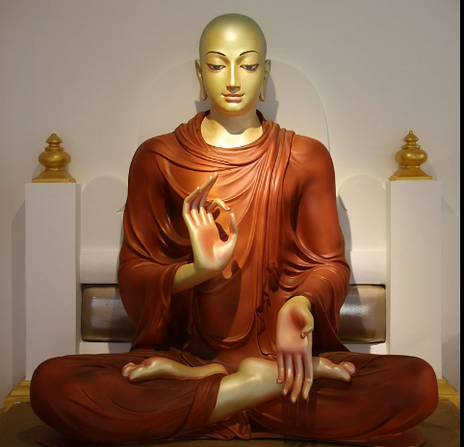
5.5 (Xuanzang's Heart Sutra, Lesson Five)
Line 4: 舍 利 子 色 不 異 空
sa ri ja saek bur i gong
Shariputra form not different emptiness
舍
人 舌
千 口
利
禾 刂
子
了 一
色
⺈ 巴
125
126
127
128
139
142
137
140
141
143
138
舍 sa (사); phonetic/lodging
舌 seol (설); tongue
千 cheon (천); thousand
十 shib (십); 10, ten
口 gu (구); mouth
利 li (리); phonetic; sharp; profit
禾 hwa (화); grain; cereal; rice
刂 do (도); blade
子 ja (자); master/son
了 yo (요); perfective aspect
一 il (일); 1, one
色 saek (색); form/color
⺈ do (도); knife; blade
巴 pa (파); a huge snake
不 bur/bu (불/부); not
異 i (이); different
空 gong (공); emptiness
https://en.wikipedia.org/wikiŚāriputra

Slide 7
5.6 (Xuanzang's Heart Sutra, Lesson Five)
Line 5: 空 不 異 色 色 即 是 空
gong bur i saek saek jeuk shi gong
emptiness not different form form same is emptiness
Line 6: 空 即 是 色
gong jeuk shi saek
emptiness same is form
異 i (이); different
田 jeon (전); farmland; field
共 gong (공); together
囗 wi (위); circle; encircle
十 shib (십); 10, ten
卄 ip (입); twenty, 20
一 il (일); 1, one
八 pal (팔); eight, 8
即 jeuk (즉); same; very close
日 il (일); sun; day; daily
厶 sa (사); self, private, secret
卩 jeol (절); seal
異
田 共
囗 十 卄 一 八
130
即
日 厶 卩
囗 一
131
144
145
147
148
146

Slide 8
5.7 (Xuanzang's Heart Sutra, Lesson Five)
度 (do, 도, meaning "save") appears ~40 times in the Ksitigarbha Sutra.
First great vow – obviously.
衆 生 無 邊 誓 願 度
jung saeng mu byeon seo won do
many beings without number vow save
Homage to the Three Jewels. But there it is only used for its phonetic value in the incense offering mantra:
唵 婆阿羅 度碑耶 吽
om ba a ra do bi ya hum
Xuanzang's Hymn to Maitreya:
唯願慈尊度有情
I only wish (唯願) that Maitreya (慈尊) will save (度) sentient beings (有情)
度 has three components: 广, 廿, 又.
Only one of these components is new: 廿
广 was the very first component in this course, because it is the first component of the first character in the title: 摩.
又 is a component of the third character in the title, 般. It's also a component of the fifth character in the title, 波, as well as well as four other characters in the Heart Sutra: 婆受聲復.
Which brings us to 廿, which is pronounced ip (입), and means twenty (20). In modern Korean this is rarely, if ever used. Instead, one would use 二十 (pronounced i-shib, 이십).

Slide 9
5.8 (Xuanzang's Heart Sutra, Lesson Five)
一 切 il che, 일체; all, each and every
The character 切 only appears in the Heart Sutra as part of the two character phrase 一切 (il che, 일체), which means "all", or "each and every".
We know that 一 just means "one". On its own,切 means either to "cut or slice with a knife" or "to be close to". This is a good example of a "binome" whose meaning is far from apparent just based on the meanings of the individual characters!!
Another interesting thing about 一切 is that in the Japanese version of the Heart Sutra this two-character combination occurs three times, whereas in all other versions (Chinese, Korean, and Vietnamese) it only occurs twice.
The "extra" occurrence in the Japanese version is found here (line 20):
遠 離 一 切 顚 倒 夢 想 究 竟 涅 槃
"Far apart from (遠 離)
every (一 切)
distortion (顚 倒)
delusion (夢 想)
finally at last nirvana (究 竟 涅 槃)"
The two components of 切 are 七 (chil, 칠), which is the number 7, and 刀 (do , 도), meaning "knife" or "blade". Only 七 is new.
In addition to 刀 (which is both a standalone and a component form) there two more component forms:
刂 found in 利 (li, 리), meaning "sharp" or "profit" and
⺈ found in 色 (saek, 색), meaning "form" or "color".

Slide 10
5.9 (Xuanzang's Heart Sutra, Lesson Five)
苦 = grass + old (艹+古)
艹 = cho (초); 古 = go (고)
艹: 若菩苦觀薩蘊夢藐
(䒑: 諦意識竟菩道)
古: 故苦舍
厄 = cliff + seal (厂 + 㔾)
厂 = han (한); 㔾 = jeol (절)
厂 (not 广): 厄波婆薩虛耨
㔾: 厄 (卩: 即)
"All suffering" (一 切 苦 ) occurs once near the beginning – and again near the end:
度 一 切 苦 厄 Line 3
save(d) (from) all suffering (and) distress
能除 一 切 苦 Line 26
able to relieve all suffering
能 = neung (능); be able to; can
能 = 厶 + 月 + 匕 + 匕
除 = je (제); to get rid of; remove
除 = 阝 + 亼 + 小

Slide 11
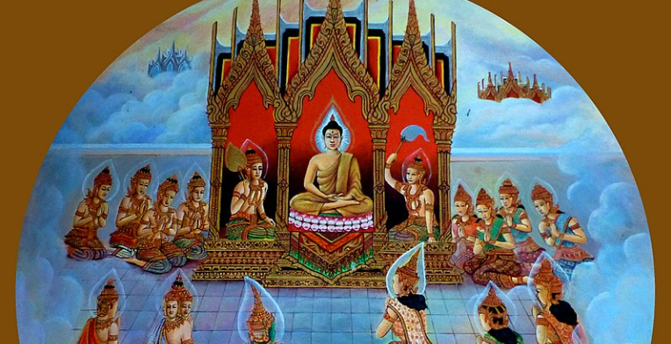
5.10 (Xuanzang's Heart Sutra, Lesson Five)
舍 利 子
g舍 (sa, 사; lodging) = 人 (in, 인; person) + 舌 (seol,설; tongue)
利 (li, 리; sharp) = 禾 (hwa, 화; grain) +刂 (do, 도; blade)
子 (ja, 자; master) = 了 (yo, 요; perfective) + 一 (il, 일; one)
The first two characters, 舍 利 , are used for their phonetic value: "sa ri". The third character, 子 (ja), is the traditional title given to honored teachers such as Confucius (孔子, gong-ja, "Master Gong"), and Mencius (孟子, maeng-ja, "Master Maeng").
The character usually translated into English as "profit" in the famous dialog between Mencius and King Hui of Liang is 利. Note the striking similarity between this dialog and the one between Bodhidharma and King Wu of Liang.
The king said, "Venerable sir, you have not considered a thousand li too far to come. Surely you have some means to profit our state?" Mencius replied: “Why must the king speak of profit? I have only teachings concerning humaneness and rightness. If the king says, 'How can I profit my state?' the officers will say, 'How can I profit my house?' and the gentlemen and the common people will say, 'How can I profit myself?' Those above and those below will compete with one another for profit, and the state will be imperiled.
[Mencius 1.1]
Image depicting the Buddha teaching the Abhidharma to his mother in Triastrimsa Heaven, which he would later dictate to Shariputra.
https://en.wikipedia.org/wiki/Śāriputra

Slide 12
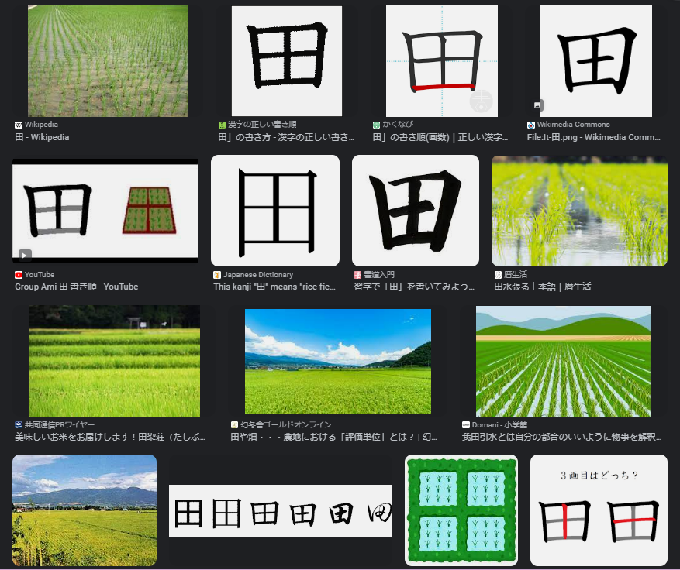
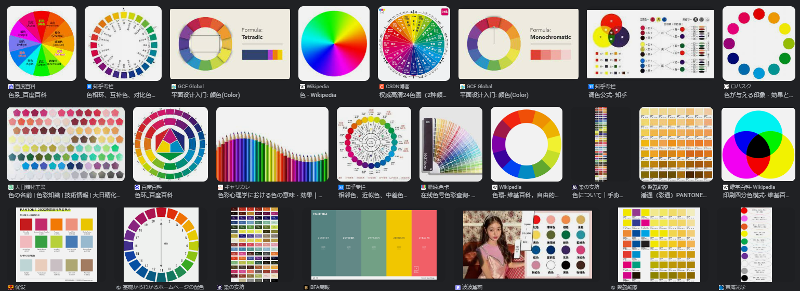
5.11 (Xuanzang's Heart Sutra, Lesson Five)
色 不 異 空, 空 不 異 色
色 (saek, 색; form, color) = ⺈(do, 도; blade) + 巴 (pa, 파; huge snake)
不 (bur/bu, 불/부; no, not)
異 (i, 이; different) = 田 (jeon, 전; field) + 共 (gong, 공; together)
Google image search on the character 田 (jeon, 전)
google image search on the character 色 (saek, 색)

Slide 13

5.12 (Xuanzang's Heart Sutra, Lesson Five)
色 即 是 空
空 即 是 色
大梅禪師曾問馬祖禪師：
「如何是佛？」
馬祖禪師答得快：
「即心即佛。」
The monk (曾)Great plum (大梅) asked (問) Majo Zen Master(馬祖禪師), "What is Buddha? (如何是佛)?"
Majo Zen Master (馬祖禪師) immediately gave this reply (答得快):
"Mind is Buddha (即心即佛)."
There is more than one way to say "mind is buddha":
"心即是佛" 679K hits
"即心即佛" 113K hits
"mind is buddha" 36.4K
"this mind is buddha" 6.4K
"this very mind is buddha" 1.9K
According to Paul W. Kroll's A Student's Dictionary of Classical and Medieval Chinese, 即 means:
"marks a noun or a verbal phrase as being exactly or precisely what is meant; exactly, precisely, just (so), the very …. (Budd.) 色 即 是 空, 空 即 是 色, "form is exactly emptiness, emptiness is exactly form," famous phrase from Heart Sutra.

Slide 14
5.13 (Xuanzang's Heart Sutra, Lesson Five)
觀 自 在 菩 薩 行 深 般 若 1
gwan ja jae bo sal practice deeply prajna
---------------------------------------------------------------------------------------------------------------------------
波 羅 蜜 多 時 照 見 五 蘊 皆 空 2
paramita when perceive five skandhas all empty
---------------------------------------------------------------------------------------------------------------------------
度 一 切 苦 厄 3
save all suffering distress
---------------------------------------------------------------------------------------------------------------------------
舍 利 子 色 不 異 空 4
Shariputra form not different emptiness
---------------------------------------------------------------------------------------------------------------------------
空 不 異 色 色 即 是 空 5
emptiness not different form form same is emptiness
---------------------------------------------------------------------------------------------------------------------------
空 即 是 色 6
emptiness same is form
Putting it all together: Lines 1 through 6.
"Avalokitesvara Bodhisattva when practicing deeply the Prajna Paramita perceives that all five skandhas are empty and is saved from all suffering and distress. Shariputra, form does not differ from emptiness, emptiness does not differ from form."
"When Bodhisattva Avalokiteshvara was practicing the profound Prajna Paramita, he illuminated the Five Skandhas and saw that they are all empty, and he crossed beyond all suffering and difficulty.
Shariputra, form does not differ from emptiness; emptiness does not differ from form. Form itself is emptiness; emptiness itself is form."
"Avalokiteshvara while practicing deeply with
the Insight that Brings Us to the Other Shore,
suddenly discovered that all of the five Skandhas are equally empty, and with this realization he overcame all Ill-being.
Listen Sariputra, this Body itself is Emptiness and Emptiness itself is this Body. This Body is not other than Emptiness and Emptiness is not other than this Body." [Thich Nhat Hanh]

Slide 15
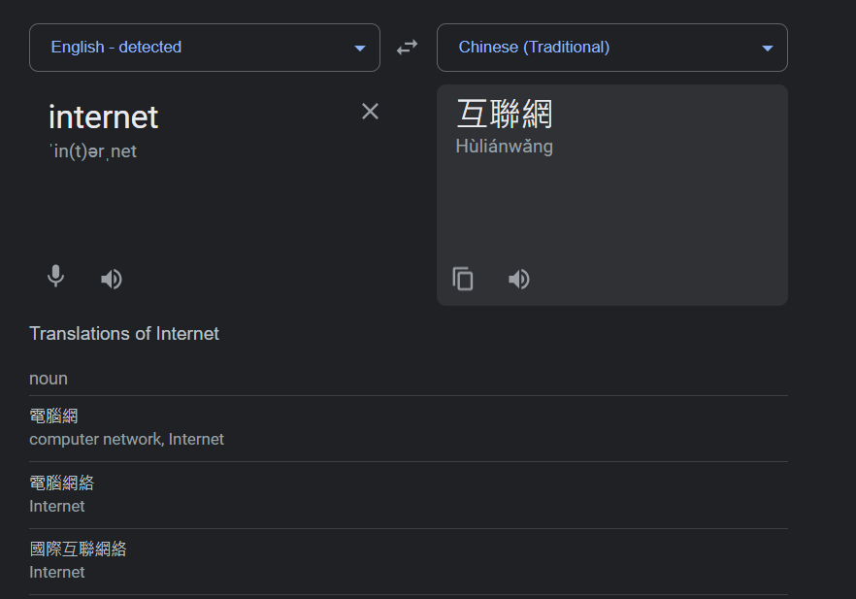
5.14 (Xuanzang's Heart Sutra, Lesson Five)
互 百
互 ho (호); mutual; mutually; reciprocally
百 baek (백); one hundred
• 互聯網 = internet (mutually connected web)
• 百 (100) = 一 + 白 (one + white)
HSK 2; JLPT N5
"how to say internet in Chinese" https://www.google.com/search?q=how+to+say+internet+in+chinese

Slide 16
5.15 (Xuanzang's Heart Sutra, Lesson Five)
Vocabulary for Lesson Five (NOTE: CCC = Chinese Character Cognates by Joon Geem)
度 do (도); go-over; ferry across; save (sentient beings) CCC 270
切 che/jeol (체/절); close to; eager, earnest, sincere CCC (002)
苦 go (고); suffering; bitter CCC 625
厄 aek (액); misfortune/distress CCC not found
舍 sa (사); phonetic/lodging CCC 618
利 li (리); phonetic; sharp; profit, benefit, advantage CCC 087
子 ja (자); master/son CCC 206
色 saek (색); form/color CCC 622
不 bur/bu (불/부); not CCC 006
異 i (이); different CCC 514
即 jeuk (즉); very close to, agree, conform, same CCC (572)
廿 ip (입); twenty, 20 CCC (501)
七 chil (칠); 7, seven CCC 002

Slide 17
5.16 (Xuanzang's Heart Sutra, Lesson Five)
Vocabulary for Lesson Five Continued (NOTE: CCC = Chinese Character Cognates by Joon Geem)
古 go (고); the past; ancient times; old CCC 128
十 shib (십); 10, ten CCC 107
㔾 jeol (절); variant form of 卩, xiān, seal CCC not found
舌 seol (설); tongue CCC 617
千 cheon (천); thousand CCC 108
禾 hwa (화); grain; cereal; rice plant CCC (087, 146, 210)
刂 do (도); blade CCC (080)
了 yo (요); perfective aspect; indicates change CCC not found
⺈ do (도); knife; blade CCC (115)
巴 pa (파); a huge snake that can swallow an elephant CCC (583)
田 jeon (전); farmland; field CCC 505
共 gong (공); together; adv. jointly; as a group CCC 072

Slide 18
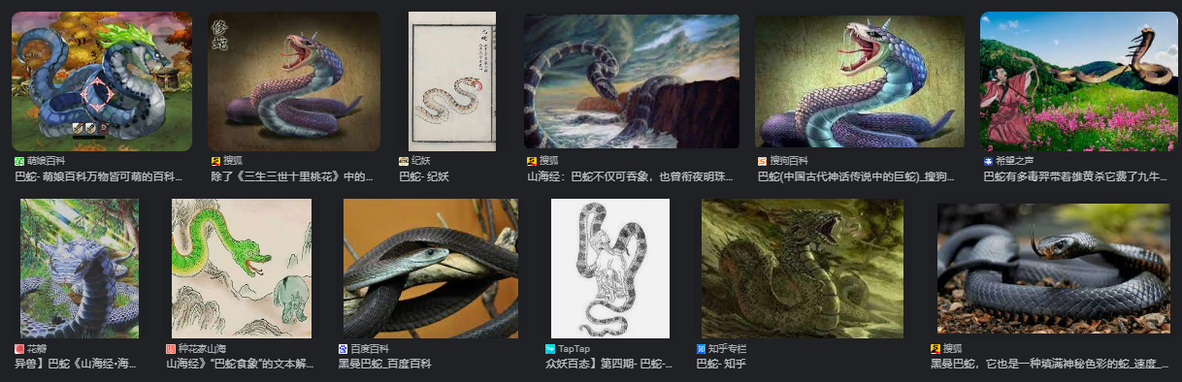
5.17 (Xuanzang's Heart Sutra, Lesson Five)
卄 ip (입); twenty, 20, variant form of 廿 CCC not found
厶 sa (사); self, private, secret CCC not found
卩 jeol (절); seal CCC (104)
互 ho (호); mutual CCC not found
百 baek (백); hundred CCC 519
巴
蛇
pa sa (파사)

