Slide 1
6.0 (Xuanzang's Heart Sutra, Lesson Six)
受 想 行 識 亦 復 如 是 7
su sang haeng shik yeok bu yeo shi (수상행식역부여시)
feelings, perceptions, impulses, consciousness, also originally like this
舍 利 子 是 諸 法 空 相 8
sa ri ja shi je beop kong sang (사리자시제법공상)
Shariputra, this all dharmas emptiness marked
不 生 不 滅 不 垢 不 淨 9
bul saeng bul myeol bul gu bu jeong (불생불멸불구부정)
not born, not destroyed, not tainted, not pure
2023 Mar 4 Apr 1
May 6 Jun 3
Jul 1 Aug 5
Sep 2 Oct 7
Nov 4 Dec 2
2024 Jan 6 Feb 3
Heart
Sutra
Lesson
Six
Class schedule:
3:00 to 3:35 pm
first session
--- 5 minute break ---
3:40 to 4:15 pm
second session
--- 10 minute break ---
4:25 to 5:00 pm
third session
In this lesson we cover
lines 7 though 9

Slide 2
6.1 (Xuanzang's Heart Sutra, Lesson Six)
The Big Picture
摩 訶 般 若 波 羅 蜜 多 心 經 Title
觀 自 在 菩 薩 行 深 般 若 1 乃 至 無 老 死 亦 無 老 死 盡 15
波 羅 蜜 多 時 照 見 五 蘊 皆 空 2 無 苦 集 滅 道 無 智 亦 無 得 以 16
度 一 切 苦 厄 3 無 所 得 故 菩 提 薩 埵 依 17
舍 利 子 色 不 異 空 4 般 若 波 羅 蜜 多 故 心 無 罣 礙 18
空 不 異 色 色 即 是 空 5 無 罣 礙 故 無 有 恐 怖 19
空 即 是 色 6 遠 離 顚 倒 夢 想 究 竟 涅 槃 20
受 想 行 識 亦 復 如 是 7 三 世 諸 佛 依 般 若 21
舍 利 子 是 諸 法 空 相 8 波 羅 蜜 多 故 得 阿 耨 多 羅 22
不 生 不 滅 不 垢 不 淨 9 三 藐 三 菩 提 故 知 般 若 23
不 增 不 減 是 故 空 中 無 色 10 波 羅 蜜 多 是 大 神 呪 24
無 受 想 行 識 無 眼 耳 鼻 舌 身 意 11 是 大 明 呪 是 無 上 呪 25
無 色 聲 香 味 觸 法 12 是 無 等 等 呪 能 除 一 切 苦 26
無 眼 界 乃 至 無 意 識 界 13 眞 實 不 虛 故 說 般 若 波 羅 蜜 多 27
無 無 明 亦 無 無 明 盡 14 呪 即 說 呪 曰 28
揭 諦 揭 諦 波 羅 揭 諦 波 羅 僧 揭 諦 菩 提 娑 婆 訶 Mantra
Months 1-3
Months 7-9
Months 4-6
We
Are
Here
Months 10-12
Months 7-9
Months 1-3

Slide 3
6.2 (Xuanzang's Heart Sutra, Lesson Six)
What new characters and components are being introduced in Lesson Six?
受 想 行 識 亦 復 如 是 7
su sang haeng shik yeok pu yeo shi (수상행식역부여시)
feelings, perceptions, impulses, consciousness, also originally like this
舍 利 子 是 諸 法 空 相 8
sa ri ja shi je beop kong sang (사리자시제법공상)
Shariputra, this all dharmas emptiness marked
不 生 不 滅 不 垢 不 淨 9
bul saeng bul myeol bul gu bu jeong (불생불멸불구부정)
not born, not destroyed, not tainted, not pure
受 su (수); feeling; to receive
想 sang (상); perception; to think
識 shik (식); consciousness; to know
亦 yeok (역); also; again
復 bu (부); to go and return; to return
如 yeo (여); as; as if; such as
諸 je (제); all
法 beop (법); dharma; thought; thing
相 sang (상); to each other; see for oneself
滅 myeol (멸); extinguish; destroy
垢 gu (구); impure, tainted
淨 jeong (정); pure

Slide 4
6.3 (Xuanzang's Heart Sutra, Lesson Six)
The twelve new characters also introduce 15 new components. And we'll also add three more characters to bring the total up to 30.
受 = 爫 + 冖 + 又
想 = 木 + 目 + 心
識 = 言 + 戠; 戠 = 音 + 戈; 戈 = 弋 + 丿
亦
復 = 彳 + 复; 复 = 𠂉 + 日 + 夂
如 = 女 + 口
諸 = 言 + 者; 者 = 耂 + 日
法 = 氵 + 去; 去 = 土 + 厶
相 = 木 + 目
滅 = 氵 + 烕; 烕 = 戌 + 火; 戌 = 戈+丿+一
垢 = 土 + 后
淨 = 氵 + 爭; 爭 = 爫 + 彐 + 亅
163. 爫 jo (조); nail/claw; dispute/fight/contend
164. 戠 shi (시); sword
165. 音 eum (음); sound; noise; musical note
166. 戈 gwa (과); dagger-ax/halberd, spear
167. 弋 ik (익); arrow attached to a string
168. 复 bok (복); repeat; double; overlap
169. 夂 chi (치); to go; walk slowly
170. 者 ja (자); (this)
171. 耂 no (노); old
172. 去 geo (거); to go; to go to (a place)
173. 烕 myeol (멸); extinguish; destroy
174. 戌 sul (술); dog (zodiac); eleventh of the twel
175. 后 hu (후); ruler; king; emperor
176. 爭 jaeng (쟁); fight; contend; strive
177. 彐 gye (계); snout;pig-head;pig-snout
178. 今 geum (금); now; at present; this
179. 从 jong (종); follow; from
180. 坐 jwa (좌); to sit; to take a seat; to take (a

Slide 5
6.4 (Xuanzang's Heart Sutra, Lesson Six)
151
152
受 想 識
爫 冖 又 木 目 心 言 戠
囗 二 亠 二 口 音 戈
立 日 弋 丿
153
163
164
165
166
167
受 su (수); feeling
爫 jo (조); nail/claw
冖 myeok (멱); cover
又 u (우); again
想 sang (상); perception
木 mog (목); tree
目 mok (목); eye
心 shim (심); heart/mind
囗 wi (위); enclosure
二 i (이); 2, two
識 shik (식); consciousness
言 eon (언); words, speech
戠 shi (시); sword
亠 du (두); lid
口 gu (구); mouth
音 eum (음); sound; noise
戈 gwa (과); halberd
立 rib (립); stand
日 il (일); sun; day
弋 ik (익); to shoot; arrow
丿byeol (별); left falling stroke

Slide 6
6.5 (Xuanzang's Heart Sutra, Lesson Six)
亦 復 如 諸
亠 小* 丿 彳 复 女 口 言 者
𠂉 日 夂 亠 二 口 耂 日
155
154
156
157
168
170
171
169
亦 yeok (역); again
復 bu (부); return
彳 cheok (척); step
复 bok (복); repeat
𠂉 in (인); person
日 il (일); sun
夂 chi (치); to go
者 ja (자); "that which"
耂 no (노); old
如 yeo (여); as if
女 yeo (여); female
口 gu (구); mouth
諸 je (제); all
言 eon (언); words, speech
者 ja (자); "that which"
亠 du (두); lid
二 i (이); two (2)
耂 no (노); old

Slide 7
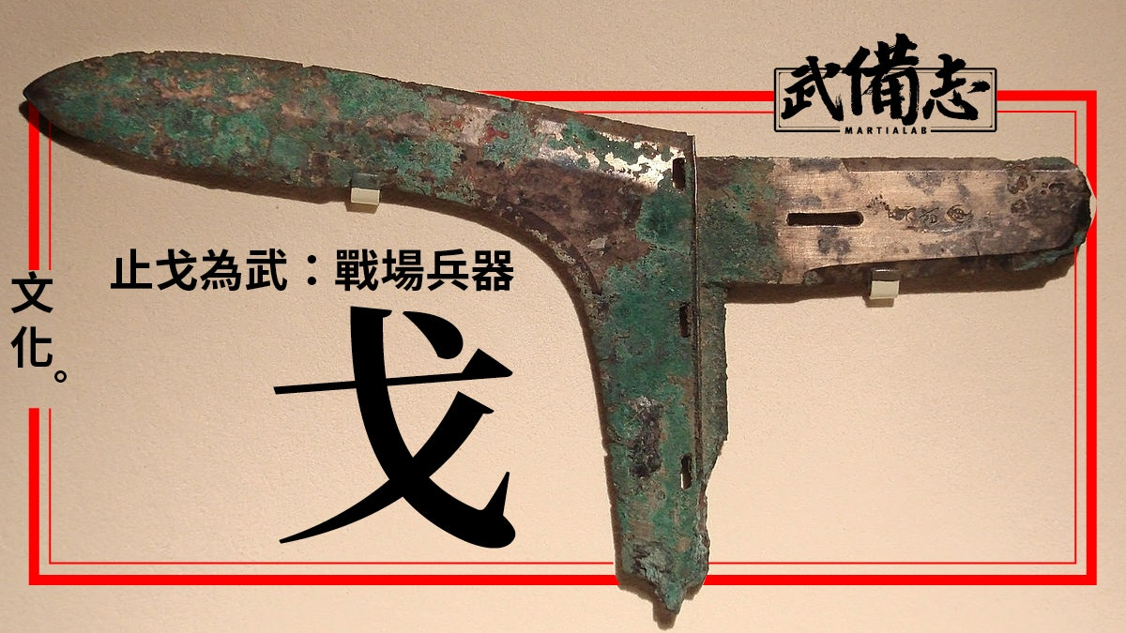
6.6 (Xuanzang's Heart Sutra, Lesson Six)
法 相 滅
氵 去 木 目 氵 烕
土 厶 戌 火
戈 丿 一
158
159
160
158
173
174
法 beop (법); dharma
相 sang (상); characteristic
滅 myeol (멸); extinguish
氵 su (수); water
去 geo (거); to go
土 to (토); earth
厶 sa (사); secret
木 mog (목); tree
目 mog (목); eye
烕 myeol (멸); extinguish
戌 sul (술); dog (zodiac)
火 hua (화); fire
戈 gwa (과); halberd
丿 byeol (별); left falling stroke
一 il (일); 1, one
https://www.hk01.com/武備志/352194/武器-一種沒落了的戰場兵器-戈

Slide 8
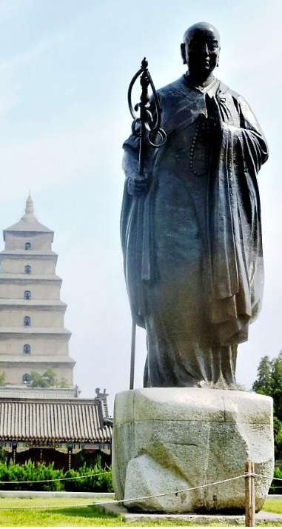
6.7 (Xuanzang's Heart Sutra, Lesson Six)
垢 淨
土 后 氵 爭
𠂋 口 爫 彐 亅
161
161
175
176
*
177
垢 gu (구); tainted, impure
土 to (토); earth
后 hu (후); ruler, king
淨 jeong (정); pure
氵 su (수); water
爭 jaeng (쟁); fight
爫 jo (조); nail/claw
彐 gye (계); snout
亅 gweol (궐); hook
Photo by John Hill
From: https://en.wikipedia.org/wiki/Xuanzang

Slide 9
6.8 (Xuanzang's Heart Sutra, Lesson Six)
178
179
180
今 从 坐
人 丶 ㇇ 人 人 土 从
㇇
1st stroke in 又
2nd stroke in 夕
2nd stroke in 水
3rd stroke in 永
4th stroke in 今
It is written as a single stroke, without lifting the pen, but it can also be considered a combination of two strokes, a horizontal left to right stroke, followed by a curving stroke down and to the left.
*
今 geum (금); now; at present; this
人 in (인)
丶 ju (주); alt. of 主
㇇ no pronunciation
从 jong (종); follow; from
坐 jwa (좌); to sit; take a seat
土 to (토)

Slide 10
6.9 (Xuanzang's Heart Sutra, Lesson Six)
Review characters:
受 想 行 識 亦 復 如 是 7
su sang haeng shik yeok pu yeo shi (수상행식역부여시)
feelings, perceptions, impulses, consciousness, also originally like this
舍 利 子 是 諸 法 空 相 8
sa ri ja shi je beop kong sang (사리자시제법공상)
Shariputra, this all dharmas emptiness marked
不 生 不 滅 不 垢 不 淨 9
bul saeng bul myeol bul gu bu jeong (불생불멸불구부정)
not born, not destroyed, not tainted, not pure
摩 訶 般 若 波 羅 蜜 多 心 經 Title
觀 自 在 菩 薩 行 深 般 若 1
波 羅 蜜 多 時 照 見 五 蘊 皆 空 2
度 一 切 苦 厄 3
舍 利 子 色 不 異 空 4
空 不 異 色 色 即 是 空 5
空 即 是 色 6
揭 諦 揭 諦 波 羅 揭 諦 波 羅 僧
揭 諦 菩 提 娑 婆 訶 Mantra
生 was already introduced as a component of 薩 in Lesson 4

Slide 11
6.10 (Xuanzang's Heart Sutra, Lesson Six)
Review Components
冖 又 木 目 心
囗 二 言 亠 一
丶 口 立 日 丿
丷 䒑 彳 𠂉 女
人 土 氵 厶 火
摩 訶 般 若 波 羅 蜜 多 心 經 Title
觀 自 在 菩 薩 行 深 般 若 1
波 羅 蜜 多 時 照 見 五 蘊 皆 空 2
度 一 切 苦 厄 3
舍 利 子 色 不 異 空 4
空 不 異 色 色 即 是 空 5
空 即 是 色 6
揭 諦 揭 諦 波 羅 揭 諦 波 羅 僧
揭 諦 菩 提 娑 婆 訶 Mantra
myeok; cover u; again mok; tree mok; eye shim; mind
wi; circle i; two eon; words du; lid il; one
ju; lord gu; mouth rib; stand li; sun byeol; slash
pal; eight cho; grass cheok; step in; person yeo; female
Only these six previous characters don't have at least one component that is in this lesson: 多 切 厄 利 色 不
in; person to; earth su; water sa; secret hua; fire

Slide 12
6.11 (Xuanzang's Heart Sutra, Lesson Six)
Hats:
亠 爫 冖 宀 艹 丷 䒑
Legs:
女 儿 八 灬 巾 丶
Single strokes:
亅 丿 一 丶 ㇀ ㇇
du; lid jo; claw myeok; cover myeon; roof cho; grass pal; eight cho; grass
yeo; female in; person pal; eight hua; fire geon; kerchief ju; lord
gweol; hook byeol; slash il; one ju; lord rising stroke left falling stroke

Slide 13
6.12 (Xuanzang's Heart Sutra, Lesson Six)
戈 is radical #62.
It is a component of two characters in this lesson: 識 (shik; consciousness), and 滅 (myeol; destroy)
It is made by combining 弋 (ik; arrow; radical #56) with 丿 (byeol; slash; radical #4)
弋 ik arrow
戈 gwa halberd (24 characters with this radical in Kroll's dictionary)
戌 sul dog
戠 shi sword
烕 myeol destroy (very rare)
滅 myeol destroy
識 shik consciousness; to know (不識 – Bodhidharma)
減 gam decrease (line 10 – Lesson 7)
咸 ham all, completely; 31st Hexagram of I Ching
我 a I, me, self (Kanzeon: 常樂我淨; jo raku ga jo: eternity, joy, self, purity)
成 seong accomplish (佛道無上誓願成; bul do mu sang seo won seong; Buddha Way unsurpassed vow accomplish)

Slide 14
6.13 (Xuanzang's Heart Sutra, Lesson Six)
Single line Two lines
戠 戠 戠 戠 戠
DengXian Batang KaiTi MS Mincho Microsoft JengHei

Slide 15
6.14 (Xuanzang's Heart Sutra, Lesson Six)
受 想 行 識 亦 復 如 是 7
su sang haeng shik yeok bu yeo shi (수상행식역부여시)
feelings, perceptions, impulses, consciousness, also originally like this
受 su (수) feelings
想 sang (상) perceptions
行 haeng (행) impulses
識 shik (식) consiousness
亦 yeok (역) also
復 bu (부) after all
如 yeo (여) like
是 shi (시) this
5
空 gong emptiness
不 bu not
異 i different
色 saek form
色 saek form
即 jeug same
是 shi is
空 gong emptiness
6
空 gong emptiness
即 jeug same
是 shi is
色 saek form

Slide 16
6.15 (Xuanzang's Heart Sutra, Lesson Six)
舍 利 子 是 諸 法 空 相 8
sa ri ja shi je beop kong sang (사리자시제법공상)
Shariputra, is all dharmas emptiness marked
舍 sa
利 ri
子 ja Shariputra
是 shi is
諸 je all
法 boep dharmas
空 gong emptiness
相 sang marked
From the Digital Dictionary of Buddhism entry on 法 Dharma:
• Rendered into English variously according to the context as: truth, reality; phenomenon, element, constituent, (mental) factor; things, quality (Tib. chos; Pāli dhamma). The word dharma is originally derived from the Indic root dhr, with the meaning of "that which preserves or maintains," especially that which preserves or maintains human activity…..
• It is used in the sense of 一切 all things, or anything small or great, visible or invisible, real or unreal, affairs, truth, principle, method, concrete things, abstract ideas, etc. Dharma is described as that which has entity and bears its own attributes.
Entry for 相
A characteristic; an attribute, a mark; distinctive feature (Skt. lakṣaṇa; Tib. mtshan nyid). A perceptual quality, a perceptual form, a sign; defining attribute (Skt. nimitta; Tib. mtshan ma). Perceptual image (Skt. ākāra; Tib. rnam pa). [Charles Muller; source(s): Yokoi, Stephen Hodge, JEBD]

Slide 17
6.16 (Xuanzang's Heart Sutra, Lesson Six)
不 生 不 滅 不 垢 不 淨 9
bul saeng bul myeol bul gu bu jeong (불생불멸불구부정)
not born, not destroyed, not tainted, not pure
不 bul (불) not
生 saeng (생) appear
不 bul (불) not
滅 myeol (멸) disappear
不 bu (불) not
垢 gu (구) tainted
不 bu (부) not
淨 jeong (정) pure
10
不 bu not
增 jeung increase
不 bu not
減 gam decrease
是 shi is
故 go therefore
空 gong emptiness
中 jung in the midst of
無 mu no
色 saek form
11
無 mu no
受 su feelings
想 sang perceptions
行 haeg impulses
識 shik consciousness

Slide 18
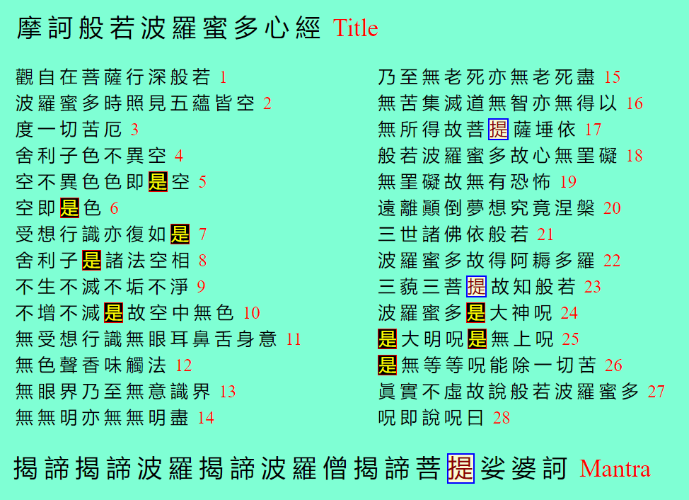
6.17 (Xuanzang's Heart Sutra, Lesson Six)
是 (shi) occurs nine times in the Heart Sutra. It also shows up as a component of 提 (ji/ri) three times.

Slide 19
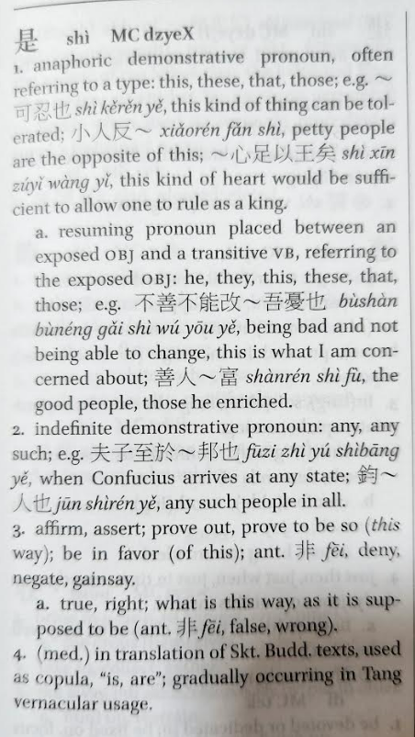
6.18 (Xuanzang's Heart Sutra, Lesson Six)
Sometimes 是 means "is", and sometimes it means "this". BUT both "is" and "this" can mean different things!
In Chinese, 是 is primarily a "anaphoric demonstrative pronoun". This means that 是 refers back to something already mentioned. As in "feelings, perceptions, impulses, and consciousness are also like THIS."
But Buddhist translators also used 是 as a "copula", which means a word that it links (aka a "linking verb") the subject of a sentence to a "subject complement", as in "The loving father of the four kinds of beings IS our root teacher, Shakyamuni Buddha" (四生慈父是我本師釋迦牟尼佛 sa saeng ja bu shi a bon sa seo ga mu ni bul).
Many Chinese language experts believe that prior to the medieval period 是 only meant "this" and never "is".
Paul W. Kroll's A Student's Dictionary of Classical and Medieval Chinese

