Slide 1
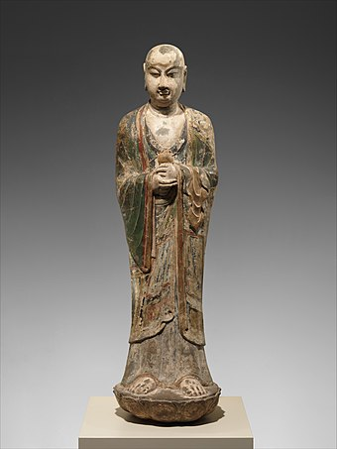
HS.0 (The Heart Sutra)
What the heck IS the Heart Sutra?
What kind of a Sutra is it??
What does "Sutra" actually mean???
IS the Heart Sutra really a Sutra????
For starters, the Heart Sutra does not start with Ananda saying "Thus have I heard"!
Pali: Evaṃ me sutaṃ;
Sanskrit: Evaṃ mayā śrūtaṃ;
Chinese: 如是我聞;
Sino-Korean: yeo si a mun, 여시아문
https://en.wikipedia.org/wiki/Thus_have_I_heard

Slide 2
HS.1 (The Heart Sutra)
But there are other "Sutras" that do not begin with "Thus have I heard" and are not the direct words of Shakyamuni Buddha as recounted by Ananda:
• The Platform Sutra
• The Kanzeon Sutra
• The Thousand Hands and Eyes Sutra
• Dogen's "Mountains and Waters Sutra"
Sutra. A sutra normally contains the sermons of a buddha or a buddha’s disciples. Although no one knows who bestowed such a distinction on this text, it is the only Chinese Buddhist text that has been so honored. This is also an indication of the extent to which Hui-neng’s followers went to elevate their master’s teachings above the teachings of all other Chinese Buddhists.
The Platform Sutra, Commentary and translation by Red Pine, Counterpoint Publishers, p. 73

Slide 3
HS.2 (The Heart Sutra)
Yet more on the Platform "Sutra"
One of the most important Masters in the history of Zen was Hui-neng, an uneducated layman who did not become a monk until many years after he was given transmission to become the Sixth Patriarch. Hui-neng’s teachings have been so admired that they have been entitled the Platform Sutra (also known as the Altar Sutra) although strictly speaking a sutra is supposed to represent the words of the historical Buddha Shakyamuni.
[Zen Sourcebook, Aldiss, et al, p. 19
https://hackettpublishing.com/zen-sourcebook]
Prior to the Platform Sutra we have no instance in which a work which was merely the record of the career and sermons of a certain Master is given the name Sutra. Strictly speaking, of course, it is not one. Thus Ch'i-sung took pains to justify its classification as such: "Ta-chien chih-jen [Hui-neng]," he writes, "was a Bodhisattva monk, and his preaching of the Platform Sutra is basically no different from the Buddha's preaching of the sutras"
[Philip B. Yampolsky translation, p. 125
Columbia University Press 1967]

Slide 4
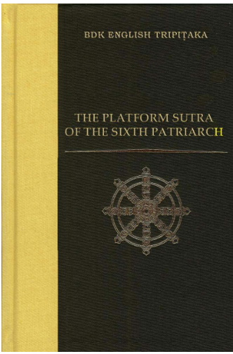
HS.3 (The Heart Sutra)
just one more ……
"The text that is translated here, of course, is the mature version of the text, a composite of Yuan dynasty editions. It is substantially longer than the Dunhuang version; at one point its editor admits freely to adding dialogues and clarifications not in any of the texts he worked from. In addition to these accretions, this version of the Platform Sutra is notable for its elaborate set of opening and closing flourishes—an encomium by the famous Qisong (1007–1072) and epitaphs by the Tang literati-officials Liu Zongyuan and Liu Yuxi being the most significant. It is interesting to note the extent to which these figures accept the image of Huineng presented in the text as a historical certainty, as well as the efforts they take to justify the nontransmission of the robe and bowl to Huineng’s successors. Even more ironic, perhaps, are the efforts by Qisong and the editor Zongbao to qualify the Platform Sutra as equivalent to scriptures spoken by the Buddha, but at the same time to suggest that it is somehow other than the 'words' to which the First Patriarch, Bodhidharma, said we must not cling."
[John R. McRae, from his Introduction, p. xvi]
The Platform Sutra of the Sixth Patriarch
Translated by John R. Mcrae, BDK America, Inc. 2000

Slide 5
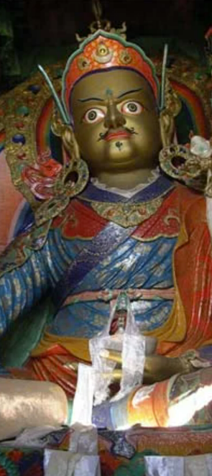
HS.4 (The Heart Sutra)
The Tibetan version of the Heart Sutra
"Thus did I hear at one time. The Bhagavan was dwelling on Mass of Vultures Mountain in Rajagriha together with a great community of monks and a great community of bodhisattvas. At that time, the Bhagavan was absorbed in the concentration on the categories of phenomena called "Profound Perception."
Also, at that time, the bodhisattva mahasattva arya Avalokiteshvara looked upon the very practice of the profound perfection of wisdom and beheld those five aggregates also as empty of inherent nature.
"Then, through the power of Buddha, the venerable Shariputra said this to the bodhisattva mahasattva arya Avalokiteshvara: "How should any son of the lineage train who wishes to practice the activity of the profound perfection of wisdom?"
Padmasambhava, statue in the Hemis Monastery, Ladakh union territory, India.
https://www.britannica.com/biography/Padmasambhava

Slide 6
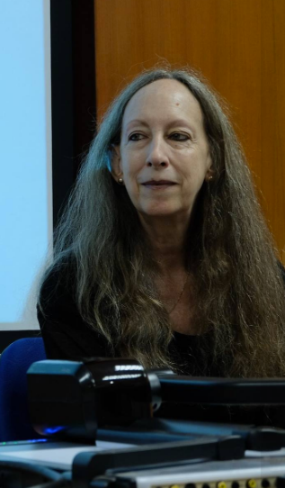
HS.5 (The Heart Sutra)
Which came first: the Chinese or the Sanskrit??
"It was around 1989, and I was teaching about the Prajñāpāramitā Sutras for the first time to students at the University of Hawaii. The paper that I wrote on the Heart Sutra came about completely by accident. Specifically, it was triggered by what happened when I was teaching my students about the Large Sutra and the Heart Sutra in the Prajñāpāramitā texts. One night, I was studying both the Sanskrit and Chinese versions of the Large Sutra [the Pañcaviṃśatisāhasrikā Prajñāpāramitā, or Perfection of Wisdom in Twenty-five Thousand Lines] and the Heart Sutra, and I noticed for the first time that the core section of the Heart Sutra was in both sutras, and that in the two Chinese texts the wording matched almost exactly. But in the Sanskrit versions of both sutras, though the content was the same, the wording was completely different. In other words, the Chinese texts aligned, but the Sanskrit texts did not…..
"Because of this experience, when I looked carefully at the Chinese and Sanskrit texts I knew immediately that the Sanskrit version of the Heart Sutra was a back-translation [from Chinese]…. I had never planned to do work on the Heart Sutra at all. But I instantly knew what had happened. I was totally stunned! I had never imagined anything like this, and I certainly hadn’t gone looking for it."
From an interview with Jan Nattier in Frederick Schodt's My Heart Sutra (pp. 102-103)

Slide 7
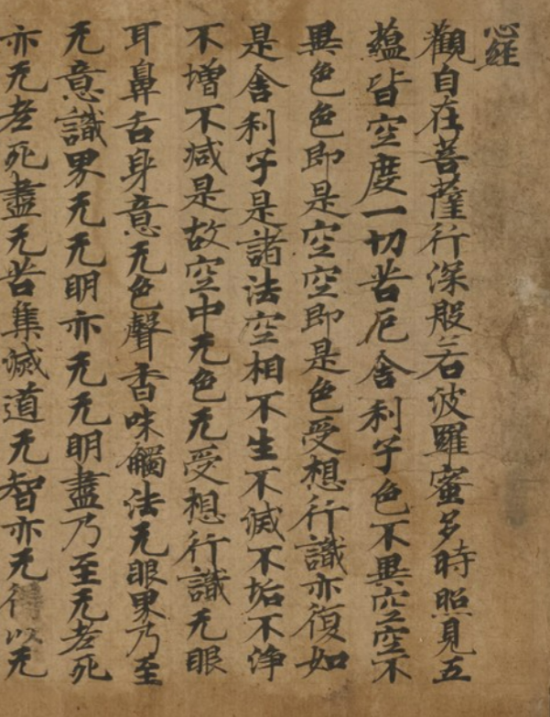
HS.6 (The Heart Sutra)
"The shorter Heart Sutra consists of three sections: (1) a brief introduction, in which the perspective of the bodhisattva Avalokitesvara on the emptiness of the five skandhas (based on his practice of the Perfection of Wisdom) is introduced; (2) a core, in which Avalokitesvara (the implied speaker, though his name does not appear in this section) addresses a series of observations to the elder (sthavira) Sariputra, beginning with the well-known affirmation of the non-difference between form and emptiness and culminating in a series of negations countering virtually all the most basic categories of Buddhist analysis of the person, the nature of causality, and the path; and (3) a conclusion, in which the bodhisattva who relies on the Perfection of Wisdom is described, the Perfection of Wisdom is touted as the basis for the enlightenment of all buddhas, and the well known mantra (gate gate paragate parasamgate bodhi svaha) is recommended as a means to eliminating all suffering. The sutra concludes with the mantra itself, which in all non-Sanskrit versions of the text is maintained in its Indian form (that is, it is transliterated rather than translated)."
[Nattier, 1992, The Heart Sutra: A Chinese Apocryphal Text?]
Heart Sutra calligraphy attributed to Kukai (Kobo Daishi, 774-835)
https://artmuseum.princeton.edu/collections/objects/84975

Slide 8
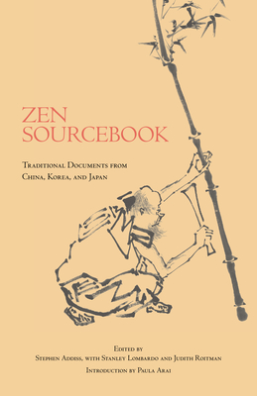
HS.7 (The Heart Sutra)
Not a Sutra, "per se"?
"The Heart Sutra is arguably the fundamental text of East Asian Buddhism. It has been enormously influential, and it is chanted as part of daily practice in virtually all Zen temples. It was long thought to have been a section or an abbreviation of the 600-volume Sanskrit Perfection of Wisdom Sutra. A recent study by Jan Nattier suggests that the Heart Sutra was actually composed in China, probably in the seventh century, and later translated into Sanskrit. Although the center section was indeed taken from the Perfection of Wisdom Sutra, the beginning and end seem to have been originally written in Chinese, leading to a genuine Sanskrit mantra at the close. This text may have been originally intended for chanting as a scripture, rather than composed as a sutra per se, but known as the "Heart Sutra" it has become a major inspiration for many Buddhist sects."
[ Zen Sourcebook, Aldiss, et al, p. 3]
Zen Sourcebook:
Traditional Documents from China, Korea, and Japan
Edited by Stephen Addiss
With Stanley Lombardo and Judith Roitman
https://hackettpublishing.com/zen-sourcebook

Slide 9
HS.8 (The Heart Sutra)
But maybe it's not really that complicated.
Everyone agrees that the "core" of the Heart Sutra consists of quotations found in the much longer Prajna Paramita Sutras (which Mahayana Buddhists accept as "real" Sutras).
And there are many examples where parts of one Sutra are taken out and designated as a separate "Sutra" on its own:
• The 25th Chapter of the Lotus Sutra is often called the "Avalokitesvara Sutra".
• Several chapters of the Avatamsaka Sutra are referred to as separate Sutras:
Ten Stages Sutra, Manifestations of the Tathagata Sutra, etc
• The Mahāratnakūṭa Sūtra is actually a compilation of 49 different Sutras.
Longer Sukhāvatīvyūha Sūtra, Śrīmālādevī Siṃhanāda Sūtra, etc

Slide 10
HS.9 (The Heart Sutra)
Also, it's very clear that the Chinese word for "Sutra" has multiple possible meanings, even for Buddhists.
As already mentioned, Zen Buddhists matter-of-factly assert that a written work attributed to Hui Neng is a Sutra, even though it obviously is not the words of Shakyamuni Buddha (not to mention that it might very well not the words of Hui Neng either!)
But it's not just the Platform Sutra. Buddhists do not object to the title of the "Kanzeon Sutra", nor to the title of the "Thousand Hands and Eyes Sutra". This indicates that the phenomenon of intentionally elevating the status of a revered text by calling it a "Sutra" is not limited to the Platform Sutra.
In fact, throughout the history of Chinese Buddhism a large number of texts that many believe were composed in Chinese hundreds of years after the death of the Buddha have been given the title of Sutra. In a great many cases these texts have eventually been weeded out and they have come to be referred to as "apocryphal" or even "spurious" or simply "not authentic". There is a long history of this – long predating so-called "modern" scholarship.
Other important examples of texts that are widely thought to be of later, Chinese (or in at least one notable case, Korean) origin include (1) The Vajrasamadhi Sutra, (2) The Sutra of Perfect Enlightenment, (3) The Sutra of Forty Two Sections, (4) The Shurangama Sutra, (5) the Brahma's Net Sutra, (6) the Blood Bowl Sutra, and (7) the Amitāyurdhyāna Sūtra (aka, the Visualization Sutra).

Slide 11
HS.10 (The Heart Sutra)
From Kroll's "A Student's Dictionary of Classical and Medieval Chinese", entry for 經:
1. the warp threads in weaving …. hence, basic framework on which to construct organization
2. guideline, norm, standard; guiding principle
3. classic(s), canon(s), foundational texts recognized as incorporating the basic teachings and providing stable shape to civilization and culture, in early times numbered 5 [五經] but by Tang times 9 were the main texts used on civil service exam….
(a) Buddhism: sutra(s), the scriptures supposedly spoken by the Buddha, all of which begin with "Thus have I heard" ….
(b) Daoism: scriptures, sacred and pre-cosmic texts issuing from the void and formed from primordial qì (氣), transcribed into celestial script by the divinities and eventually revealed in vulgar human script to select persons.
4. align, regularize, arrange, organize…….
5. meridians, north-south orientation of route or area.
5a. basic circulatory channels or conduits of qì (氣) ….
易經 I Ching
書經 Classic of Documents
禮經 Book of Rites
樂經 Classic of Music
道德經 Tao Te Ching
山水経 Mountains and Waters Sutra (Dogen)

Slide 12

HS.11 (The Heart Sutra)
Sarah Mattice on “Exploring the Heart Sutra as a Chinese Text”
https://www.youtube.com/watch?v=vxcfIuoHj1Q
Jan Nattier: The Proto-History of Buddhist Translation: From Gāndhārī and Pāli to Han-Dynasty Chinese
https://www.youtube.com/watch?v=aCCkA12ynLs
Also a nice but longish blog post by Jayarava Attwood on the "Japanese Reception of the Chinese Origins Thesis":
https://jayarava.blogspot.com/2017/11/japanese-reception-of-chinese-origins.html
And here's a link to Jan Nattier's original 1992 article:
https://journals.ub.uni-heidelberg.de/index.php/jiabs/article/viewFile/8800/2707
Sarah Mattice
(University of North Florida)

Slide 13
HS.12 (The Heart Sutra)
title
core, continued
The Maha Prajna Paramita Hrdaya Sutra
Avalokitesvara Bodhisattva
when practicing deeply the Prajna Paramita
perceives that all five skandhas are empty
and is saved from all suffering and distress.
Shariputra, form does not differ from emptiness,
emptiness does not differ from form.
That which is form is emptiness,
that which is emptiness form.
The same is true of feelings,
perceptions, impulses, consciousness.
Shariputra, all dharmas are marked with emptiness;
they do not appear or disappear,
are not tainted or pure,
do not increase or decrease.
Therefore, in emptiness no form, no feelings,
perceptions, impulses, consciousness.
No eyes, no ears, no nose, no tongue, no body, no mind;
no color, no sound, no smell, no taste, no touch,
no object of mind;
no realm of eyes
and so forth until no realm of mind consciousness.
No ignorance and also no extinction of it,
and so forth until no old age and death
and also no extinction of them.
No suffering, no origination,
no stopping, no path, no cognition,
also no attainment with nothing to attain.
The Bodhisattva depends on Prajna Paramita
and the mind is no hindrance;
without any hindrance no fears exist.
Far apart from every deluded view one dwells in Nirvana.
In the three worlds
all Buddhas depend on Prajna Paramita
and attain Anuttara Samyak Sambodhi.
Therefore, know that Prajna Paramita
is the great transcendent mantra,
is the great bright mantra,
is the utmost mantra,
is the supreme mantra,
which is able to relieve all suffering
and is true, not false.
So proclaim the Prajna Paramita mantra,
proclaim the mantra which says:
gate gate paragate parasamgate bodhi svaha
introduction
conclusion
core
mantra

Slide 14
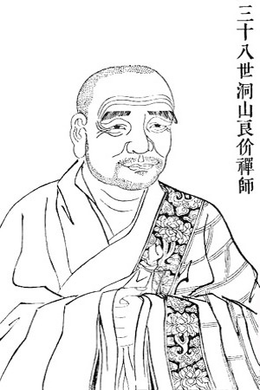
HS.13 (The Heart Sutra)
Dongshan and the Heart Sutra
洞山
Dòngshān
동산
Dongsan
The Master, whose personal name was Liang-chieh, was a member of the Yu family of Kuei-chi. Once, as a child, when reading the Heart Sutra with his tutor, he came to the line, "There is no eye, no ear, no nose, no tongue, no body, no mind." He immediately felt his face with his hand, then said to his tutor, "I have eyes, ears, a nose, a tongue, and so on; why does the sutra say they don't exist?" This took the tutor by surprise, and, recognizing Tung-shan's uniqueness, he said, "I am not capable of being your teacher." From there the Master went to Wu-hsieh Mountain, where, after making obeisance to Ch'an Master Mo, he took the robe and shaved his head. When he was twenty-one he went to Sung Mountain and took the Complete Precepts.
Dongshan Liangjie
(洞山良价, 807-869)
https://en.wikipedia.org/wiki/Dongshan_Liangjie

Slide 15
HS.13 (The Heart Sutra)
The Great Bright Mantra:
The Heart of the Heart Sutra
What the heck IS the Heart Sutra Mantra?
What kind of a Mantra is it??
What does "Mantra" actually mean???
IS the Heart Sutra Mantra really a Mantra????

Slide 16
HS.14 (The Heart Sutra)
The Bodhisattva depends on Prajna Paramita
and the mind is no hindrance;
without any hindrance no fears exist.
Far apart from every deluded view one dwells in Nirvana.
In the three worlds
all Buddhas depend on Prajna Paramita
and attain Anuttara Samyak Sambodhi
Therefore know that Prajna
Paramita is the great
transcendent mantra,
is the great bright mantra,
is the utmost mantra
is the supreme mantra,
which is able to relieve all suffering
and is true, not false.
So proclaim the Prajna Paramita
proclaim the mantra which says:
a je a je ba ra a je
ba ra seung a je mo ji sabaha
go ji ban ya
ba ra mil ta shi great
shin ju
shi dae myeong ju,
shi mu sang ju
shi mu deung deung ju
neung je il che go
jin shil bur heo
go seol ban ya ba ra mil ta
ju jeuk seol ju wal
a je a je ba ra a je
ba ra seung a je mo ji sabaha
故 知 般 若
波 羅 蜜 多 是 大
神 呪
是 大 明 呪
是 無 上 呪
是 無 等 等 呪
能 除 一 切 苦
眞 實 不 虛
故 說 般 若 波 羅 蜜 多
呪 即 說 呪 曰
揭 諦 揭 諦 波 羅 揭 諦
波 羅 僧 揭 諦 菩 提 娑 婆 訶

Slide 17
HS.15 (The Heart Sutra)
Devanagari:
गते गते पारगते पारसंगते बोधि स्वाहा
International Alphabet of Sanskrit Transliteration
gate gate pāragate pārasaṃgate bodhi svāhā
Hanja:
揭 諦 揭 諦 波 羅 揭 諦 波 羅 僧 揭 諦 菩 提 娑 婆 訶
Romaji (Sino-Japanese):
gya tei gya tei hara gya tei hara so gya tei bo ji so wa ka
Romaja (Sino-Korean):
a je a je ba ra a je ba ra seung a je mo ji sa ba ha
Hangeul:
아 제 아제 바 라 아 제 바 라 승 아 제 모 지 사 바 하

Slide 18
HS.16 (The Heart Sutra)
On Mantras and Buddhism
Mantras are very old – much older than Buddhism.
There are Jain Mantras, Sikh mantras, and also mantras in all the different varieties of "Hinduism".
Sometimes Buddhists try to avoid using the word mantra. Theravada Buddhists do not use the word at all, except when they are saying that they don't use them. And yet chanting practice is central to Theravada Buddhism. And many of these chants are done repeatedly, one could say in a mantra-like fashion. And these "Paritta" chants are done specifically for the purpose of obtaining "protection and blessings".
In Sanskrit there is also the word "japa" which literally means something like "mutter". In practice it is used to refer to repeating something (ie, a "mantra") over and over. It often implies that one is keeping count of how many times you are repeating whatever it is.
Unlike "mantra", the Sanskrit word "dharani" is only found in Mahayana Buddhism. Sometimes "dharani" is used with a variety of very specific technical meanings. But very often it just means "mantra", or "long mantra".

Slide 19

HS.17 (The Heart Sutra)
Sometimes Buddhists are overly concerned with emphasizing the differences between Buddhism and other paths. To some extent this is understandable. But a lot of things in Buddhism are not unique to Buddhism:
Meditation
Mantras
Sutras
Stupas
Malas
Mandalas
Mudras
Rebirth
Karma
Dharma
Dao
Monasticism
Sanskrit
Om
Tamil "Om"

Slide 20
HS.18 (The Heart Sutra)
ॐ भूर्भुव॒ स्सुवः॑
तत्स॑ वि॒तुर्वरे᳚ण्यं॒
भर्गो॑ दे॒वस्य॑ धीमहि
धियो॒ यो नः॑ प्रचो॒दया᳚त् ॥
oṃ bhūr bhuvaḥ suvaḥ
tat savitur vareṇyaṃ
bhargo devasya dhīmahi
dhiyo yo naḥ pracodayāt
– Rigveda 3.62.10[13]
Om - Para Brahman (entire universe);
Bhur - Bhuloka (physical plane);
Bhuvah - Antariksha (space);
Suvah - Svarga Loka (Heaven);
Tat - Paramatma (Supreme Soul);
Savitur - Isvara (Surya) (Sun god);
Varenyam - Fit to be worshipped;
Bhargo - Remover of sins and ignorance;
Devasya - Glory (Jnana Svaroopa ie Feminine / Female)
Dheemahi - We meditate;
Dhiyo - Buddhi (Intellect);
Yo - Which;
Nah - Our;
Prachodayat: Enlighten / inspire.
https://en.wikipedia.org/wiki/Gayatri_Mantra

Slide 21
HS.19 (The Heart Sutra)
The Dalai Lama [from: "The Essence of the Heart Sutra"]:
"Up to this point, the Heart Sutra is said to be an explanation of emptiness for trainees who are of unexceptional aptitude. The text then makes a concise presentation, in the form of a mantra, of emptiness, which is aimed at people of the highest aptitude….
"The mantra contains the implicit, or hidden, meaning of the Heart Sutra, revealing how the understanding of emptiness is related to the five stages of the path to buddhahood. In this mantra, we can read the first 'go' as an exhortation to enter the path of accumulating merit, and the second as an exhortation to the path of preparing the mind to deeply perceive emptiness. 'Go beyond' refers to the path of seeing reality, the direct and unmediated realization of emptiness. A practitioner who sees in this way has become an arya, or noble being. 'Go totally beyond' indicates the path of meditation (gom in Tibetan, literally 'habituation'), wherein one becomes deeply familiar with emptiness through constant practice. The final part of this mantra, 'bodhi svaha,' is an exhortation to establish oneself firmly in the ground of enlightenment, which is to say, enter final nirvana.
"We can relate these five stages on the path to buddhahood—accumulation, preparation, seeing, meditation, and no more learning—to the different parts of the main body of the Heart Sutra. The fourfold presentation of emptiness at the beginning of the sutra—'form is emptiness, emptiness is form. Emptiness is not other than form, form is also not other than emptiness'—presents the way to practice emptiness at the first two stages—accumulation and preparation. The emptiness of the eight aspects of phenomena—'all phenomena are emptiness; they are without defining

Slide 22
HS.20 (The Heart Sutra)
characteristics,' and so on—presents the mode of generating insight into emptiness at the stage of seeing. The phrase 'There is no ignorance, there is no extinction of ignorance,' and so on, explains the method of practicing emptiness at the level of the stage of meditation. The next section, 'Therefore, Shariputra, since bodhisattvas have no attainments, they rely on this perfection of wisdom and abide in it,' explains the practice of emptiness on the last bodhisattva level, where the bodhisattva abides in adamantine meditative absorption.
"The actual transition from one stage to the next takes place when the practitioner is immersed in meditative equipoise. At the initial stage, that is when the practitioner is on the path of accumulation, one’s understanding of emptiness is derived more from intellectual understanding of emptiness and the nature of phenomena. Bodhisattva practitioners with keen intellects may attain significant understanding of emptiness prior to generating the altruistic attitude of bodhichitta; those less inclined toward intellection may develop the aspiration to liberate all beings first. In either case, a profound understanding of emptiness will powerfully impact other areas of practice, reinforcing and complementing them. A deep understanding of emptiness can lead to powerful renunciation, which is the aspiration to free oneself from the suffering of cyclic existence, and it can serve also as the basis for cultivating strong compassion toward all beings.
"In the stage of accumulation, one’s realization of emptiness is derived primarily from learning, reflection, and intellectual understanding; and through meditation on what one has learned, one’s understanding becomes deeper and deeper, until one ultimately gains a total clarity of insight. At this point, one enters the stage of preparation. Here, the individual’s insight into emptiness, while not yet direct, is no longer intellectual or conceptual but rather experiential."

Slide 23
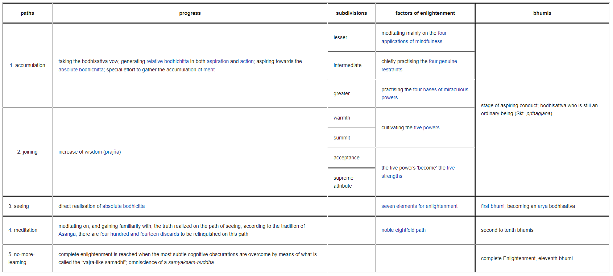
HS.21 (The Heart Sutra)

Slide 24
HS.22 (The Heart Sutra)
Kukai*
Sravakayana
pratyekabuddhayana
Mahayana
Mantra and Mandala
Ultimate realization
Dalai Lama
Path of accumulation
Path of preparation/joining
Path of seeing (1st Bhumi)
Path of meditation (2nd - 10th Bhumi)
Buddhahood ("no more learning")
1st gate
2nd gate
Paragate
Parasamgate
Bodhi Svaha
*from: "An Annotated Translation of Kukai's 'Secret Key to the Heart Sutra'" by Thomas Eijo Dreitlein

Slide 25
HS.23 (The Heart Sutra)
https://kwanumzen.org/teaching-library/1977/09/14/low-class-practice
Dear Soen Sa Nim,
How are you? I hope you are well, even though you are working so hard. Everyone at the Cambridge Zen Center says hello to you and to our West Coast family.
I must tell you something. This summer, I came to believe in Buddhism 100%, so I am very happy. Before, there was a lot of fighting in my mind about whether or not to practice. But this summer, a lot of bad karma disappeared. This fighting stopped, so practicing became possible. Also, I was able to quit smoking -- something I thought I'd never be able to do in a million years. How did this happen?
Do you remember two years ago when a lot of bad karma appeared in my mind, and I moved out of the Zen Center and stopped practicing? Then you gave me the mantra: "Gate, gate, paragate, parasamgate, bodhi svaha." Within three months I was back at the Zen Center, practicing. Then you said, "O.K., your mind is stronger, so now you must breathe in, 'Clear mind' and breathe out, 'Don't know."' I did this practice for a while,, even though I did not like it. But, at the beginning of the summer, my old bad karma again appeared -- "I hate Zen; I don't want to practice." So I started doing the mantra again. And again, this bad karma disappeared.
Now, I don't understand mantras. All I know is that when I begin to lose my direction, this mantra sets me straight again. Is it O.K. to do it all the time even when my mind is strong? Some people say that using a mantra is a very lowclass practice. Is this true? Please tell me about using a mantra.
Thank you for teaching me about Buddhism.
Love,
Dyan
An exchange of letters (from 1977) between Zen Master Seung Sahn and a student discussing the Heart Sutra Mantra.

Slide 26
HS.24 (The Heart Sutra)
Dear Dyan,
Thank you for your letter. How are you? The West Coast family says hello to you and the Cambridge Zen Center family.
You say that you believe in Buddhism 100%. 1 am glad to hear that! Congratulations on your practice becoming very strong. You also said that you stopped smoking; that is wonderful.
In your letter, you wrote about mantra and don't-know mind. Some people say that using a mantra is low-class. That is wrong. It is their thinking that is low class. The Compass of Zen* says, "Without thinking, sutra practice, mantra practice, yom bul (repeating the Buddha's name) practice, and Zen practice are all the same, but if you are attached to thinking and attached to words, all practices are different." When we eat, some people use chopsticks, some use forks, some use spoons, some use fingers. What you use is not important -- did you get a full stomach? Whether you use a mantra or kong-ans is not important. What matters is how you keep just-now mind moment to moment. If you understand this, you can always keep enough mind. This means that you already have freedom from life and death, and you understand the True Way and how to help other people. That is the Great Vow, not only in this lifetime but for numberless lifetimes to come to save other people.
You already have the mantra "Gate, gate, paragate, parasamgate, bodhi svaha."' You have very good karma with this mantra, so use this good karma for all beings. Don't check your mind; don't check your feelings; don't check other people's minds. Only go straight -- don't know with your mantra -- then, no problem.

Slide 27
HS.25 (The Heart Sutra)
Many people want to climb to the top of a mountain. One person begins to climb from the south side of the mountain; someone else begins from the north side, another from the west side, and another from the east side. They only go straight and arrive at the top, but the person on the south side thinks the direction of the person on the north side is wrong. Each thinks the others' direction is wrong. Don't check another's direction; this is no good. All arrive at the top, at the same point; that is most important.
There is one important point about mantra practice you must understand. With mantra, getting one mind and samadhi are very easy. But you cannot find your True Way if you are attached to mantra. Only mantra has no direction. However, "Who is doing the mantra?" means having a direction. Having a direction means keeping a question and letting your cognition become clear so you can perceive your correct situation. This is Great Love, Great Compassion, and the Great Bodhisattva Way. So only mantra is one mind, but if you keep the great question and mantra, that is clear mind.
Only-go-straight don't-know mind is clear like space. There is no subject, no object, no inside, no outside. When you are doing something, you must do it. If you are not thinking, that is correct mantra and correct don't-know mind. What does the cat say? What does the dog say? You already understand.
I hope you only go straight -- don't-know with your mantra, soon become a great Bodhisattva, finish the Great Work of life and death, get Enlightenment, and save all people from suffering.
Yours in the Dharma,
S. S.

Slide 28
HS.26 (The Heart Sutra)
Nice, fast recording of Sino-Japanese Heart Sutra chanted by nuns:
https://www.mindisbuddha.org/class-uploads/heart-sutra-fast-nuns-click-sticks.mp3
Maka Han nya Hara mita Shingyo title
Kan ji zai bo satsu. Gyo jin han nya 1
ha ra mi ta ji. Sho ken go on kai ku. 2
Do is-sai ku yaku. 3
Sha ri shi. Shiki fu i ku. 4
Ku fu i shiki. Shiki soku ze ku. 5
Ku soku ze shiki. 6
Ju so gyo shiki. Yaku bu nyo ze. 7
Shari shi. Ze sho ho ku so. 8
Fu sho fu metsu. Fu ku fu jo. 9
Fu zo fu gen. Ze ko ku chu. Mu shiki 10
mu ju so gyo shiki. Mu gen ni bi ze-shin ni. 11
Mu shiki sho ko mi soku ho. 12
Mu gen kai nai shi mu i shiki kai. 13
Mu mu myo yaku mu mu myo jin. 14
Nai shi mu ro shi. Yaku mu ro shi jin. 15
Mu ku shu metsu do. Mu chi yaku mu toku. I 16
mu sho toku ko. Bodai sat-ta. E 17
han nya ha ra mi ta ko. Shin mu kei ge 18
mu ke ge ko. Mu u ku fu. 19
On ri is-sai ten do mu so. Ku gyo ne han. 20
San ze sho butsu. E han nya 21
ha ra mi ta ko. Toku a noku ta ra 22
san myaku san bo dai. Ko chi han nya 23
ha ra mi ta. Ze dai jin shu. 24
Ze dai myo shu. Ze mu jo shu. 25
Ze mu to do shu. No jo is-sai ku. 26
Shin jitsu fu ko. Ko setsu han nya hara mi ta 27
shu. Soku setsu shu watsu. 28
Gya tei gya tei hara gya tei. mantra
Hara so gya tei bo ji so wa ka.
Han-nya shin gyo.

Slide 29
HS.27 (The Heart Sutra)
The Heart Sutra as a Mantra Delivery System
Shariputra, form does not
differ from emptiness,
emptiness does not differ from form.
That which is form is emptiness,
that which is emptiness form.
The same is true of feelings,
perceptions, impulses, consciousness.
Shariputra, all dharmas are marked with emptiness;
they do not appear or disappear,
are not tainted or pure,
do not increase or decrease.
Therefore, in emptiness
no form, no feelings,
perceptions, impulses, consciousness.
No eyes, no ears, no nose, no tongue, no body, no mind;
no color, no sound, no smell,
no taste, no touch,
no object of mind;
no realm of eyes
and so forth until no realm of mind consciousness.
No ignorance and
also no extinction of it,
and so forth until no old age and death
and also no extinction of them.
No suffering, no origination,
no stopping, no path, no cognition,
also no attainment
with nothing to attain.

