Slide 1
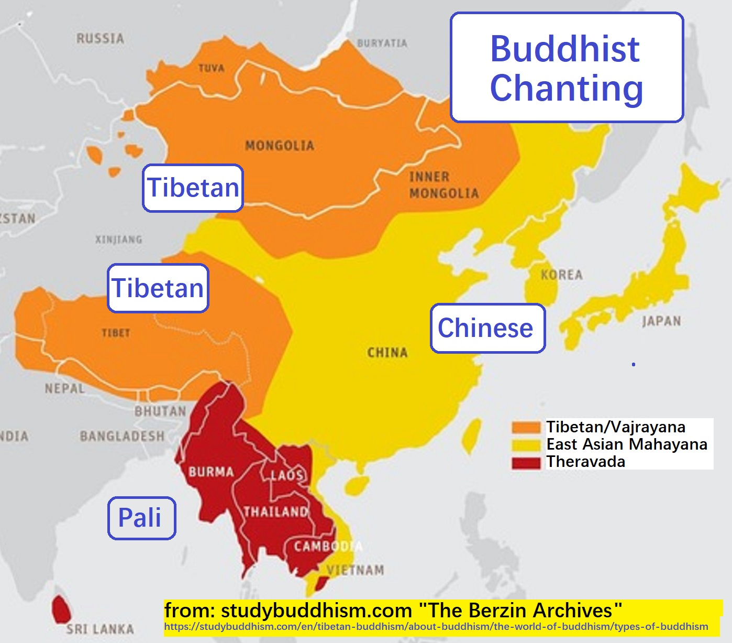
0.0 (Buddhist Chanting, Preview)
• If you visit a Buddhist temple anywhere in Asia, you will hear the sound of chanting.
• In South Asia you will hear chanting in Pali.
• In Central Asia you will hear chanting in Tibetan.
• In East Asia you will hear chanting in Chinese.
• In Korea, Buddhist chanting has historically been done in "Sino-Korean". This is just the Korean pronunciation of Chinese characters.

Slide 2
0.1 (Buddhist Chanting, Preview)
Many different ways of writing/pronouncing the same characters:
摩訶般若波羅蜜多心經
mó hē bō rě bō luó mì duō xīn jīng Pinyin (Mandarin)
ma ha bát nhã ba la mật đa tâm kinh Quốc Ngữ (Vietnamese)
まかはんにゃはらみったしんぎょう Hiragana (Japanese)
ma ka han nya ha ra mi ta shin gyō Romaji (Japanese)
마 하 반 야 바 라 밀 다 심 경 Hangul (Korean)
ma ha ban ya ba ra mil ta shim gyong Romaja (Korean)

Slide 3
0.2 (Buddhist Chanting, Preview)
One night in the year 706, two friends (Nohil Puduk and Taltal Pakpak) both had the same dream. A golden arm appeared in the sky and touched them on the forehead. When they shared their dreams the next day they were amazed and resolved to devote the rest of their lives to spiritual practice. In Mudung Valley on Paegwol Sahn (White Moon Mountain) they built two simple huts. Puduk devoted himself to chanting to Maitreya (Miruk Jonbul), and Pakpak chanted to Amitabha (Namu Amita Bul).
After three years of this, one night Kwanseum Bosal appeared to them both. She caused Puduk to be transformed into Maitreya, and She caused Pakpak to be transformed into Amitabha. News of this miracle spread and people from the surrounding areas gathered and were able to hear the Dharma being taught by both Maitreya and Amitabha! Eventually the two friends miraculously rose up into the clouds, still teaching the Dharma as they disappeared into the heavens.
The King of Silla, Kyongdok (r. 742-765) sponsored the building of a temple on the site of this miraculous event.
"By saying that these two commoners attained Buddhahood in this very body, the author of this tale, obviously influenced by the doctrine that all beings inherently possess buddha-nature, asserts that single-minded devotion to a Buddhist deity is a viable and efficacious path of practice that not only causes the aspirant to acquire merit but enables him to access his full spiritual potential."
[Richard McBride II, "Domesticating the Dharma: Buddhist Cults and the Hwaom Synthesis in Silla Korea"]

Slide 4
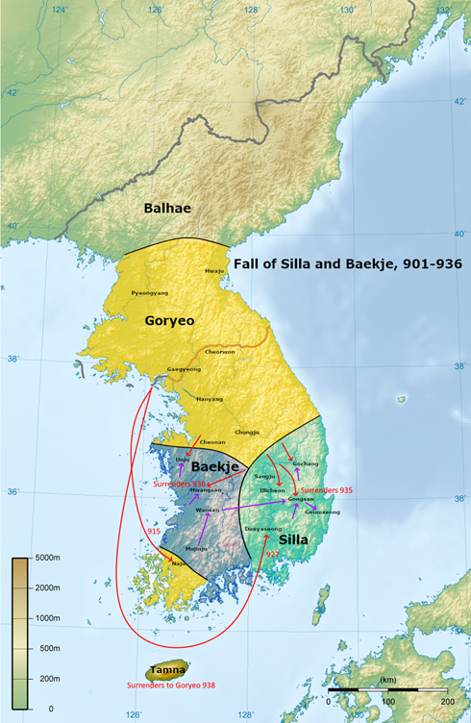

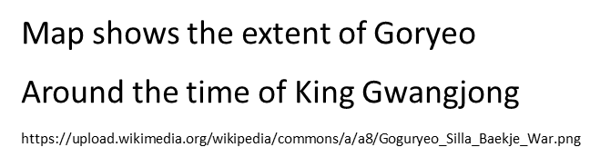
0.3 (Buddhist Chanting, Preview)
Zen Master Yungming Yanshou (永明延壽 904-976) recited the Great Dharani six times a day, as recorded in the "Record of Self-cultivation of Chan Mater Yungming".
Yungming was very popular and influential and was even acclaimed as an incarnation of Maitreya. He was based in southern China at a time when Buddhism flourished there while being persecuted in the north. Gwangjong, the King of Goryeo (reigned 949-975) was so impressed with Yungming's teachings that the he had 36 monks sent from Goryeo to study under Yungming, each one of whom is reported to have received Dharma transmission from Yungming and then returned to Goryeo.
Zen Master Chinul (1158-1210) was greatly influenced by Yungming, and quotes from him as an authority on "the one approach that surpasses all precedents":
"Samādhi is the essence of one’s own mind. Prajñā is the function of one’s own mind. Since samādhi is in fact prajñā, the essence is not separate from the function." [Chinul here quotes Yungming's Zongjing lu 宗鏡錄 "Record of the Source Mirror". Taken from Chinul's "Excerpts from the 'Dharma Collection and Special Practice Record' with Inserted Personal Notes".]

Slide 5
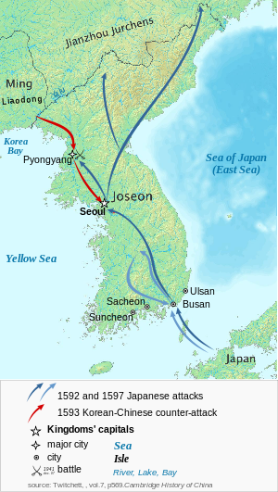
0.4 (Buddhist Chanting, Preview)
Zen Master Sosan Taesa (aka Hyujeong, 1520-1604) was greatly influenced by both Chinul and Yungming. Sosan Taesa promoted chanting and mantra recitation practice, and defended them against the criticism of dogmatic purists who insisted, specifically with respect to chanting "namu amita bul" in order to be reborn in Amitabha's Western Pure Land, that "Your own mind is the Pure Land, so you cannot be born in the Pure Land; your own nature is Amitābha, so Amitābha cannot appear in front of you." To which Sosan Taesa replied:
"These words seem to be correct and yet are wrong.
"Buddha has no craving or anger, so do I also have no craving or anger?
"Buddha transforms hell into lotus flower (realms) as easily as turning over his hands, yet I always fear falling into hell because of the power of karma, so how can there be this transformation into a lotus flower (realm)?
"Buddha contemplates the endless worlds as if they were in front of his eyes, but I still do not even know matters beyond the intervening wall, so how can I see the worlds of all directions as if they are in front of my eyes?
"Therefore, even though everybody’s nature is Buddha, since in practice we are sentient beings, if we refer to our attributes and functions, we are as far different as heaven and earth."

Slide 6

0.5 (Buddhist Chanting, Preview)
Sosan Taesa also emphasized the power of mantra practice:
"As to the use of mantras: It may be relatively easy to control karma made in the present life, so you can correct it through your own effort. However, the karma accumulated over many previous lives is very difficult to erase. For this work you must rely on the mystic power of repeating a mantra."
"At present some people of the world wish to be correct and yet are perverse, wish to be clean and yet are stained, prosper in virtue and yet are poor in blessings, do good deeds and yet have personal tragedies, are very much without evil and yet have misfortunes, do not kill and yet die young. All of these [misfortunes are due to] past karma. The Lengyan Jing says, 'For those who intone the divine mantras, their five heinous and serious sins are like wind-blown sand, and [in the] next [life] they are certain to become a buddha.'" [Mirror of Zen, by Sosan Taesa (Lengyan Jing = Surangama Sutra)]
滅定業陀羅尼: 唵 缽囉 末鄰 陀寧 娑婆訶
Jijang Bosal's Dharani for Eliminating Fixed Karma

Slide 7
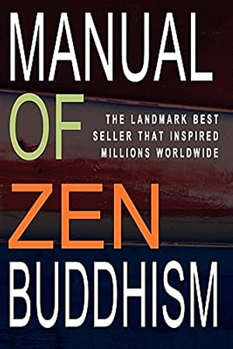
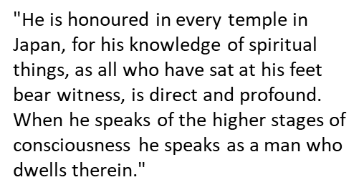
0.6 (Buddhist Chanting, Preview)
When Zen Master Seung Sahn arrived in the United States in 1972, many Westerners already had some pretty set ideas about what Zen is and is not. In particular there was a strong tendency to believe that "just sitting" is the only "true" Zen practice. From this perspective, the idea that chanting is a legitimate practice is viewed with puzzlement, suspicion, and often with open hostility. Such an attitude is well expressed in a quote by D.T. Suzuki in his book "Manual of Zen Buddhism", first published in 1934:
"Properly speaking, the dharani has no legitimate place in Zen."
Master Seung Sahn, of course, had his first great awakening experience while chanting the "Great Dharani", which is actually one of the three Dharanis' that D.T. Suzuki included in his book, along with the above disclaimer!
Master Seung Sahn emphasized chanting in a way that made many Western Zen students decidedly uncomfortable. This discomfort was not just due to the anti-chanting imprecations of Suzuki and other "just sitting" dogmatists. In 1972 and to this day, many people who are attracted to the Buddha Dharma are looking for something that doesn't look or feel "religious". Few things look or feel more religious than chanting "Homage the Three Jewels", especially with all the bowing!
ff
滅業障眞言: 唵 阿嚕 勒繼 娑婆訶
Kwanseum Bosal's Mantra for Eliminating Fixed Karma

Slide 8
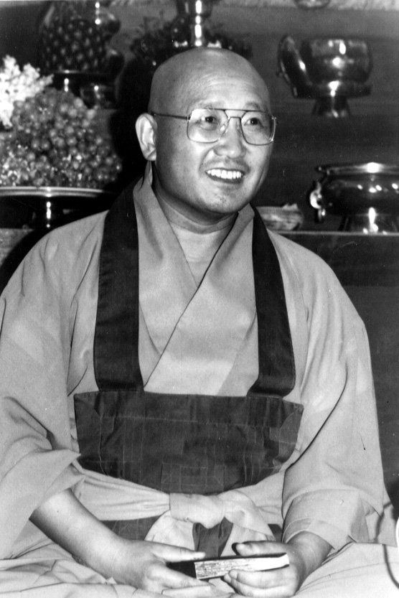
0.7 (Buddhist Chanting, Preview)
But he persisted.
It should be emphasized, however, that the promotion of chanting practice was not some special idiosyncrasy of Zen Master Seung Sahn's. Nor is it some unique feature of Korean Buddhism.
The Buddha taught his students to chant (the Metta Sutta, the Ratana Sutta, etc).
Chanting is a universal activity in all Buddhist temples around the world (including "Zen" temples).
Zen Master Yungming chanted the Great Dharani six times a day over a thousand years ago in China.
Zen Master Hakuin was an enthusiastic advocate of chanting, especially the "Extend Life Ten Phrase Kannon Sutra", aka "Kanzeon chanting".
And even D.T. Suzuki was forced to concede that any complete description of Zen practice, as it is really practiced and not just as D.T. Suzuki supposed it should be practiced, must include a discussion of Dharanis!

Slide 9
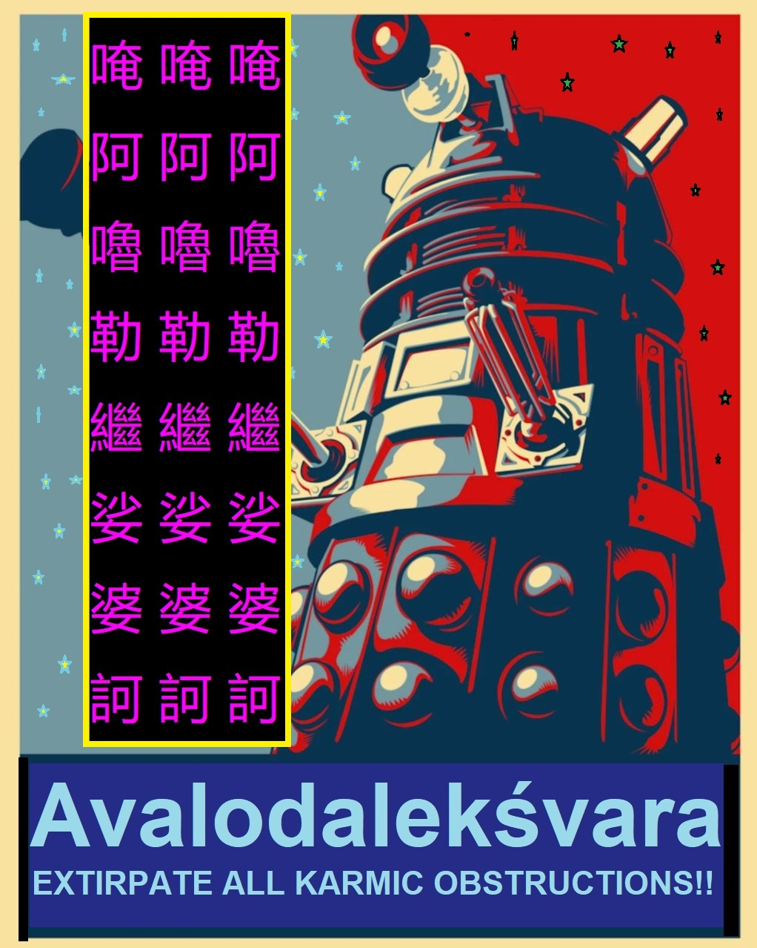
0.8 (Buddhist Chanting, Preview)
Syllabus at a glance:
1. March, April:
Jijang Bosal Chanting
2. May, June:
Ye Bul / Homage to the Three Jewels
3. July, August:
Xuanzang's Heart Sutra
4. September, October:
Extend Life Ten Phrase Kannon Sutra (Kanzeon chanting)
5. November, December:
Great Dhāraṇī of Spiritually Sublime Phrases
6. January (2024), February:
Kwanseum Bosal Chanting

Slide 10
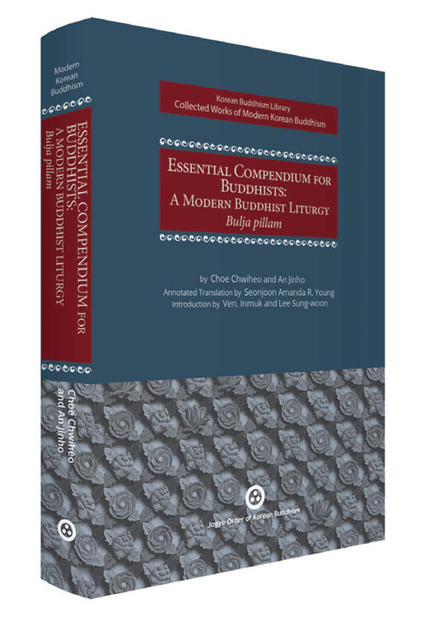
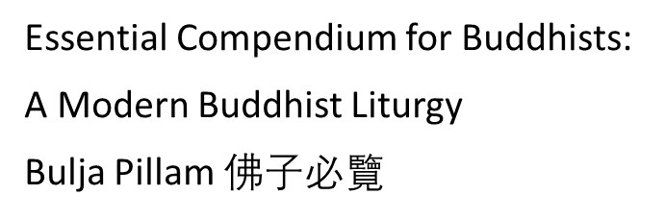
0.9 (Buddhist Chanting, Preview)
We will learn the chants (or perhaps learn more about them!)
How to "do" (chant) the chants.
Also what they "mean".
(Not in any esoteric sense, but what do the words mean.)
History and background of the chants.
History and background of Buddhist chanting.
Same for Chinese chanting, and Korean chanting.
Some chanting terminology. What does "Yeom Bul" mean??
What is a mantra? What is a dharani? Are they different?
What does "Ki Do" mean? (It might not be what you think.)
What is "Sino-Korean"? (What is Hangul? What is Romaja?)
Chanting as a personal practice (that you can do on your own).
Why is a "Japanese" chant (Kanzeon) included???

Slide 11
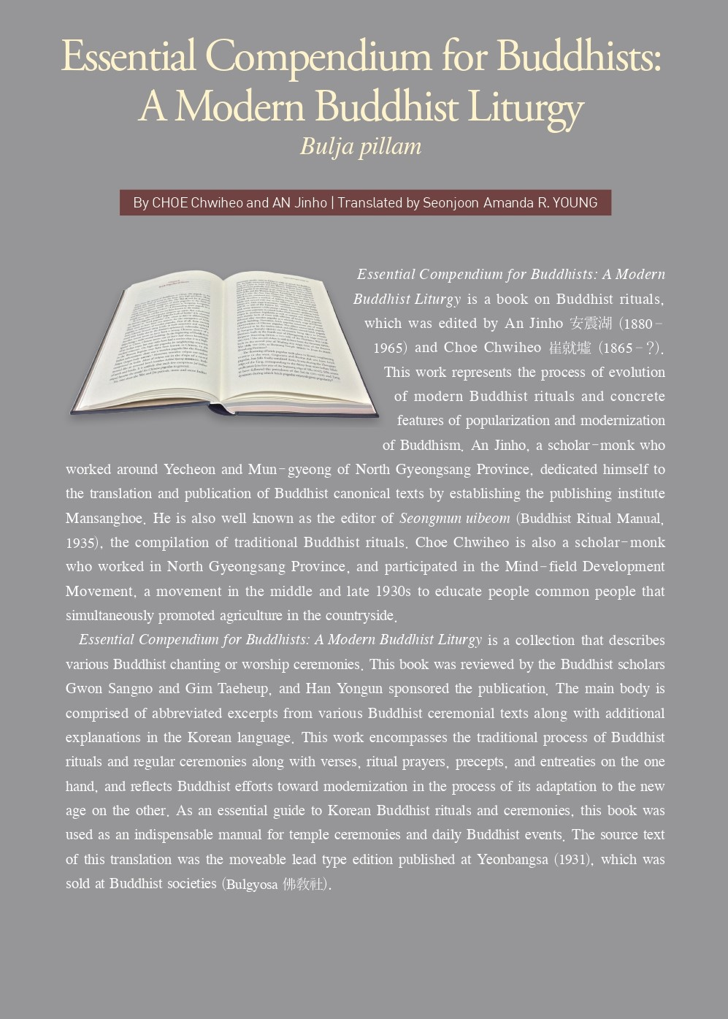
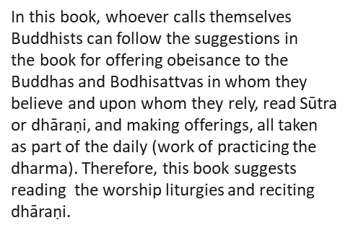
0.10 (Buddhist Chanting, Preview)
Some valuable resources for learning more about Buddhist chanting practice:
Dhāraṇī and Mantra in Contemporary Korean Buddhism: A Textual Ethnography of Spell Materials for Popular Consumption, Richard D. McBride II, Journal of the International Association of Buddhist Studies Volume 42 • 2019 • 361–403 (available through academia.edu)
Must Read Texts for Buddhists and the Modernization of Korean Buddhist Ritual, Richard D. McBride, 2019, Journal of Korean Religions (available through academia.edu)
Enchanting Monks and Efficacious Spells - Rhetoric and the Role of Dharani in Medieval Chinese Buddhism, Richard D. McBride II (available through academia.edu)
Everyday Temple Chant in South Korean Chogye Sect Buddhism: An Analytical Study of the Personal Styles Cultivated by Monks, Simon Mills and Sung-Hee Park, Analytical Approaches to World Music Journal, 10 (1). pp. 1-68
Direct link to download pdf: http://dro.dur.ac.uk/36137/1/36137.pdf?DDD23+dmu0sm+vbdv77
Essential Compendium for Buddhists: A Modern Buddhist Liturgy, Bulja Pillam, 佛子必覽, Choe Chwiheo and An Jinho, Annotated Translation by Seonjoon Amanda R. Young
http://www.koreanbuddhism.net/bbs/board.php?bo_table=5040&wr_id=43

Slide 12
0.11 (Buddhist Chanting, Preview)
Chanting, mantras, dharanis, and Yeom Bul (aka nianfo/nembutsu) are often mistakenly associated only with particular sects or schools of Buddhism. Worse, it is often thought that those things, as D.T. Suzuki said, have "no legitimate place in Zen."
Sometimes it is thought that anything to do with mantras is necessarily associated with "Esoteric" or "Tantric" Buddhism somehow. But actually mantra practice is ubiquitous in Mahayana Buddhism, and also in Therevada Buddhism as well (where it is called Paritta chanting).
Sometimes it is thought that Yeom Bul practice (repeating the name of a Buddha or Bodhisattva) is exclusively a "Pure Land" practice. But "Yeom Bul" literally means "Mindfulness of Buddha", and was a practice taught by the Buddha himself. One of the most fundamental texts of Theravada Buddhism, Buddhaghosa's "The Path of Purification", has a chapter on "Mindfulness of Buddha" practice.
In Korean Buddhism, Yeom Bul is sometimes used to very specifically refer to the practice of reciting "Namu Amita Bul". Other times it is used for any practice of reciting the name of any Buddha or Bodhisattva: "Kwanseum Bosal", "Jijang Bosal", "Sogamuni Bul", "Mireuk Jonnul", etc. It can even refer to reciting the names of the traditional Gods worshipped by Koreans prior to the arrival of Buddhism, including the Mountain God (Sahn Shin) and the Seven Stars (Chil Son). But Yeom Bul is also used to refer more broadly to chanting practice in general. The Jogye order maintains a "Chanting Committee" that disseminates mp3 recordings of Buddhist chants, trains Chanting teachers and arranges for them to travel around the country to provide on-site training, etc. This board is called the Yeombul Wiweon.

Slide 13
0.12 (Buddhist Chanting, Preview)
The class will have a practical focus. The intention is to encourage and support the practice of chanting.
We will meet twice a month, and spend two months on each chant. So we will have four class meetings for each chant.
Every month there will be at least 30 minutes of class time devoted to discussion. You have to register for the class in order to participate in the discussion live (via zoom). Registration is through Patreon ($2 a month): https://www.patreon.com/mindisbuddha
The emphasis will not be on learning the Chinese characters, but for each syllable of each chant we will look at the Chinese character for that syllable, how it is pronounced in Sino-Korean, and what it means. For your reference the class materials will also include the Hangul (Korean script) and the Pinyin (Mandarin pronunciation) for each character. This is very helpful if you want to do your own "research" (googling)!
For example, the first chant we'll look at is the Jijang Bosal chant. The first line is:
namu nam bang hwa ju jijang bosal 南無 南邦 化主 地蔵 菩薩
Which literally means: bow to (namu) southern direction (nam bang) transformation lord (hwa ju) Jijang Bosal

Slide 14
0.13 (Buddhist Chanting, Preview)
Why is Jijang Bosal associated with "the southern direction". And why is he called the "Lord of Transformation"?
It's good to know what it is that we are chanting, and to have a general idea of what it means.
Zen Master Seung Sahn taught that if your mind is very clear then even chanting "Coca Cola" is good practice.
But what if your mind is not very clear? Then maybe "Coca Cola" is not the best chanting practice. (Zen Master Seung Sahn only used "Coca Cola" as a provocative example – he never actually taught "Coca Cola Chanting"!)
For those of us who have minds that are very unclear, it is good to do chanting that either comes directly from the Sutras, or is a poetic ("chantable") expression of Buddhist teaching that comes from a tradition that we feel a strong personal connection with.
In the process of learning the meaning of the chants we will be learning about some very basic and important Buddhist teachings and concepts.
For example, in Buddhist cosmology the "Southern Continent" of "Jambudvipa" is where we live. It is also the world in which Shakyamuni Buddha was born as Siddhartha. "Jambudvipa" is named for the "Jambu" tree (sometimes called "Rose-Apple"), which is the tree under which Siddhartha first discovered the simple, spontaneous form of meditation that he would come to later call the "Middle Way".
One traditional belief about Jijang Bosal is that he, in particular, has been entrusted with taking care of the beings of Jambudvipa (us) in between the Parinirvana of Shakyamuni and future arrival of Maitreya.

Slide 15
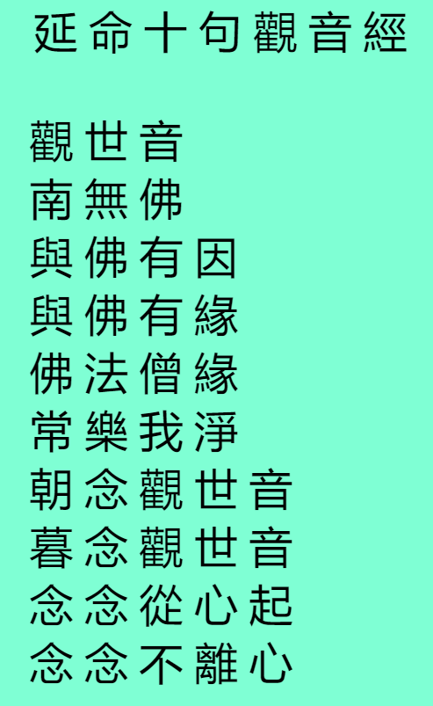
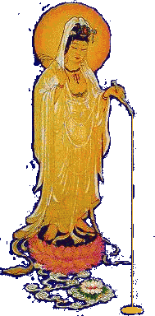

0.14 (Buddhist Chanting, Preview)
Knowing more about one's own tradition can help one to better appreciate other traditions. In fact, it can help you to see that "other" traditions are really not so "other".
For example, once you learn that the "Korean" Heart Sutra is really just the Korean way of pronouncing the characters in Xuanzang's Heart Sutra, then it is just one more step to realizing that Japanese Buddhists are chanting the exact same thing when they chant the Heart Sutra "in Japanese".
Another example is the "Kanzeon chant", which was originally in Chinese but is today usually associated with Japanese Buddhism. The story of the chant goes back many centuries in China. Originally it was taught as a very condensed version of the 25th Chapter of the Lotus Sutra – so that chanting "Kanzeon" was believed to be equivalent to chanting that entire chapter.
Many years ago my teacher, Zen Master Dae Gak, decided to add the Kanzeon chant to the repertoire of chants he taught his students. But he isn't the only non-Japanese Zen Master to do this. The Chinese Zen Master Sheng Yen also started to teach his students to do this chant many years ago, after he heard it while visiting Buddhist temples in Japan.

Slide 16

0.15 (Buddhist Chanting, Preview)
Zen Master Seung Sahn taught his students many different mantras, many of which are part of the chants that he taught.
These mantras were originally in Sanskrit, and then they were "transliterated" into Chinese. Each Sanskrit syllable was replaced with a Chinese character on the basis of the sound (not the meaning) of the character.
One nice example is the "Dharani Spoken by the Buddha to Dispel Calamities and Bring Good Fortune", aka "Bul Sol So Jae Gil Sang Dharani", 佛說消災吉祥 陀羅尼.
This Dharani is part of the Jijang Bosal and Kwanseum Bosal chants, which will be covered at the beginning and end of the 12 month class series. It is also chanted at Japanese Buddhist temples. In fact, it is one of the Dharanis that D.T. Suzuki felt compelled, reluctantly, to include in his 1934 book on Zen practice!
This Dharani is extremely popular throughout East Asia. One can find youtube videos of it being chanted by Buddhists in Vietnam, China, Korea, and Japan. They are all chanting more or less the same thing – just pronouncing the Chinese characters differently. There is even a version of this Dharani in Tibetan, and it is remarkably similar to the one Zen Master Seung Sahn taught to his students in the West.
佛說消災吉祥 陀羅尼: 曩謨三滿哆。母馱喃。
阿缽囉底。賀多舍娑曩喃。怛侄他。
唵。佉佉。
佉呬。佉呬。吽吽。
入嚩囉。 入嚩囉。
缽囉入嚩囉。
缽囉入嚩囉。
底瑟姹。底瑟姹。
瑟緻哩。瑟緻哩。
娑癹吒。娑癹吒。
扇底迦。室哩曳。
娑婆訶。

Slide 17
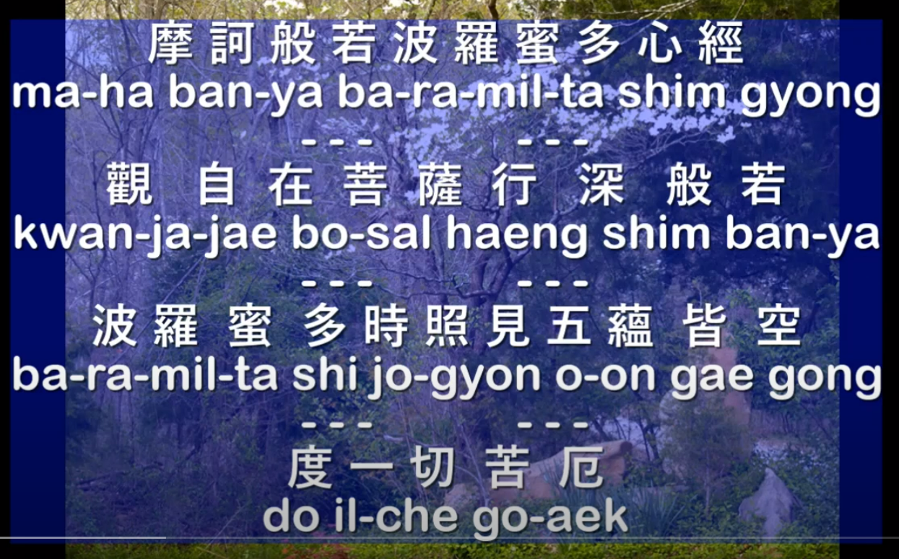
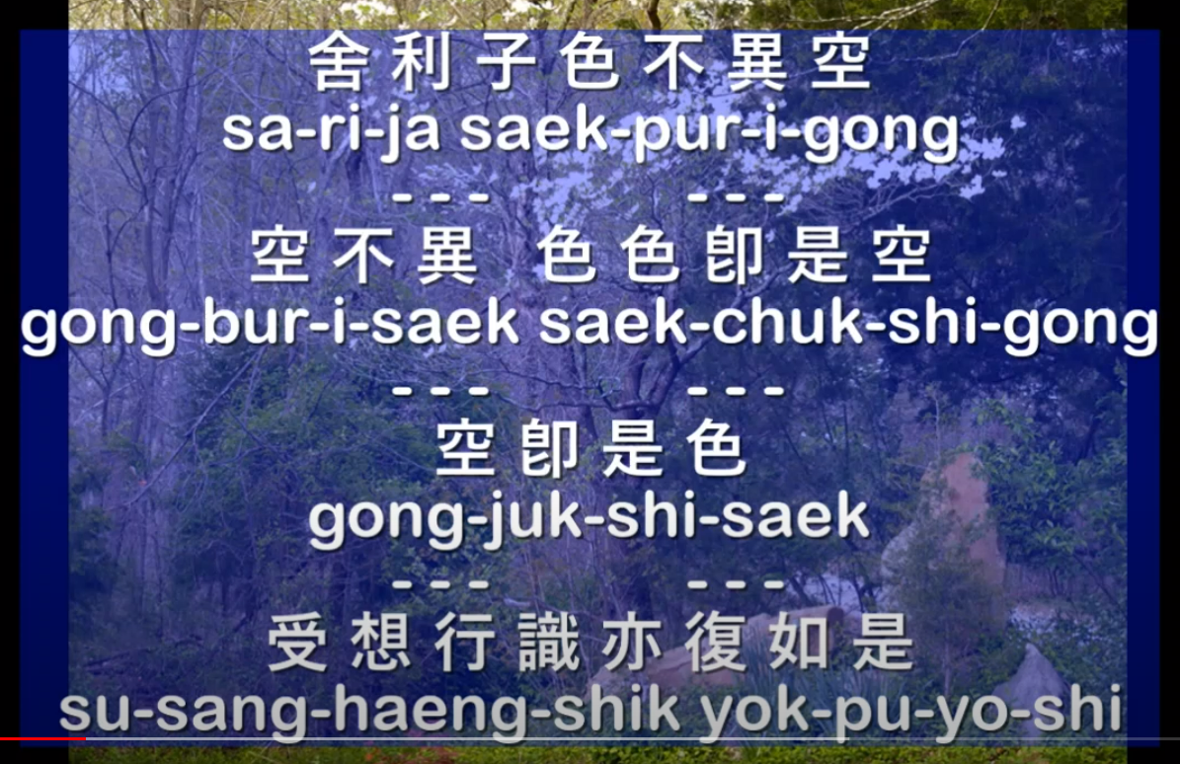
0.15 (Buddhist Chanting, Preview)
Each class will begin and end with chanting. We will always chant the "Homage to the Three Jewels" at the beginning of each class. Then at the end we will chant whichever chant we are currently studying followed by reciting the Four Great Vows in Sino Korean.
The sole purpose of this class is to encourage and support the practice of chanting. Everyone is encouraged to develop a daily practice of chanting.
Videos of all the chants are available for free on youtube. These videos show the chants spelled out in "Romaja", where the letters of the English alphabet are used to represent the sounds. So no knowledge of Chinese or Korean is necessary!
bal sa hong so won 發 四 弘 誓 願
Making the Four Great Vows:
jung saeng mu byon so won do 衆 生 無 邊 誓 願 度
Sentient beings without number we vow to save.
bon ne mu jin so won dan 煩 惱 無 盡 誓 願 斷
Kleshas without end we vow to cut.
bom mun mu ryang so won hak 法 門 無 量 誓 願 學
Dharma gates without limit I vow to learn.
bul to mu sang so won song 佛 道 無 上 誓 願 成
Buddha Way without superior I vow to attain.

